Slide 1
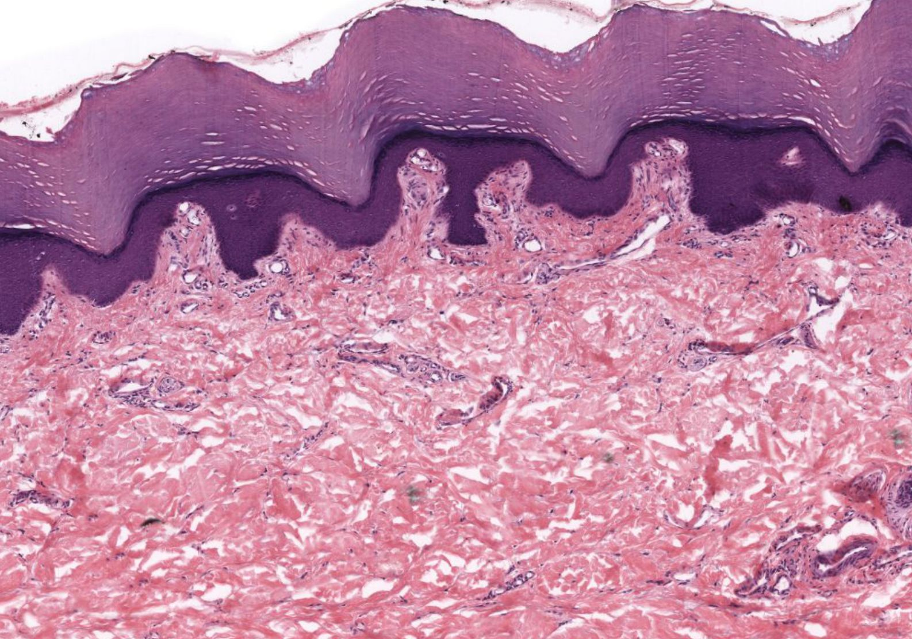
Skin
Kristine Krafts, M.D.

Slide 2
Skin Lecture Objectives
Describe the functions of skin.
Describe the five layers of the epidermis.
Describe the structure, location and function of the following cell types found in the epidermis: keratinocytes, melanocytes, Langerhans cells, and Merkel cells.
Describe the structure and contents of the papillary dermis, reticular dermis, and hypodermis.

Slide 3
Skin Lecture Objectives
Describe the structure and function of sebaceous glands, eccrine sweat glands, and apocrine sweat glands.
Describe the structure of a hair follicle (including the hair itself) and explain how and why hair can become damaged.

Slide 4
Skin Lecture Outline
Introduction
Epidermis
Dermis

Slide 5
Skin Lecture Outline
Introduction

Slide 6
Functions of Skin
Serves as a barrier protecting against physical and chemical injury and infection.
Prevents water entry and loss.
Helps regulate body temperature.
Receptor organ for sensory stimuli.
Involved in synthesis of vitamin D₃ from precursors in skin.
Excretion of substances produced by glands.

Slide 7
Embryologic Origins of Skin
Epidermis (the surface layer of skin) arises from ectoderm.
Dermis (the layer of skin just under the epidermis) arises from somites of the paraxial mesoderm.

Slide 8
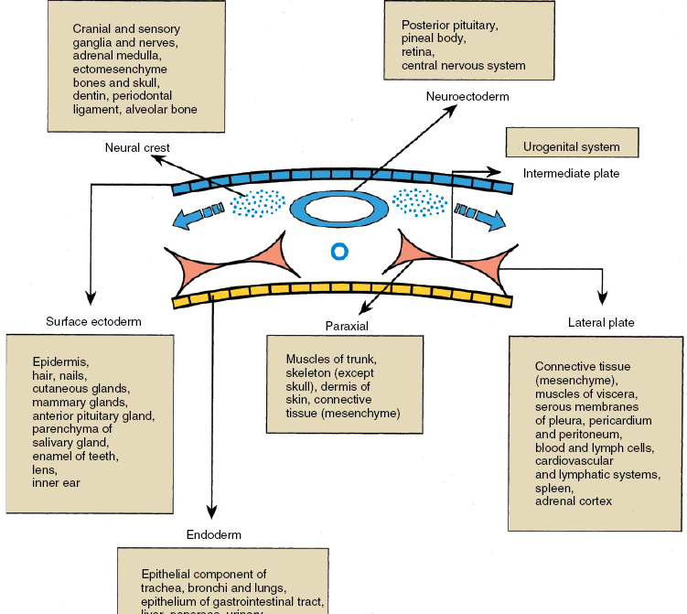
Central nervous system
Neuroectoderm
Bones of the head
Neural crest
Urogenital system
Intermediate plate mesoderm
Know this!
Surface ectoderm
Paraxial mesoderm
Lateral plate mesoderm
Epidermis
All the muscles of the body
Most of the bones of the body (except the bones of the head)
Dermis
Heart
Hematopoietic system
Endoderm
Lining of GI tract

Slide 9
Skin is composed of:
Epidermis: a surface of keratinized stratified squamous epithelium
Dermis: connective tissue
Skin appendages: Merocrine (eccrine) sweat glands, apocrine sweat glands, sebaceous glands, hair follicles, nails.

Slide 10
Epidermis
Skin
Dermis
Hypodermis
(Not technically part of the skin)

Slide 11
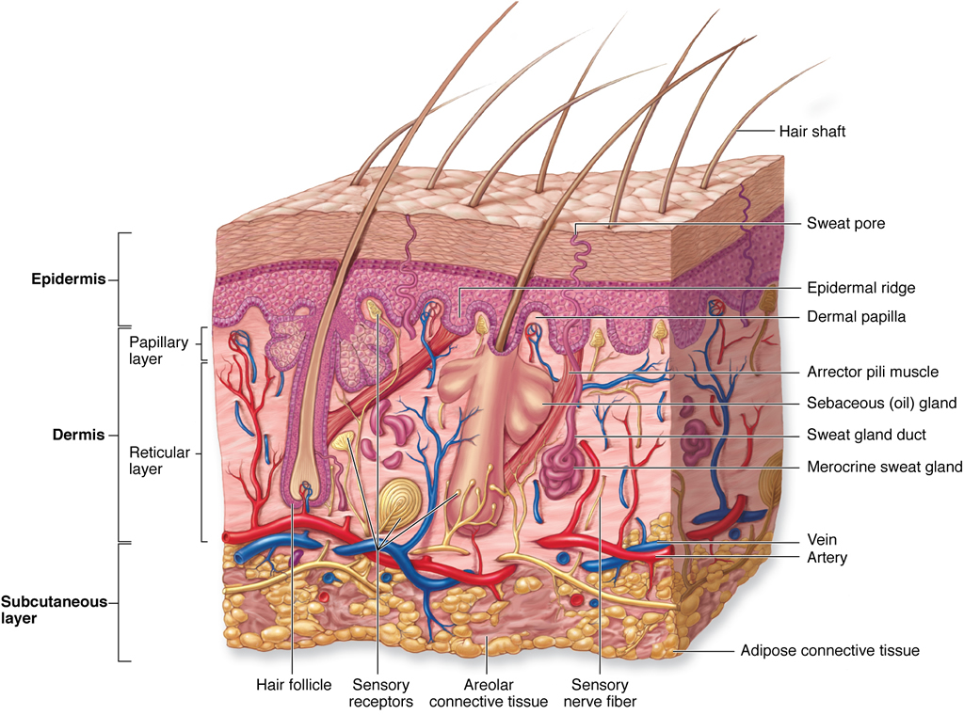
Skin and hypodermis
(Plus a bunch of other labeled items)
Hypodermis

Slide 12
Skin appendages
Hair shaft
Meissner corpuscle
Sebaceous gland
Arrector pili muscle
Hair follicle
Pacinian corpuscle

Slide 13
More skin appendages

Slide 14
Hypodermis
Also called subcutaneous tissue
NOT considered part of the skin!
Consists of loose connective tissue and adipose tissue
Function: loosely binds the skin to underlying structures

Slide 15
Skin Lecture Outline
Introduction
Epidermis
  Layers of the epidermis
  Cells of the epidermis

Slide 16
Skin Lecture Outline
Introduction
Epidermis
  Layers of the epidermis

Slide 17
The Five Layers of the Epidermis
Stratum corneum
Stratum lucidum
Stratum granulosum
Stratum spinosum
Stratum basale

Slide 18
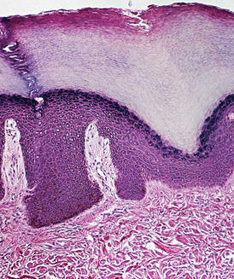
Five layers of epidermis
corneum
lucidum
granulosum
spinosum
basale

Slide 19
Stratum Corneum
Most superficial layer.
Consists of flat, dead cells – basically keratin scales - that are continuously shed.
Keratin is composed of cytokeratin filaments (long intertwined protein chains) and keratohyalin (a substance that helps hold cytokeratin filaments together).

Slide 20
Stratum corneum

Slide 21
Stratum Lucidum
Below stratum corneum.
Keratinocytes have lost nuclei and organelles and appear as homogeneous, translucent cells.
Cells contain keratin.
Present only in very thick skin.

Slide 22
Stratum lucidum

Slide 23
Stratum Granulosum
Below stratum lucidum (in thick skin) or stratum corneum (in thin skin).
Cells contain two types of granules.
Keratohyaline granules: large, basophilic;
bind cytokeratin molecules together to make keratin.
Lamellar granules: small; contain lipid that is released into intercellular spaces (acts as a cement to prevent penetration of water and other materials).

Slide 24
Stratum granulosum

Slide 25
Stratum Spinosum
Thick layer beneath stratum granulosum.
Consists almost entirely of keratinocytes (with occasional Langerhans cells).
Spot desmosomes connect cells.
Cells shrink during processing but remain attached at desmosomes, and look “spiny” or prickly.
Along with stratum basale, form “rete pegs” which dip down into the dermis.

Slide 26
Stratum spinosum
Rete pegs

Slide 27
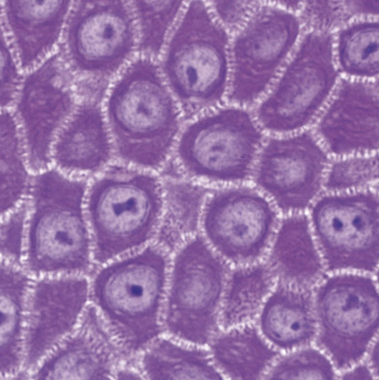
Keratinocytes in stratum spinosum are attached by spot desmosomes.
Cells retract during fixation and appear to be connected by spines.

Slide 28
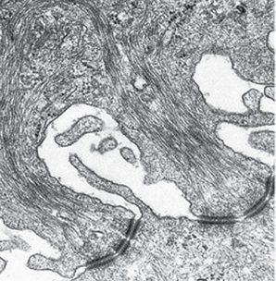
Artifactual
spaces
One cell
Cytokeratin
filaments
Spot desmosomes
Another cell
Stratum spinosum cells

Slide 29
Stratum Basale
Bottom layer; below stratum spinosum.
One layer thick. Consists mostly of keratinocytes.
Keratinocytes are attached to each other by spot desmosomes and to basal lamina by hemidesmosomes.
Also present are stem cells (which renew epidermis every 15-30 days), melanocytes and Merkel cells.

Slide 30
Stratum basale

Slide 31
Thick vs. Thin Skin
Thick skin is present on palms and soles
  Epidermis has five cell layers + thick keratin layer.
  Dermis does NOT contain hair follicles or sebaceous glands.
Thin skin is found everywhere else.
  Epidermis has four cell layers (no stratum lucidum), and the stratum corneum is much thinner.
  Dermis usually contains hair follicles and sebaceous glands.

Slide 32
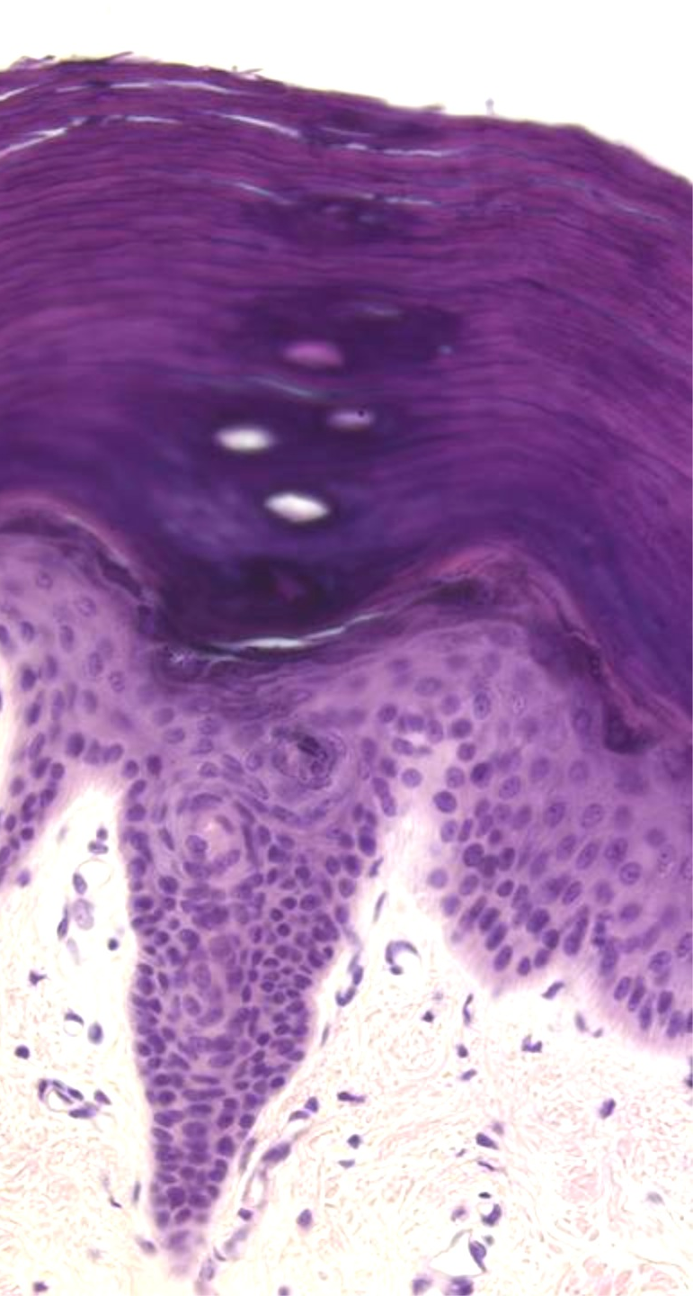
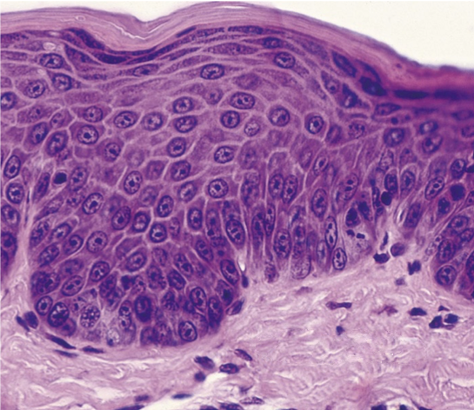
Thick skin
Thin skin
corneum
lucidum
granulosum
spinosum
basale

Slide 33
Skin Lecture Outline
Introduction
Epidermis
  Layers of the epidermis
  Cells of the epidermis

Slide 34
Five Types of Cells in Epidermis
Keratinocytes make up most of the epidermis. Most are stratified squamous epithelial cells (basal layer = cuboidal cells). Produce intermediate filaments called cytokeratins.
Langerhans cells (in stratum spinosum) process antigen.
Melanocytes (in stratum basale) produce melanin.
Merkel cells (in stratum basale) are involved in touch sensation.
Stem cells (in stratum basale) produce new keratinocytes.

Slide 35
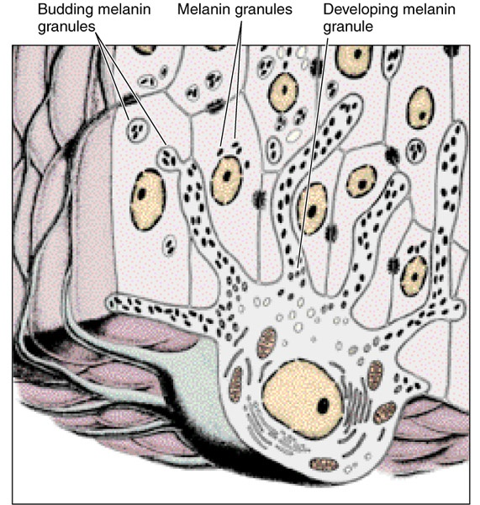
More about melanocytes
keratinocyte
melanocyte

Slide 36
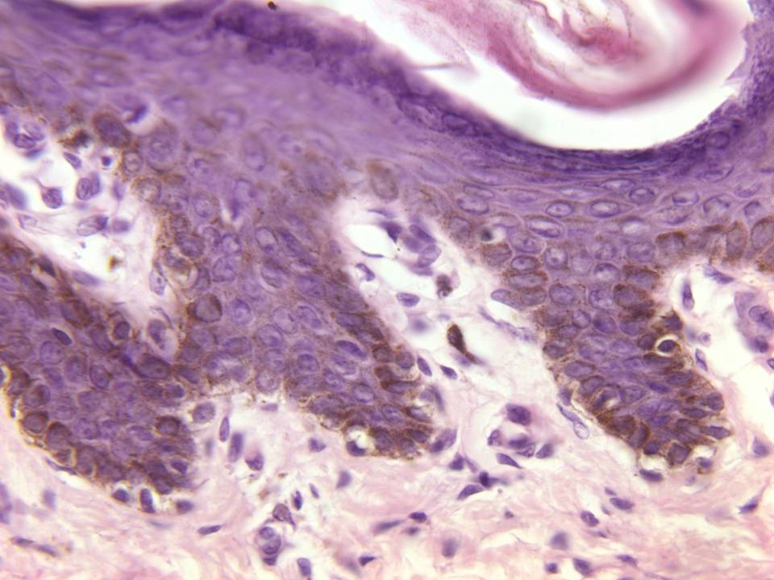
More melanin is present in keratinocytes
than in melanocytes!

Slide 37
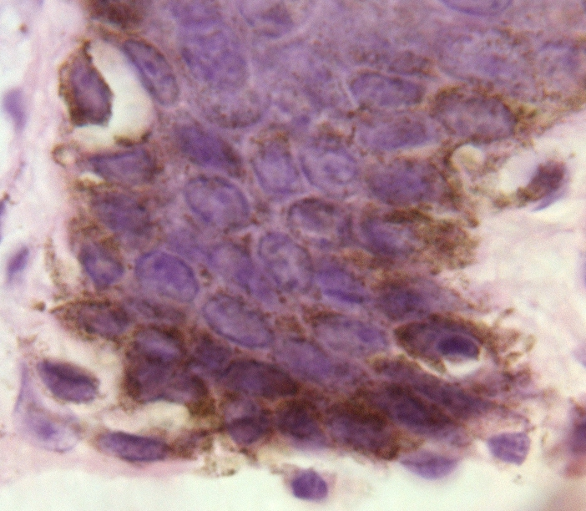
Melanin and skin color
The number of melanocytes per unit area varies from one part of the body to another but is independent of race.
Differences in skin color are due to differing numbers of melanin granules in melanocytes!

Slide 38
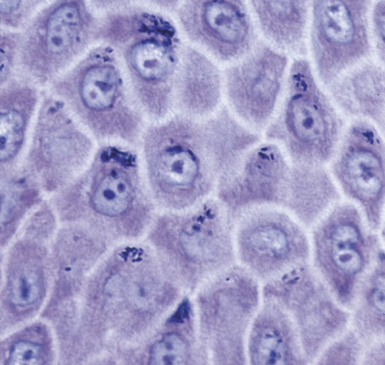
Melanin granules accumulate above keratinocyte nuclei to protect genetic material from UV damage. Smart!

Slide 39
Skin Lecture Outline
Introduction
Epidermis
Dermis
  Basic structure
  Specialized receptors and structures

Slide 40
Skin Lecture Outline
Introduction
Epidermis
Dermis
  Basic structure

Slide 41
Dermal papillae
Loose connective tissue with lots of capillary loops and thin elastic fibers
Papillary dermis
Reticular
dermis

Slide 42
Dermal papillae
Papillary dermis
Dense connective tissue with thick collagen bundles and elastic fibers, larger blood vessels and glands.
Reticular
dermis

Slide 43
Skin Lecture Outline
Introduction
Epidermis
Dermis
  Basic structure
  Specialized receptors and structures

Slide 44
Meissner’s and Pacinian Corpuscles
Meissner’s corpuscle
  Sensitive to light touch
  Consists of an unmyelinated axon meandering back and forth between flattened Schwann cells.
Pacinian corpuscle
  Sensitive to vibration and pressure.
  Consists of unmyelinated nerve terminal surrounded by layers of fibroblasts.

Slide 45
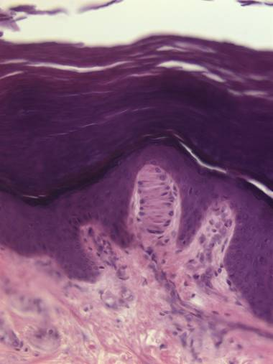
Meissner’s corpuscle: sensitive to light touch

Slide 46
Pacinian corpuscle: sensitive to vibration, pressure

Slide 47
The Pilosebaceous Apparatus
Hairs: hair follicle and shaft
Sebaceous glands and ducts: empty into hair follicle
Arrector pili muscles: cause erection of hair shaft
Hairs and sebaceous glands derive from ectoderm

Slide 48
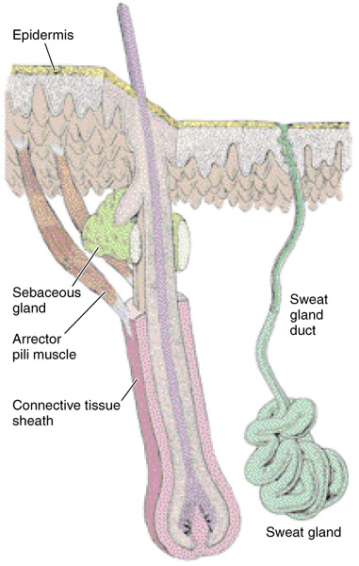
Pilosebaceous apparatus and sweat gland

Slide 49
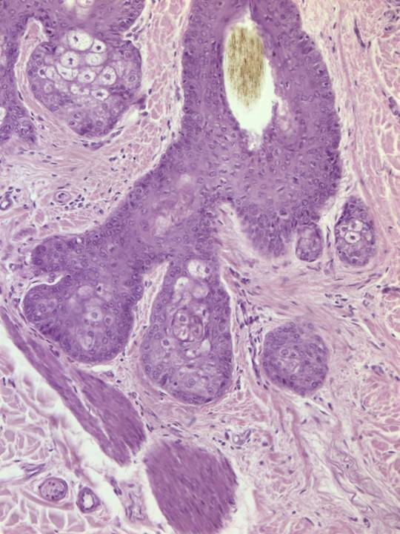
Hair follicle
Sebaceous
gland
Arrector pili muscle
Pilosebaceous apparatus

Slide 50
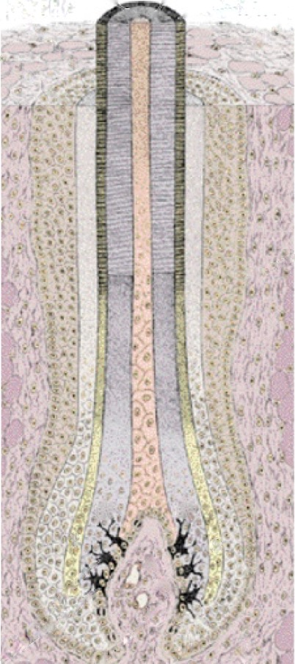
The hair follicle
is a tubular invagination of the epidermis extending deep into the dermis.
The hair shaft
arises from the base of the follicle.
The dermal papilla contains numerous capillaries. It maintains the viability of the hair follicle.
The hair bulb is basically just the base of the hair follicle.
Main parts of the hair follicle

Slide 51
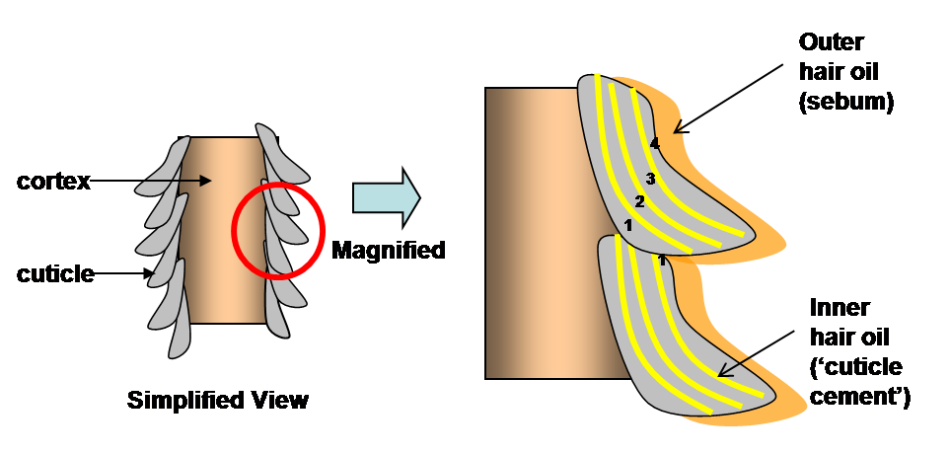

Slide 52
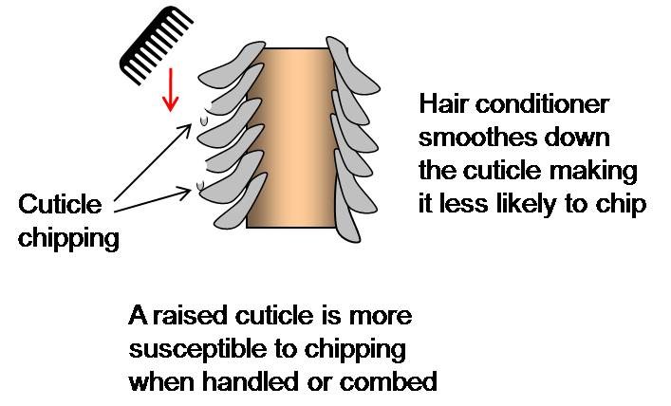

Slide 53
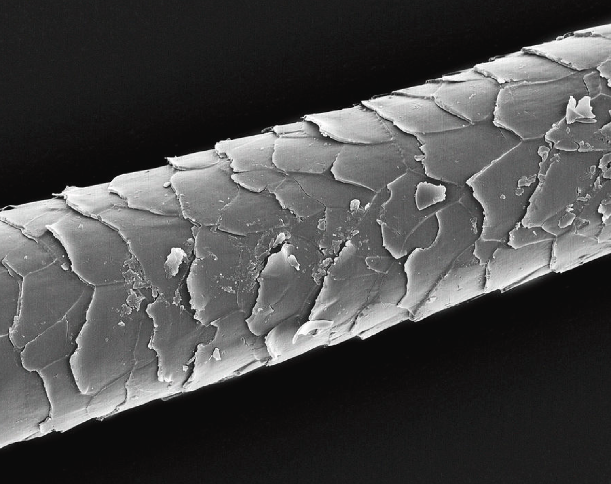
chips

Slide 54
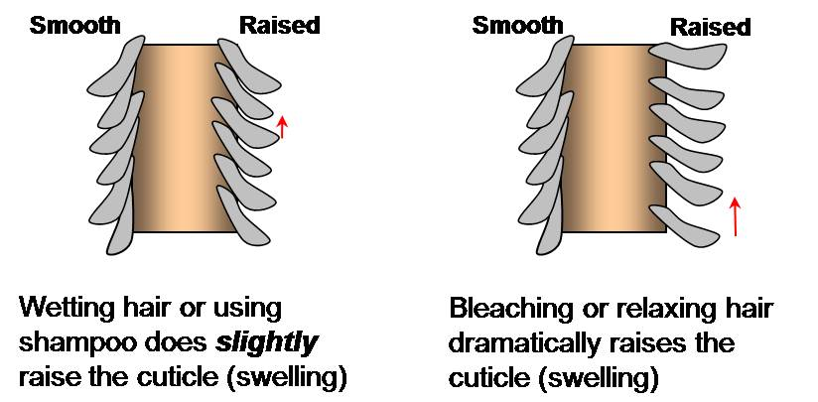

Slide 55
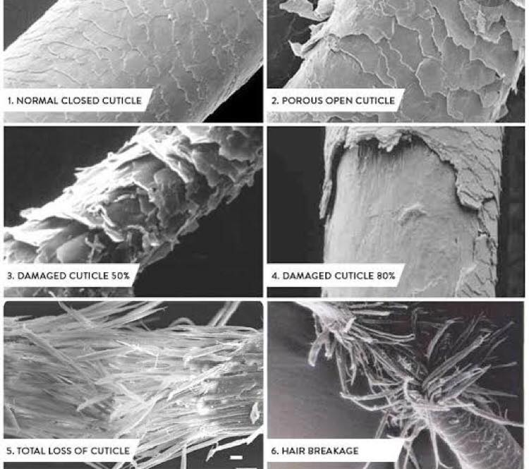

Slide 56
Skin glands
Three types: sebaceous glands, eccrine (merocrine) sweat glands, and apocrine sweat glands.
Arise from ectoderm.
Secretory portion of glands resides in the dermis.
Three different types of secretion: holocrine, merocrine, and apocrine.

Slide 57
Sebaceous glands
Present everywhere except palms and soles.
Secretory portion: peripheral, flattened undifferentiated cells. Central cells are large with foamy cytoplasm containing lipids.
Cells burst, releasing sebum (holocrine secretion).
Duct empties into hair follicle.
Become functional at puberty.

Slide 58
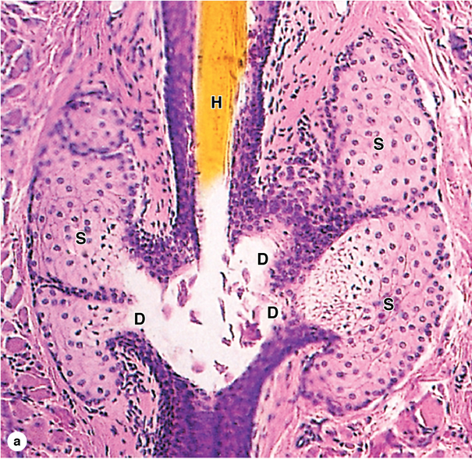
Sebaceous glands with ducts emptying into hair follicle

Slide 59
Eccrine (Merocrine) Sweat Glands
Secretory portion has three cell types:
  Clear cells (contain glycogen, produce a watery substance)
  Darker cells (produce a proteinaceous substance)
  Myoepithelial cells (surround gland)
Duct is lined by simple cuboidal epithelium and opens onto skin surface.

Slide 60
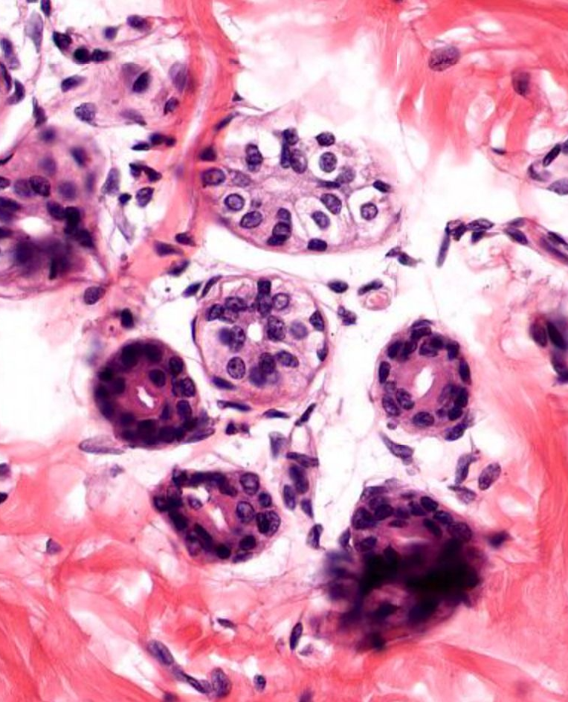
Secretory cells:
Clear
Darker
Myoepithelial cells
Eccrine sweat glands and ducts

Slide 61
Apocrine Sweat Glands
Located only in axilla, areola of breast, and anal canal.
Have larger ducts and secretory units than eccrine sweat glands.
Ducts open into hair follicles.
Apocrine secretion is viscous and contains proteins, carbohydrates and lipids.

Slide 62
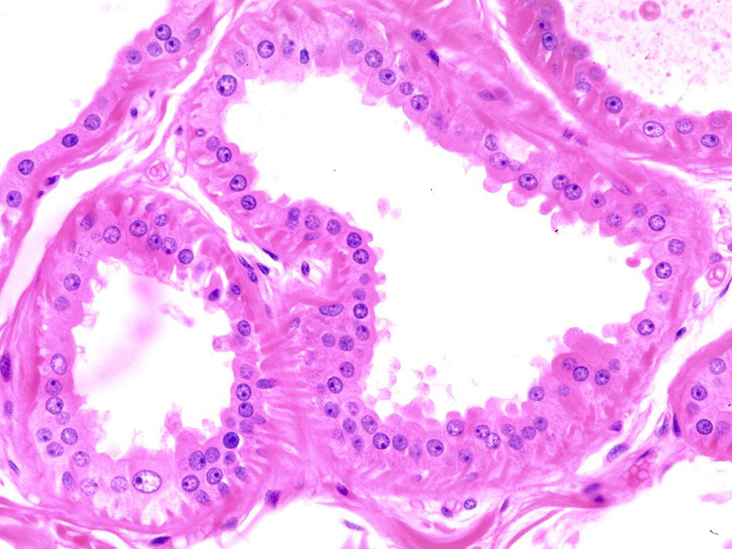
Apocrine sweat glands

Slide 63
Skin Lecture Outline
Introduction
Epidermis
Dermis

