Slide 1
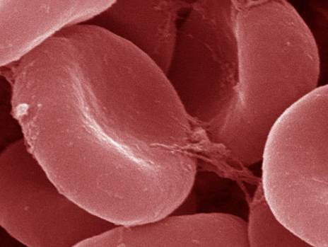
Blood
Kristine Krafts, M.D.

Slide 2
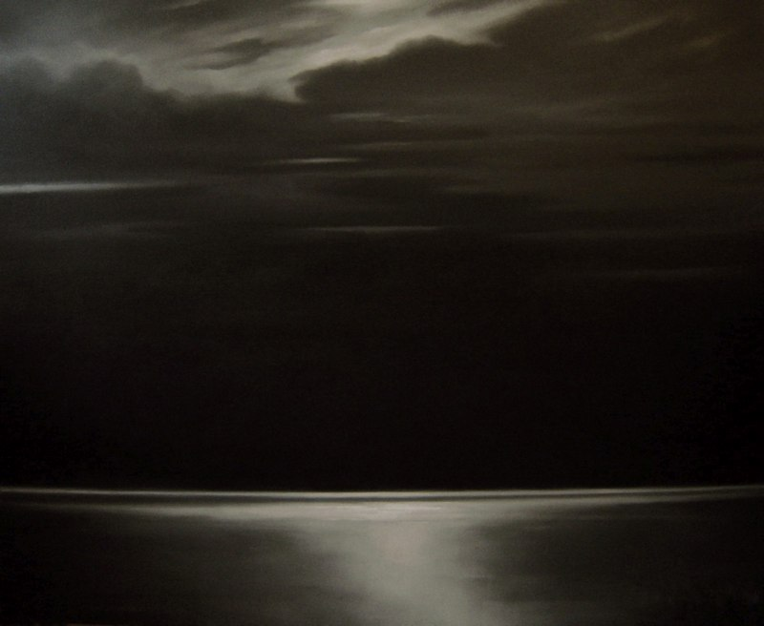
The most beautiful thing we can experience is the mysterious.
It is the source of all true art and science.
-Albert Einstein

Slide 3
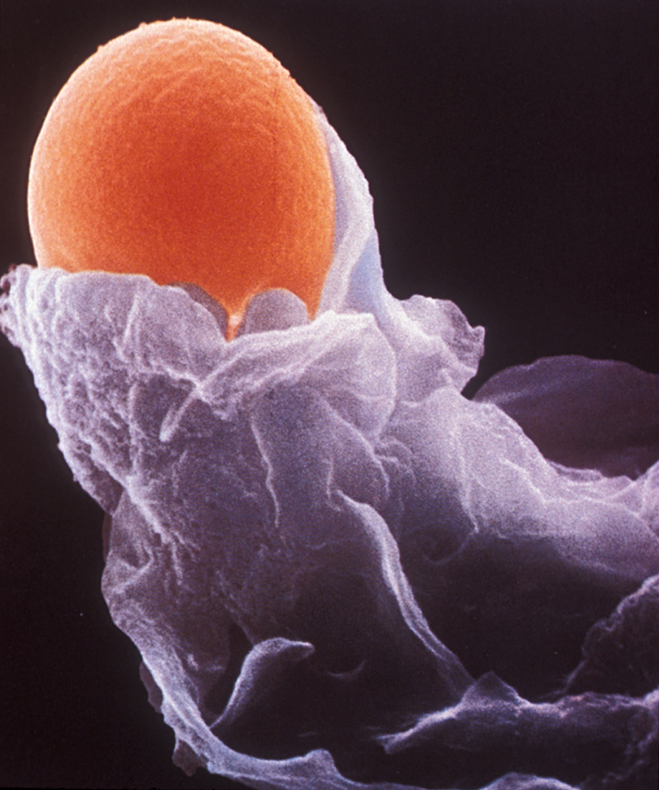

Slide 4
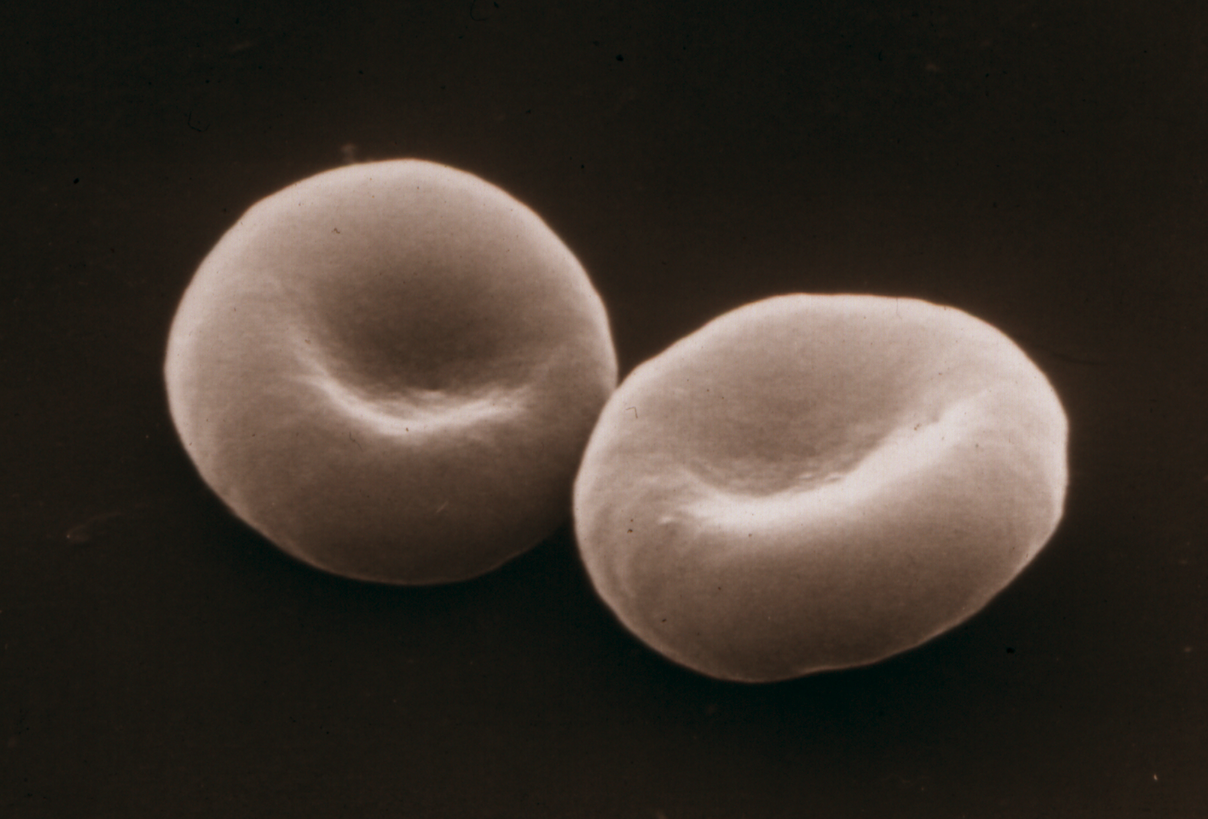

Slide 5
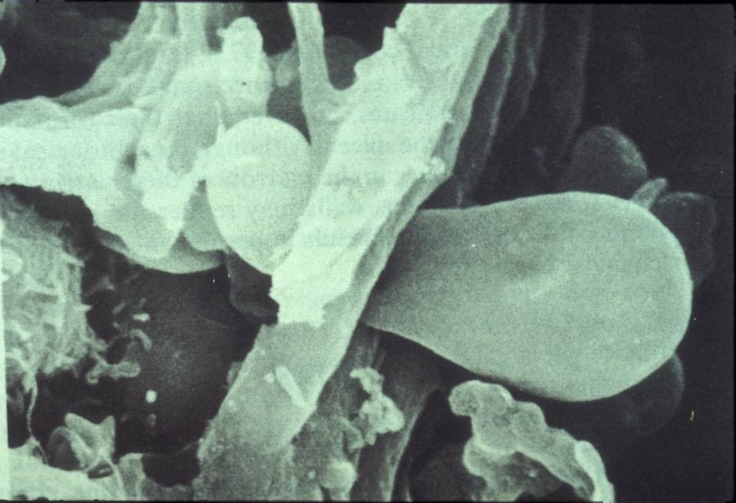

Slide 6
Blood Lecture Objectives
Be able to identify and describe the major function(s) of the following:
  Erythrocytes (RBCs)
  Granulocytes (neutrophils, eosinophils, basophils)
  Agranulocytes (lymphocytes, monocytes)
  Platelets
Know the approximate percentage of each type of leukocyte present in normal blood.
Be able to describe the differences between plasma and serum.

Slide 7
Blood Lecture Outline
Introduction
Erythrocytes
Platelets
Leukocytes
  Granulocytes
  Agranulocytes

Slide 8
Blood Lecture Outline
Introduction

Slide 9
Blood is a Specialized Connective Tissue
Composed of:
Cells
Plasma

Slide 10
Cells
Red cells (erythrocytes)
White cells (leukocytes)
Platelets

Slide 11
Plasma contents
Water: 92%
Proteins: 7%
  Albumin: 58%
  Immunoglobulins: 37%
  Fibrinogen: 4%
  Other proteins: 1%
Other stuff: 1% (electrolytes, nutrients, respiratory gases, waste products)

Slide 12
Plasma vs. Serum
Plasma clots, serum does not clot
Serum = plasma minus clotting factors (it’s what’s left after plasma clots)

Slide 13
Blood Lecture Outline
Introduction
Erythrocytes

Slide 14
Erythrocytes (Red Blood Cells)
Life span: 120 days
Derived from red cell precursors in bone marrow
Normal numbers
  Male: 4.5-6 x 10¹²/L
  Female: 4-5 x 10¹²/L

Slide 15
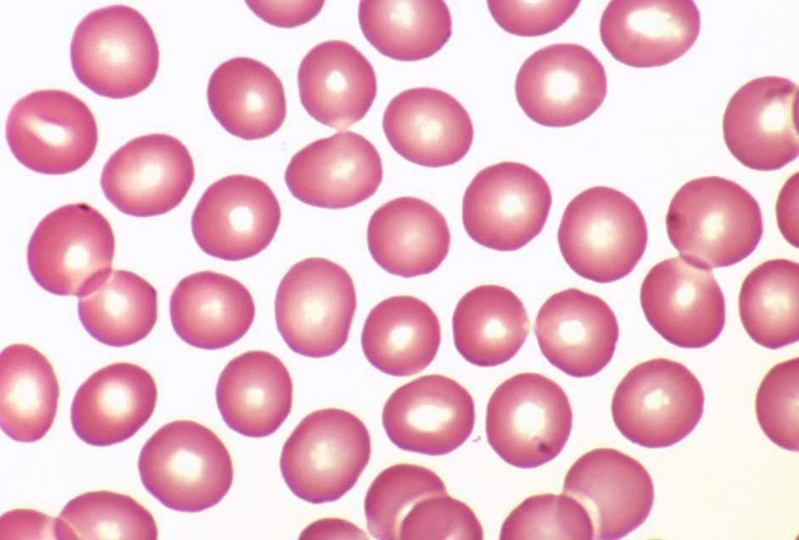
Normal red blood cells

Slide 16
Red Blood Cell Morphological Features
Nicely designed biconcave disk shape
Roughly 7 µm wide and 2 µm thick
Cytoskeleton: spectrin, ankyrin, actin
No nucleus
Cytoplasm: water (65%); organelles (1%); hemoglobin (34%)

Slide 17
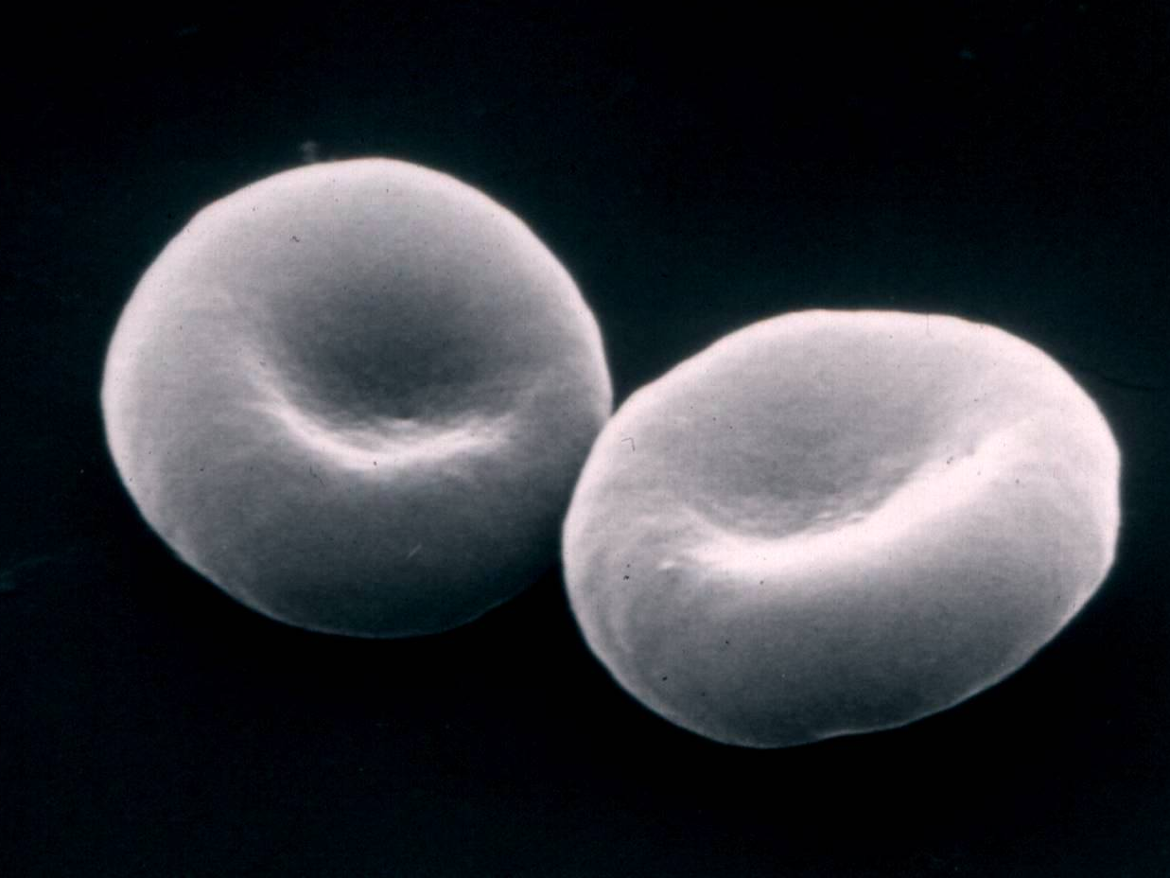

Slide 18
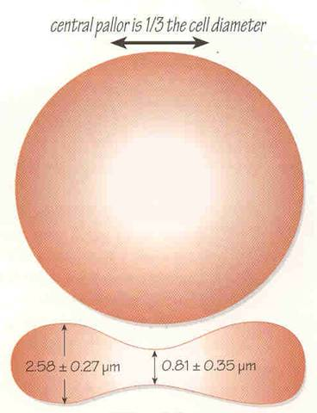
⅓

Slide 19
Pliable membrane allows cells to squeeze through tiny spaces.

Slide 20
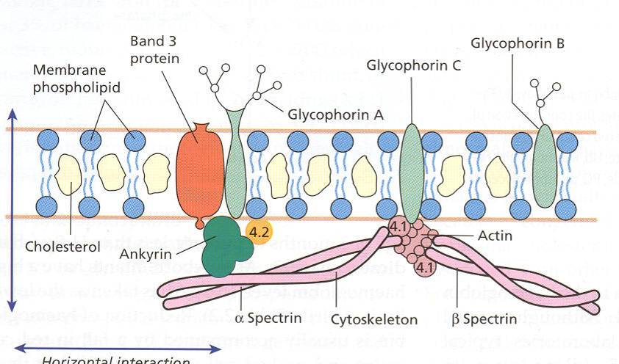
z

Slide 21
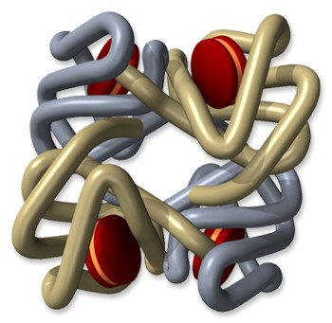
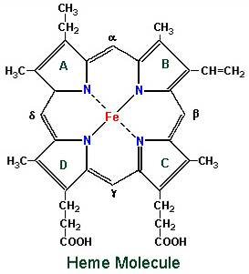
4 globin chains
4 heme molecules
Heme molecule
(carries O₂)
Hemoglobin
Main red cell function: transport oxygen using hemoglobin

Slide 22
Blood Lecture Outline
Introduction
Erythrocytes
Platelets

Slide 23
Platelets
Life span: 8-10 days
Derived from megakaryocytes in bone marrow
Normal number: 150-450 x 10⁹/L
About 2 µm in diameter
Granulomere and hyalomere regions
No nucleus
Function: help blood to clot

Slide 24
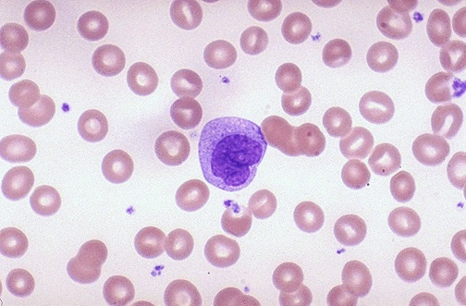
Normal platelets

Slide 25
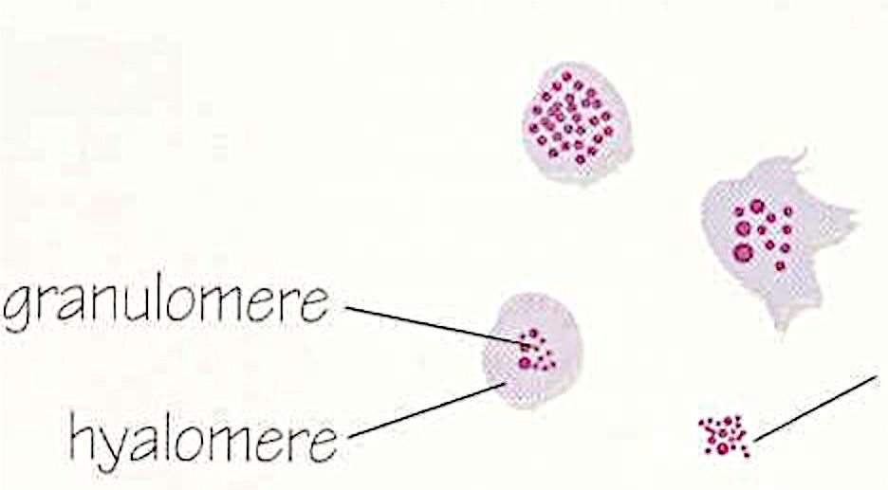
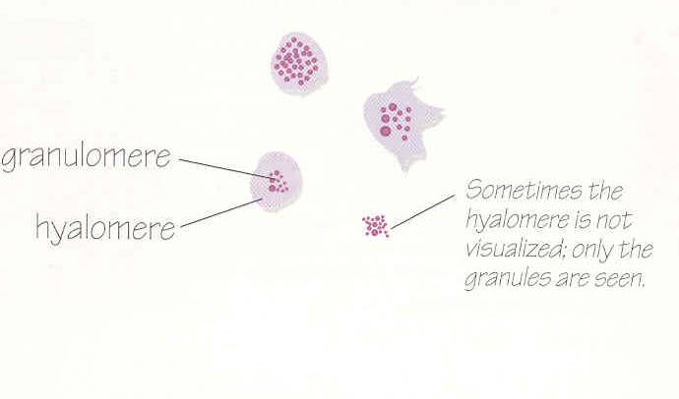
Normal Platelets

Slide 26
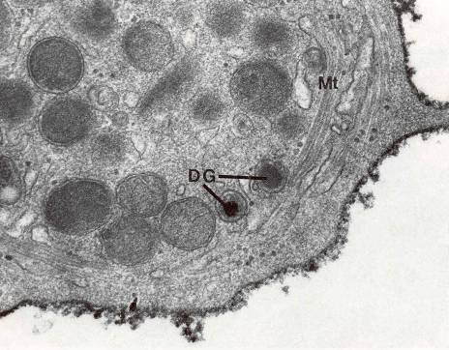
Platelets look boring but have a ton of stuff inside (granules) and outside (receptors)

Slide 27
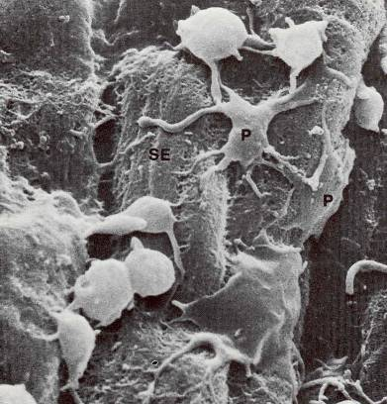
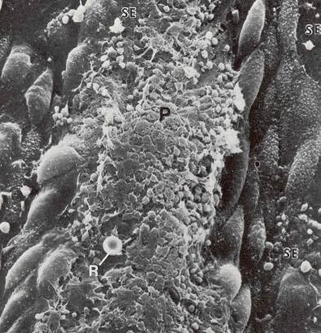
Platelets forming a clot

Slide 28
Blood Lecture Outline
Introduction
Erythrocytes
Platelets
Leukocytes

Slide 29
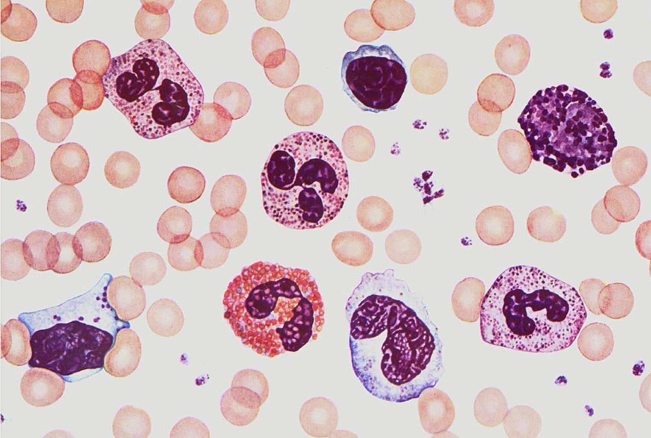
White blood cells (nice drawing)

Slide 30
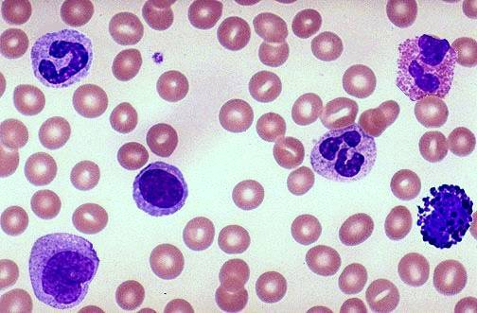
White blood cells (real blood smear)

Slide 31
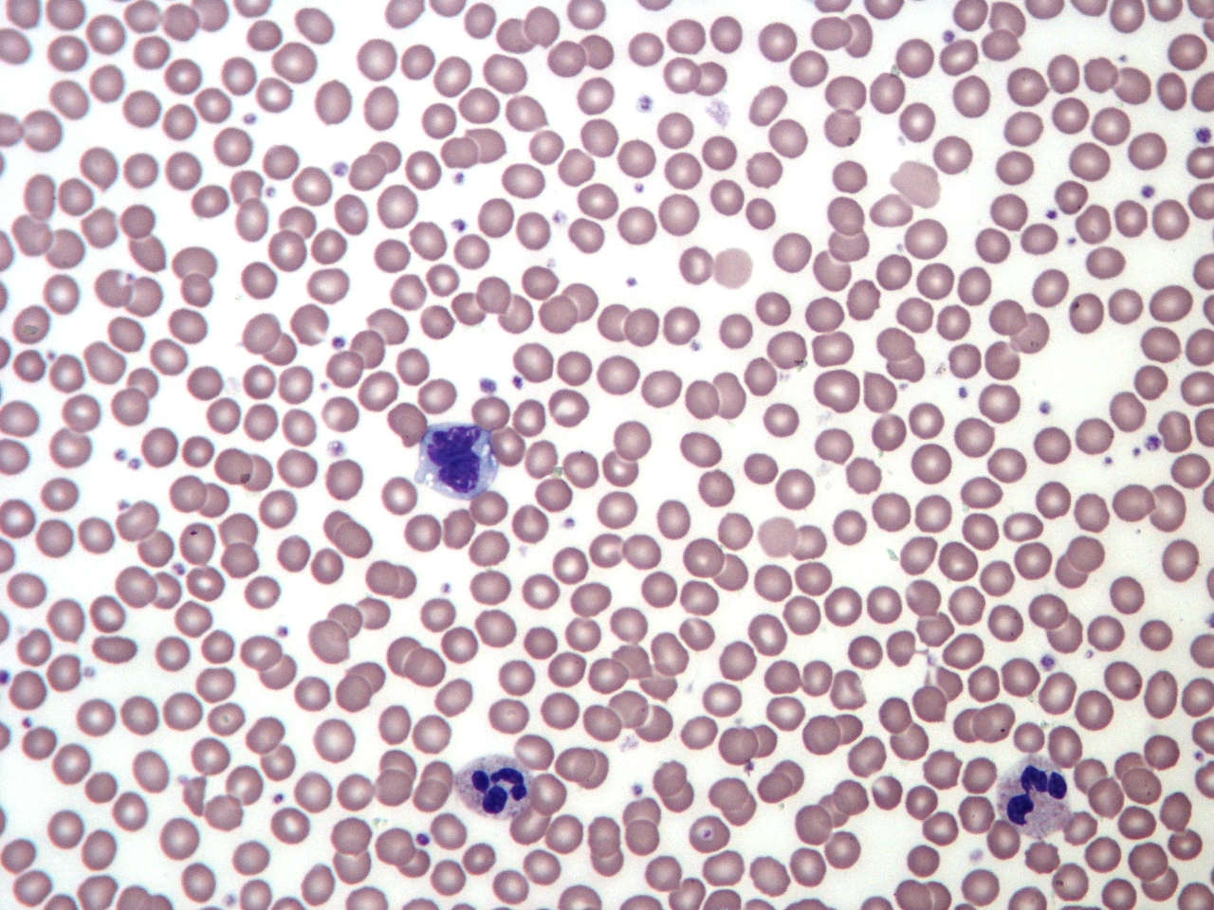
White blood cells (another real blood smear)

Slide 32

White blood cell count (WBC)
Just gives you the total number of white blood cells (normal is about 4-11 x 10⁹/L).

Slide 33
White blood cell differential (“diff”)
Tells you how many of each type of white cell are present (normally, neutrophils are the most numerous, and basophils are the least numerous).

Slide 34
Leukocytes
Granulocytes
  Neutrophils
  Eosinophils
  Basophils
Agranulocytes
  Lymphocytes
  Monocytes

Slide 35
Wait, agranulocytes have granules?!
Yes! Both granulocytes and agranulocytes have cytoplasmic granules called azurophilic granules.
But granulocytes also have specific granules that define them as cells (neutrophilic, eosinophilic and basophilic granules)

Slide 36
Granulocytes vs. agranulocytes

Slide 37
Blood Lecture Outline
Introduction
Erythrocytes
Platelets
Leukocytes
  Granulocytes

Slide 38
Neutrophils
45-75% of differential count (between 2-8 x 10⁹/L)
About 15 µm in diameter
Multi-lobed nucleus…
…hence their other name: “polymorphonuclear leukocyte” (PMN)
Two kinds of granules:
  Azurophilic (primary, purple) granules (a few)
  Neutrophilic (secondary, pink) granules (lots)

Slide 39
Normal neutrophils
Immature neutrophil

Slide 40
Neutrophil: azurophilic vs. neutrophilic granules
(hard to see on screen!)

Slide 41
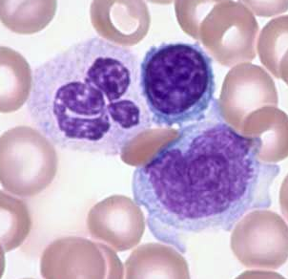
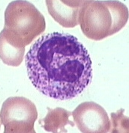
Normal neutrophil
(top left)
Neutrophil from patient with bacterial infection
Azurophilic granules become much more
prominent during bacterial infection.

Slide 42
promyelocyte
Azurophilic granules first appear in less mature neutrophils called promyelocytes. Promyelocytes divide, distributing their azurophilic granules evenly (which means more mature neutrophils have fewer azurophilic granules).

Slide 43
Neutrophil Functions
First line of defense against invaders (bacteria, foreign objects)
Spend a few hours in blood, then migrate quickly to site of infection where they spend a few days
Kill invaders by phagocytosis and by enzymatic destruction (nasty!)
Then take off and let others (macrophages) clean up the mess

Slide 44
Eosinophils
1-4% of differential count (about 0.5 x 10⁹/L)
About 15 µm in diameter
Large, gorgeous, orange-red (eosinophilic) granules in cytoplasm
Greek eos = first blush of dawn
Bi-lobed nucleus

Slide 45
Eosinophil

Slide 46
Eosinophil in real life

Slide 47
Eosinophil Functions
Major cell involved in allergic reactions (like hay fever and asthma)
Good at killing parasites (granules contain major basic protein)
Also involved in drug reactions
Help modulate immune responses

Slide 48
Basophils
Less than 1% of differential count (less than
0.3 x 10⁹/L)
About 10 µm in diameter
Tons of large, deep blue (basophilic) granules in cytoplasm
Irregularly-shaped nucleus (hard to see under all those granules)
Functions: fight infection, mediate allergic responses

Slide 49
Basophil

Slide 50
Basophil in real life

Slide 51
Blood Lecture Outline
Introduction
Erythrocytes
Platelets
Leukocytes
  Granulocytes
  Agranulocytes

Slide 52
Lymphocytes
20-50% of differential count (between 1-4 x 10⁹/L)
Most lymphocytes are small (6-12 µm) but some
are larger (up to 20 µm)
Nucleus: dark staining; “clumpy and smudgy”
Two main types (which look pretty much the same):
  B-lymphocytes
  T-lymphocytes

Slide 53
Normal lymphocytes

Slide 54
Small lymphocyte in real life

Slide 55
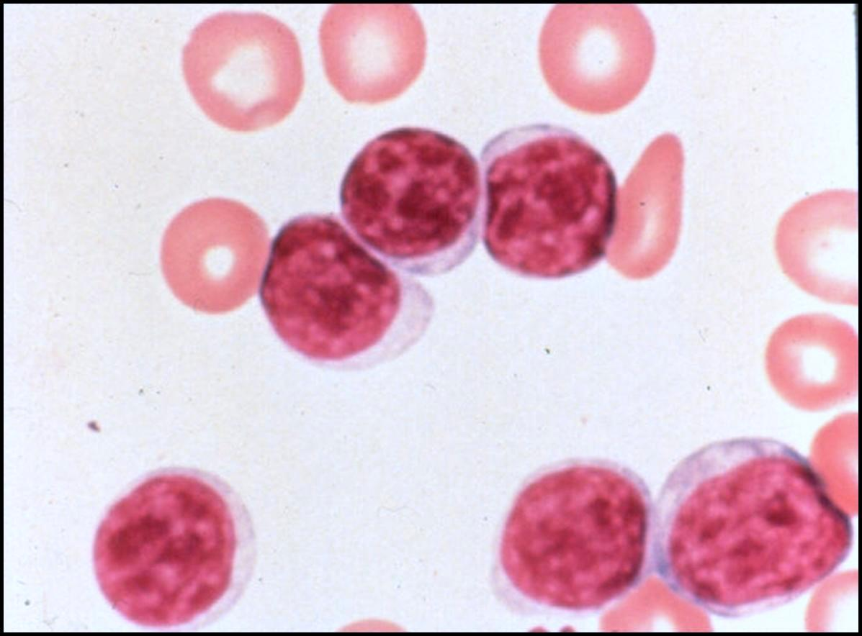
Lymphocyte chromatin pattern: clumpy and smudgy

Slide 56
Lymphocyte chromatin: clumpy but also smudgy (no white space between clumps)
Neutrophil chromatin: distinct clumps (with white space between clumps)
Monocyte chromatin:
not really clumpy

Slide 57
B-Lymphocytes
15% of circulating lymphocytes
Develop in bursa of Fabricius (in birds) and in bone marrow (in humans)
Further maturation occurs in lymphatic tissues (lymph nodes and spleen)
Ultimately, become either plasma cells (which make antibodies) or memory cells (which “remember” previous infections)

Slide 58
T-Lymphocytes
About 85% of circulating lymphocytes
Develop and mature in thymus
Also found in bone marrow and lymphoid tissues, along with B cells
Ultimately, most become either cytotoxic T cells (which kill infected cells) or helper T cells (which help other immune cells do their jobs)

Slide 59
Monocytes
1-8% of differential count (between 0.1-0.8 x 10⁹/L)
12-20 µm in diameter
Nucleus: indented, oval, kidney, or horseshoe-shaped. “Raked” chromatin.
Cytoplasm: “dishwater” (gray-blue) color, sometimes with little vacuoles and/or tiny azurophilic granules

Slide 60
Monocyte: large cell with “dishwater” cytoplasm
and “raked” chromatin

Slide 61
Monocyte Function
Differentiate into macrophages (histiocytes) in different organs
  Foreign body giant cells (anywhere)
  Kupffer cells (liver)
  Microglial cells (brain)
  Alveolar macrophages (lung)
Second line of defense against invading organisms
Help lymphocytes do their job; also phagocytic (eat up invaders and either get rid of them or present bits of them to lymphocytes)

Slide 62
Blood Lecture Outline
Introduction
Erythrocytes
Platelets
Leukocytes
  Granulocytes
  Agranulocytes

