Slide 1
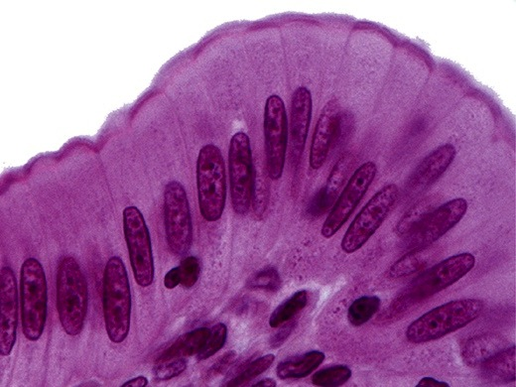
Epithelium
Kristine Krafts, M.D.

Slide 2
Epithelium Lecture Objectives
Describe the structural and functional relationship between:
  epithelium and connective tissue, and
  epithelium and basal lamina.
Describe the structural and functional features of epithelial intercellular junctions and specializations of the apical surface of epithelial cells.

Slide 3
More Epithelium Lecture Objectives
Describe the structural and functional diversity of epithelium.
Describe the classification system of covering/lining epithelium.
Describe the histologic features of glandular epithelium.

Slide 4
Epithelium Lecture Outline
Function and types of epithelium
Structure of epithelium
Types of covering/lining epithelium
Types of glandular epithelium

Slide 5
Epithelium Lecture Outline
Function and types of epithelium

Slide 6
Functions of Epithelium
Covering of external surfaces
Lining of internal surfaces
Protection
Absorption
Secretion
Sensation
Contraction

Slide 7
Two Main Kinds of Epithelium
Covering and lining epithelium
Covers outer surfaces of body and lines internal body passages
Glandular epithelium
Contains cells specialized for secretion

Slide 8
Unique Characteristics of Epithelium
Basal lamina anchors epithelium to underlying connective tissue.
Epithelial cells are very cohesive due to intercellular junctions.
Epithelial cells vary a lot in shape and size.
Epithelial tissues are avascular.
Epithelial cells demonstrate polarity.

Slide 9
Epithelium Lecture Outline
Function and types of epithelium
Structure of epithelium
  Basement membrane
  Connections between cells
  Specialized apical structures

Slide 10
Epithelium Lecture Outline
Function and types of epithelium
Structure of epithelium
  Basement membrane

Slide 11
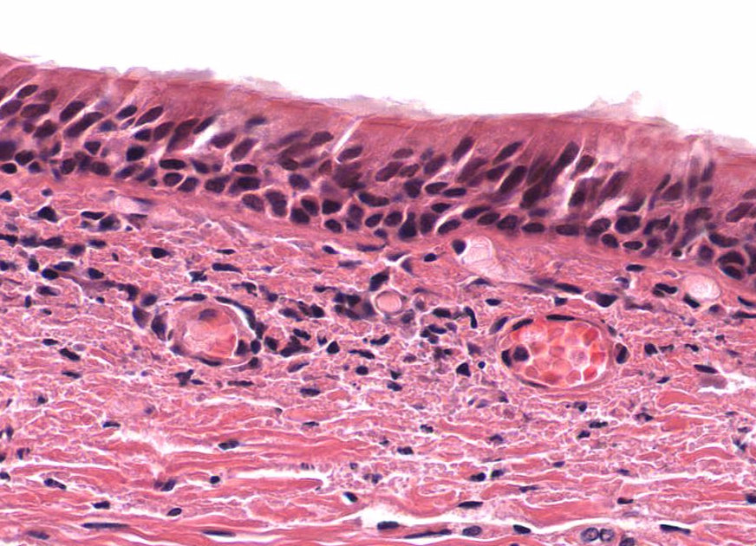
Epithelial cells
Basement membrane

Slide 12
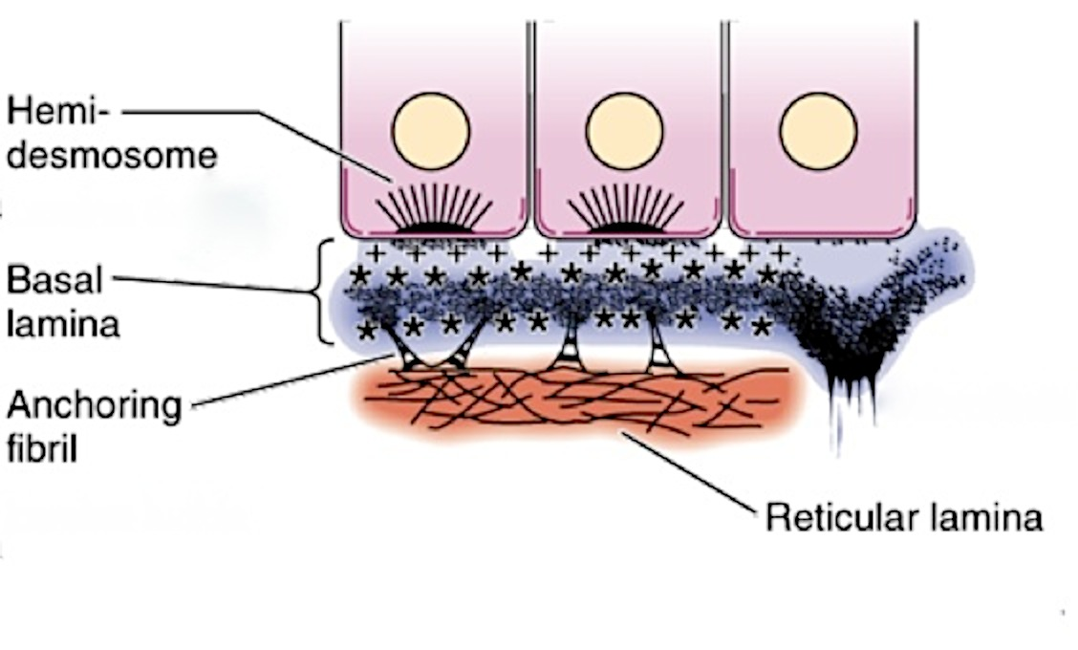














Basement membrane =
Basal Lamina + Reticular Lamina
Epithelium
Basal
lamina
Basement membrane
Reticular lamina

Slide 13
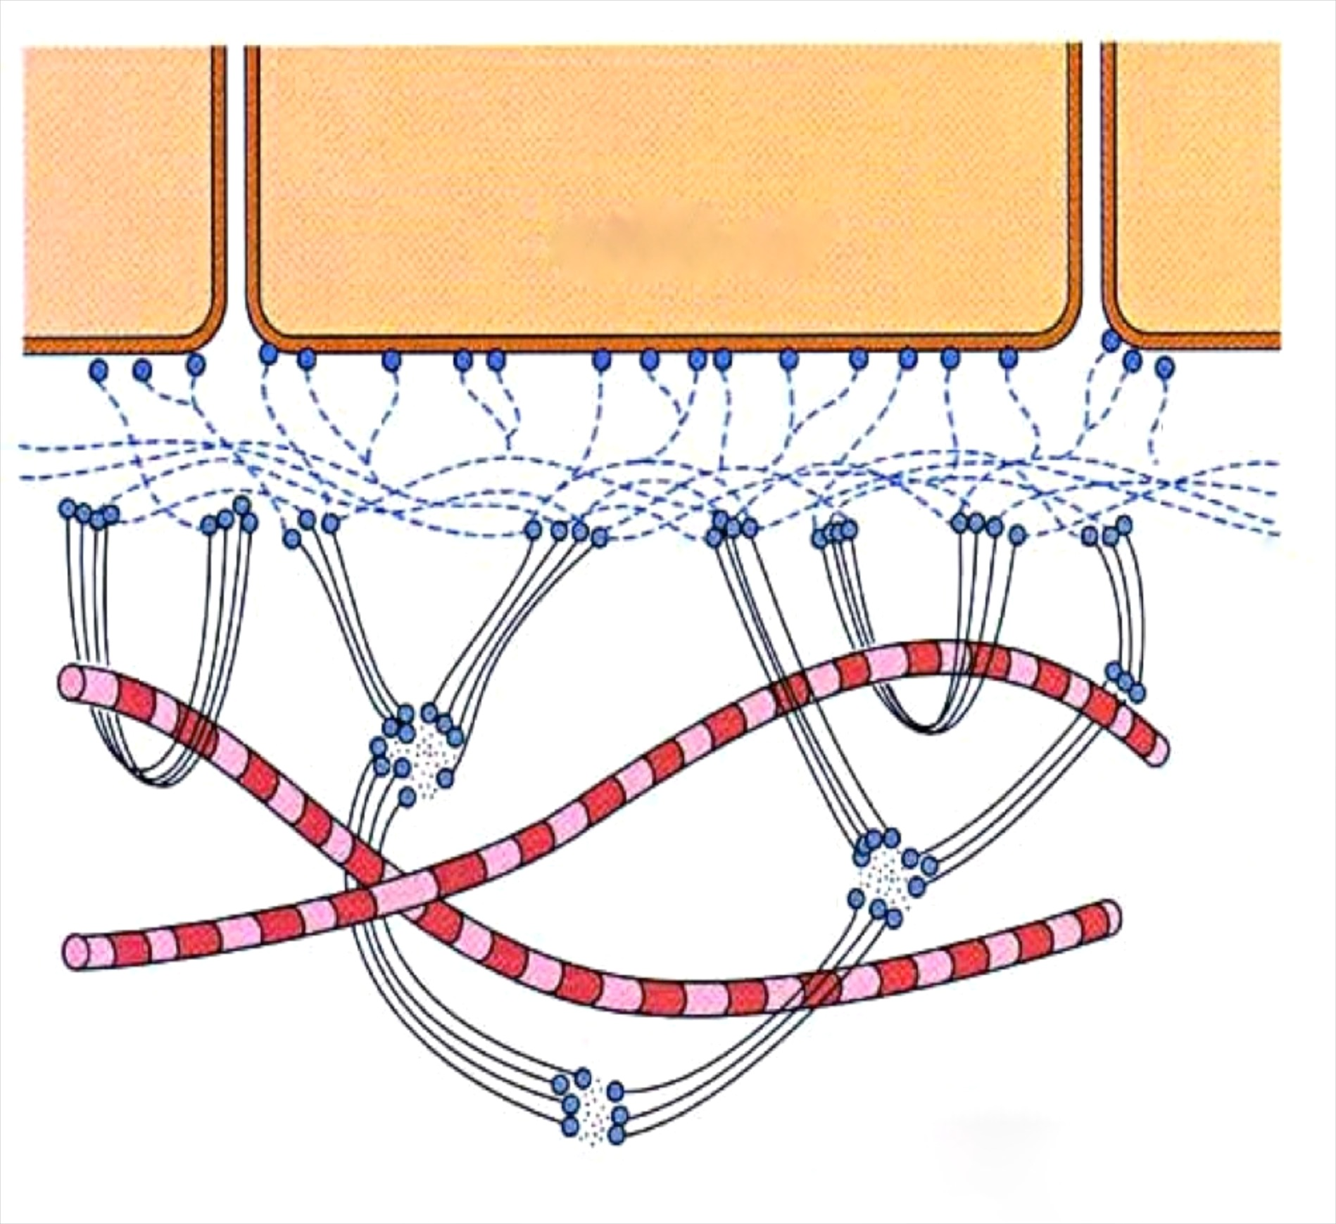
Composition of Basal Lamina and Reticular Lamina
Epithelial cell
lamina lucida
Basal
lamina
lamina densa
Type IV collagen
Reticular lamina
Reticular fibers
(Type III collagen)
Anchoring fibrils
(made of a different type of collagen not worth memorizing)

Slide 14
Don’t make this mistake!
“Basal lamina” and “basement membrane”
are sometimes used interchangeably.
This is wrong, wrong, wrong!
The basal lamina is part of the basement membrane. They are not the same thing.

Slide 15
Epithelium Lecture Outline
Function and types of epithelium
Structure of epithelium
  Basement membrane
  Intercellular junctions

Slide 16
Intercellular junctions connect epithelial cells
Intercellular junctions are present in many tissues but are especially numerous and prominent in epithelium.
Tight junction (zonula occludens)
Adhering junction (or zonula adherens)
Desmosome (macula adherens)
Hemidesmosome
Gap junction

Slide 17
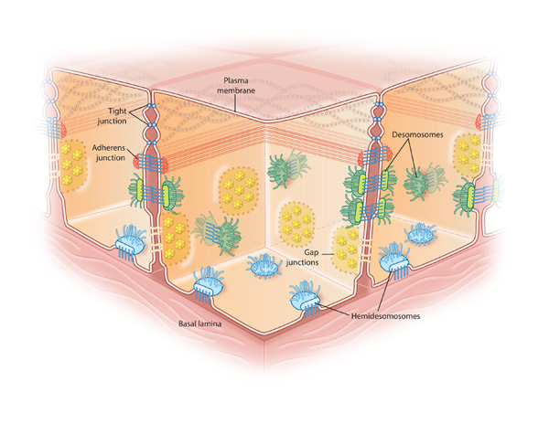

Intercellular Junctions

Slide 18
Intercellular Junctions

Slide 19
Tight junction (zona occludens)
Form a super-tight seal towards the top of two adjacent cell to prevent flow of materials between cells.

Slide 20
Adherens junction (zonula adherens)
Forming a close bond between adjacent cells, this junction runs all the way around the cell like a belt.

Slide 21
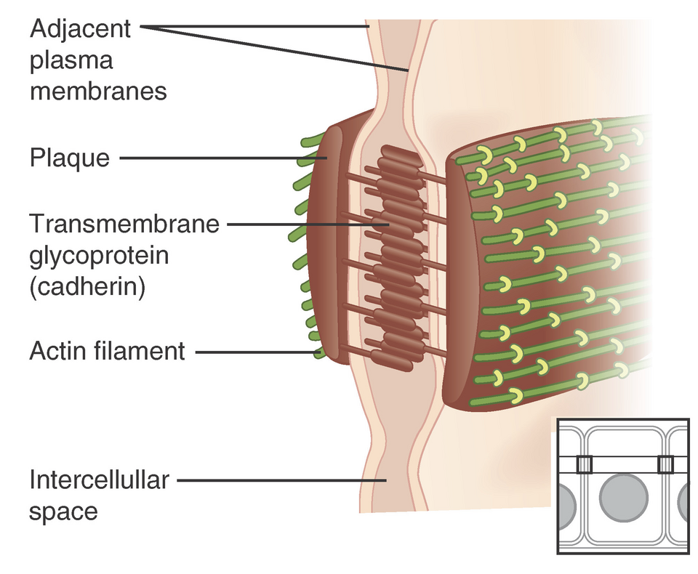







Adherens junction (zonula adherens)
Form bands that completely encircle each cell
Cadherin and catenin proteins provide adhesion between adjacent cells
Actin filaments in cytoplasm insert into attachment plaques

Slide 22
Spot desmosome (macula adherens)
Spot adhesion (like a little spot-weld between cells)
Desmosomes on adjacent cells line up
Cadherins present in intercellular space

Slide 23
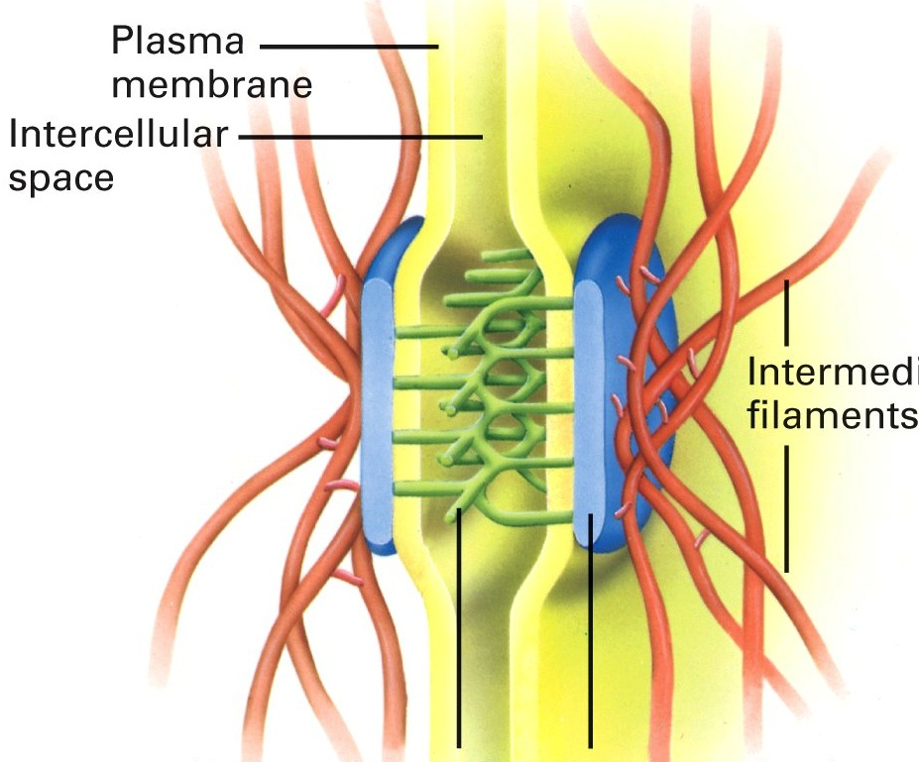
Spot desmosome (macula adherens)
Cytokeratin
filaments
  Intercellular proteins (cadherins)
Cytoplasmic attachment plaque

Slide 24
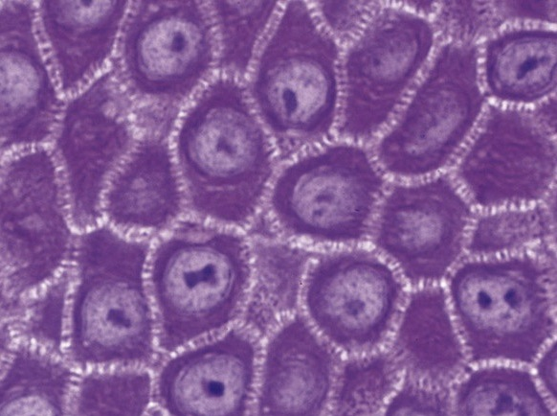
Spot desmosomes in stratum spinosum of skin

Slide 25
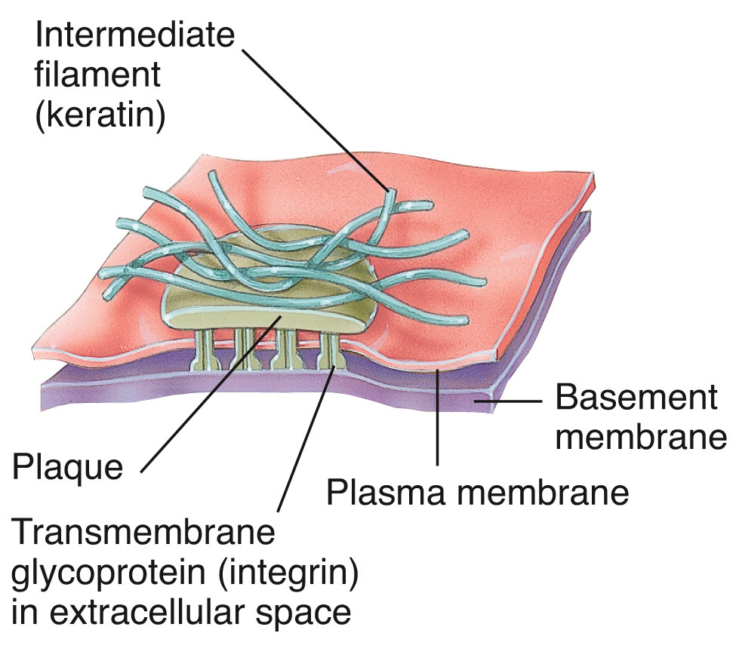
Hemidesmosome
Cytokeratin filaments
Basement membrane
Cytoplasmic
attachment
plaque
Cell membrane
Integrins
(proteins)
attaching plaque to
basement membrane

Slide 26
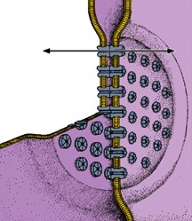
Gap (communicating) junction
Occur almost anywhere along lateral surfaces of epithelial cells and also in other cells, such as cardiac muscle cells
Connexons are protein channels with central pores connecting plasma membranes
Allow ions and other small molecules to pass through to adjacent cells to facilitate communication

Slide 27
Epithelium Lecture Outline
Function and types of epithelium
Structure of epithelium
  Basement membrane
  Intercellular junctions
  Specialized apical structures

Slide 28
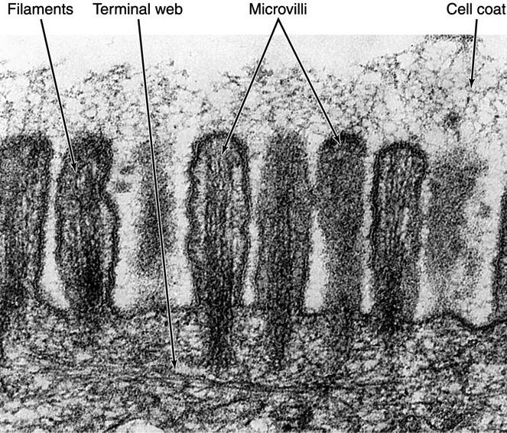
Microvilli
Microvilli + cell coat (or glyocalyx) = brush border or striated border
Purpose of microvilli: increase surface area for absorption or secretion

Slide 29
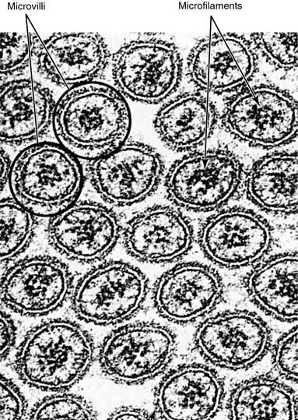
Microvilli
Microvilli have a
central core of
actin microfilaments
Microvilli don’t wave back and forth like cilia.

Slide 30
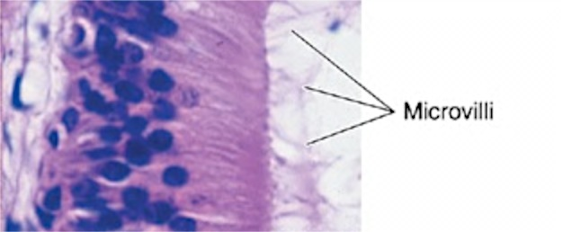
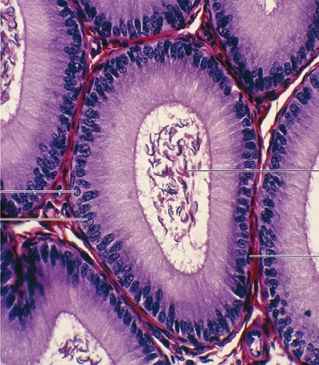
Stereocilia
Stereocilia
Stereocilia are long,
non-motile microvilli found in parts of the male reproductive system
Spermatozoa

Slide 31
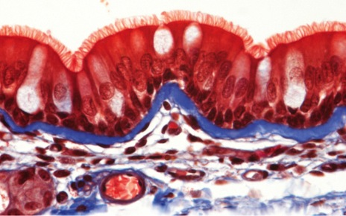
Cilia
Cilia are much longer and wider than microvilli.
They move back and forth to propel fluid along the epithelial surface.
Cilia on respiratory epithelial cells

Slide 32
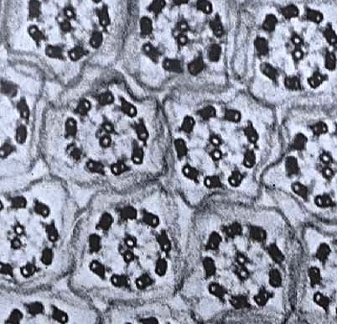
Cilia
Cilia contain microtubules in a 9 + 2 configuration called an “axoneme”
2 central microtubules surrounded by 9 pairs of microtubules

Slide 33
Epithelium Lecture Outline
Function and types of epithelium
Structure of epithelium
Types of covering/lining epithelium

Slide 34
How is covering/lining epithelium categorized?
Shape of superficial cells
Number of cell layers
Presence of specialized structures

Slide 35
How is covering/lining epithelium categorized?
Shape of superficial cells
Squamous: width > height (flattened)
Cuboidal: width = height (square, round)
Columnar: width < height (tall and slender)

Slide 36
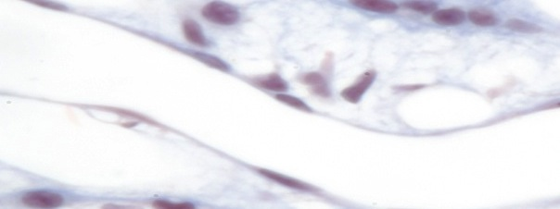
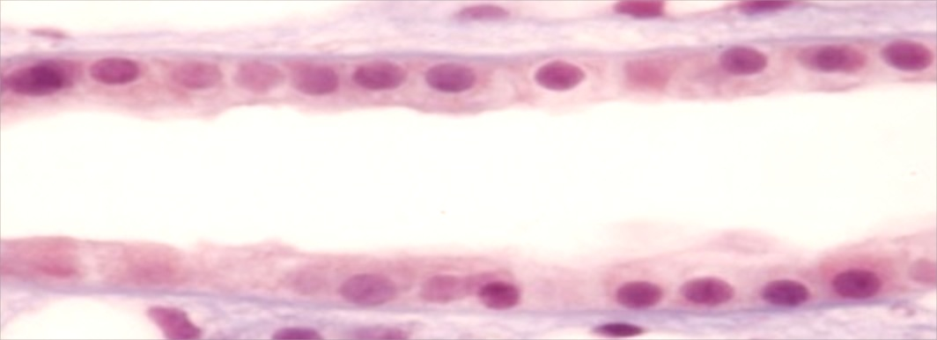
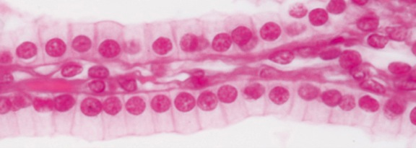
Epithelial cells have different shapes
squamous cells are flat
cuboidal cells are cute and boxy
columnar cells are tall and regal

Slide 37
How is covering/lining epithelium categorized?
Shape of superficial cells
Number of cell layers
Simple: one layer of cells
Stratified: two or more layers of cells
Pseudostratified: all cells contact basal lamina,
but not all cells reach lumen

Slide 38
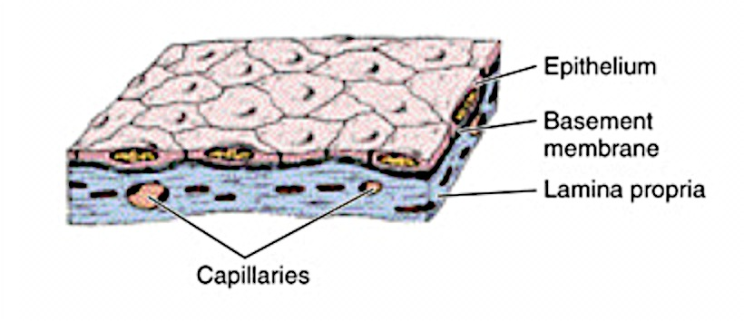
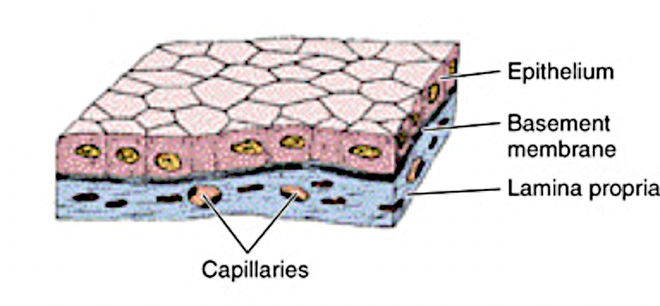
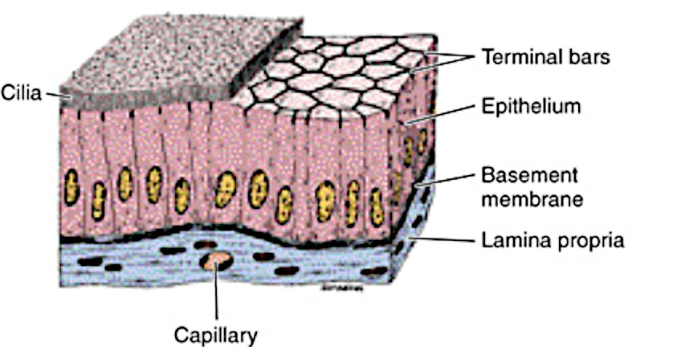
Simple epithelium: one layer of cells
Simple squamous epithelium
Simple cuboidal epithelium
Simple ciliated columnar epithelium

Slide 39
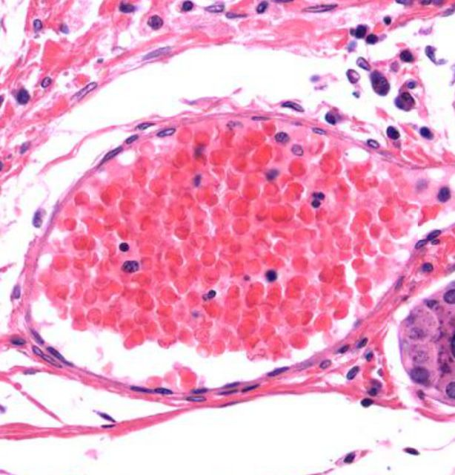
Simple Squamous Epithelium
Flattened squamous cells
in a single layer
Endothelium is simple squamous epithelium that lines vessels.
This is just an example, don’t memorize for now.

Slide 40
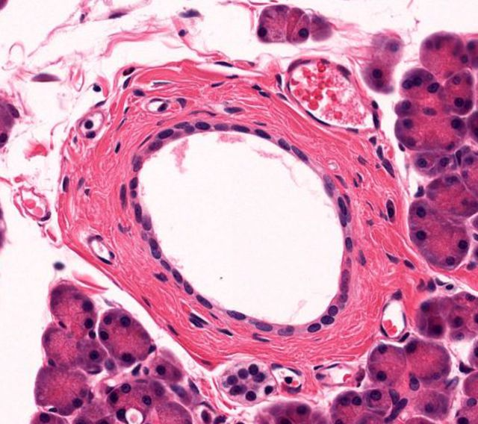
Simple Cuboidal Epithelium
Cuboidal cells
in one cute layer
Ducts are often lined by simple cuboidal epithelium.
This is just an example, don’t memorize for now.

Slide 41
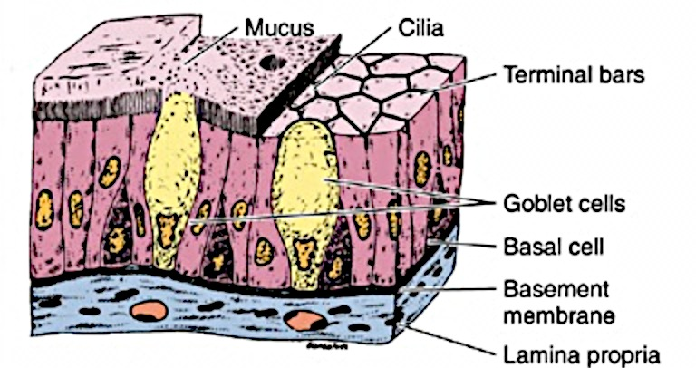
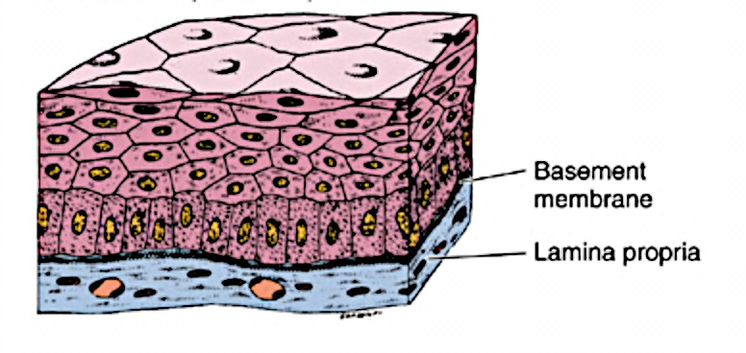
Stratified and pseudostratified epithelium
Stratified squamous epithelium
Pseudostratified ciliated
columnar epithelium

Slide 42
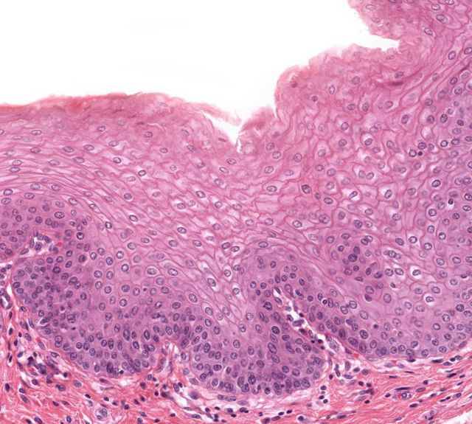
Stratified Squamous Epithelium
Several layers of squamous epithelial cells
Mucous membranes are composed of stratified squamous epithelium.

Slide 43
Pseudostratified Ciliated Columnar Epithelium
Columnar cells
Goblet cells
Cilia
This is found an many parts of the lung

Slide 44
How is covering/lining epithelium categorized?
Shape of superficial cells
Number of cell layers
Presence of specialized structures
Cilia
Microvilli
Keratin

Slide 45
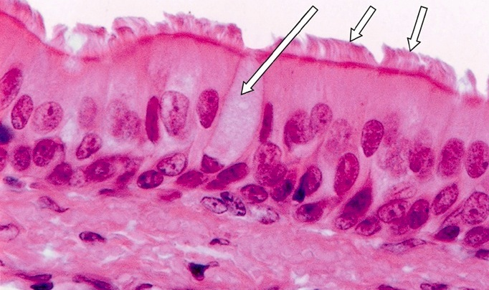
Pseudostratified Ciliated Columnar Epithelium
goblet cell
cilia
Respiratory epithelium is pseudostratified columnar,
with goblet cells and ciliated cells.

Slide 46
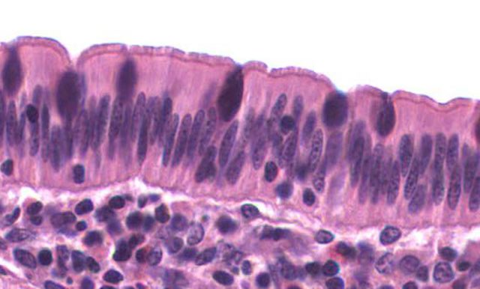
Simple Columnar Epithelium
goblet cell
microvilli
The epithelium of the small intestine is simple columnar,
with goblet cells and absorptive cells with microvilli.

Slide 47
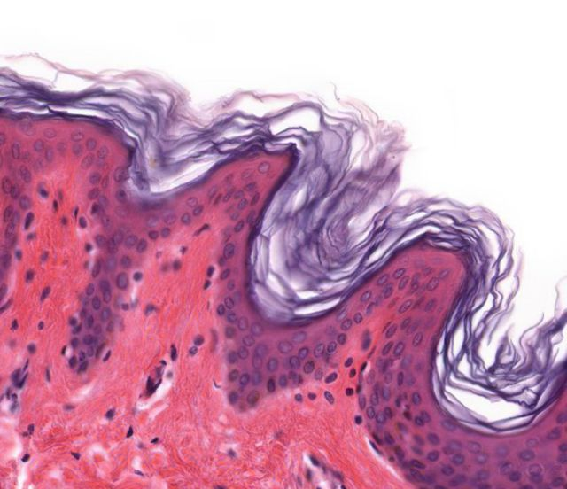
Keratinized Stratified Squamous Epithelium
Keratin
Squamous cells
in several layers
Keratin covers areas where skin is thin but needs protection.

Slide 48
Non-Keratinized Stratified Squamous Epithelium
No keratin!
Squamous cells
in several layers
Areas that are always moist (like the esophagus) are often lined by stratified squamous epithelium without a layer of keratin.

Slide 49
Epithelium Lecture Outline
Function and types of epithelium
Structure of epithelium
Types of covering/lining epithelium
Types of glandular epithelium

Slide 50
Types of Glandular Epithelia
Mucous goblet cell: unicellular gland
Exocrine gland: retains connection with surface epithelium; hormones secreted through ducts
Endocrine gland: no connection with surface epithelium; hormones secreted through blood

Slide 51
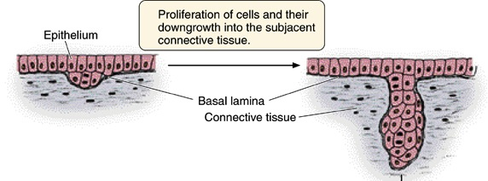
Formation of glands from surface epithelium

Slide 52
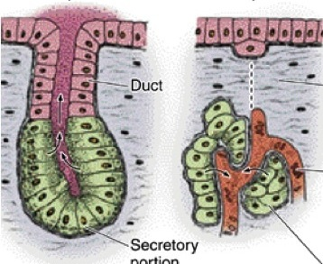
Exocrine gland
Endocrine gland
Disappearance of duct cells
Blood vessel
Secretory
portion
Secretory
portion

Slide 53
Methods of secretion in exocrine glands
Merocrine: secretory granules leave cell by exocytosis. Most common method.
Holocrine: Secretory product shed with entire cell. Example: sebaceous gland
Apocrine: secretory product shed with apical cytoplasm. Example: mammary gland

Slide 54
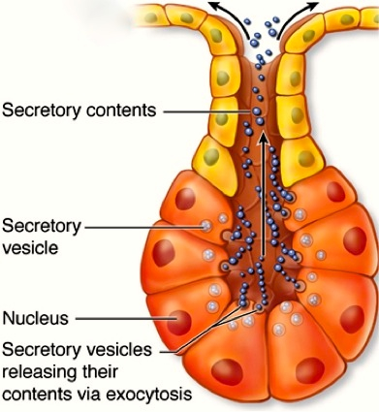
Merocrine gland
Secretes by merocrine mode of secretion: exocytosis of product at apical end of cell.
By far the most common type of exocrine gland based on mode of secretion.

Slide 55
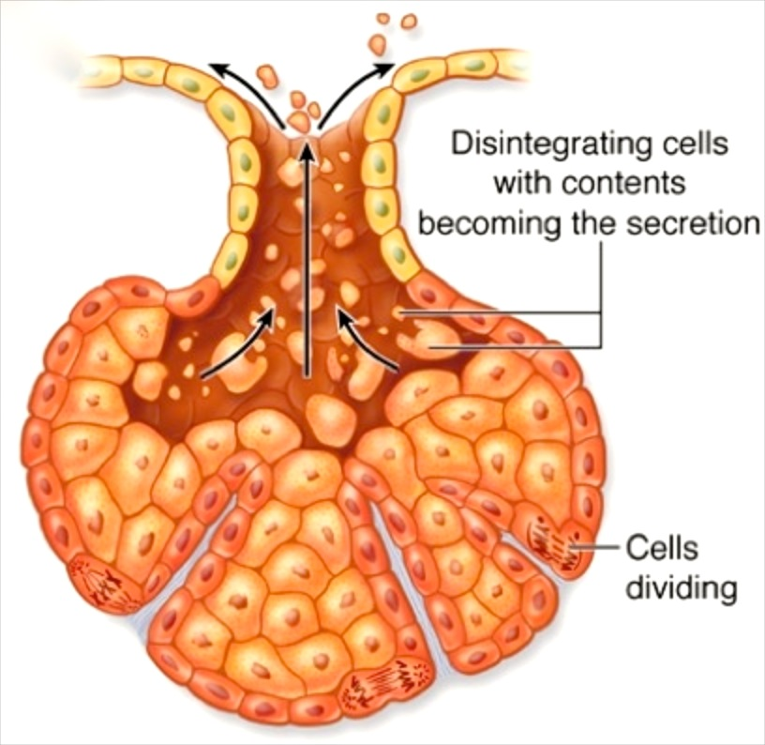
Holocrine gland
Secretion occurs by disintegration of secretory cells.
Example: sebaceous glands.

Slide 56
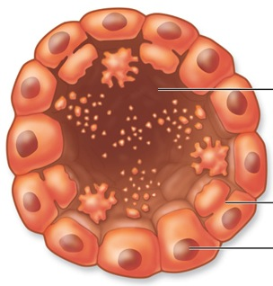
Apocrine gland
Secretion occurs by loss of large amount of apical cytoplasm.
Example: mammary glands.

Slide 57
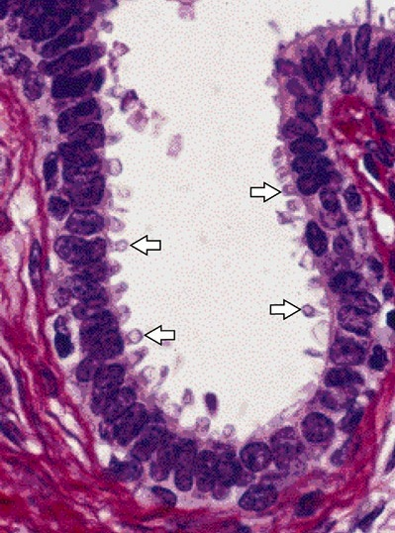
Mammary gland
Note loss of apical portions of cytoplasm.

Slide 58
Epithelium Lecture Outline
Function and types of epithelium
Structure of epithelium
Types of covering/lining epithelium
Types of glandular epithelium

