Slide 1
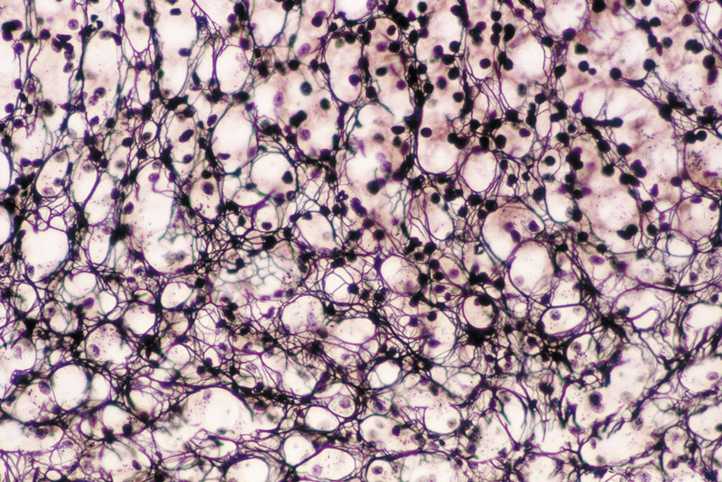
Connective Tissue
Kristine Krafts, M.D.

Slide 2
Connective Tissue Lecture Objectives
List the functions of connective tissue.
Describe the structure, function, and appearance of collagen types I – IV and elastic fibers.
Explain what ground substance is and what it looks like.
Compare and contrast the structure of glycosaminoglycans, proteoglycans, and glycoproteins.
List the four types of connective tissue proper, describe what each looks like, and explain how and where each is used in the body.

Slide 3
Connective Tissue Lecture Outline
Introduction
Extracellular matrix of connective tissue
Cells of connective tissue
Classification and examples of connective tissue

Slide 4
Connective Tissue Lecture Outline
Introduction

Slide 5
Tissue Basic Concepts
There are ONLY FOUR basic tissues!
Epithelium
Connective tissue
Muscle
Nerve
All tissues are composed of:
Cells
Extracellular matrix (stuff between cells)

Slide 6
What Makes Connective Tissue Unique?
Extracellular matrix (ECM) is the major component of most types of connective tissue.
Cells are a minor component.
The other basic tissues (epithelium, muscle, nerve) are fundamentally different in that they are composed mainly of cells.

Slide 7
Types of connective tissue
Connective Tissue
Specialized Connective Tissue
Supporting Connective Tissue
Adipose tissue
Hematopoietic tissue
Lymphoid tissue
Cartilage
Bone
Connective Tissue Proper
Surrounds delicate things like vessels Scaffolds mushy things like lymph nodes Connects bones
Supports skin

Slide 8
Connective Tissue Development
Connective tissue develops from a precursor tissue called mesenchyme (which arises from mesoderm).
Mesenchyme is an undifferentiated tissue present only in early embryonic life.
Mesenchyme gives rise to all connective tissues plus vessels and smooth muscle cells.

Slide 9
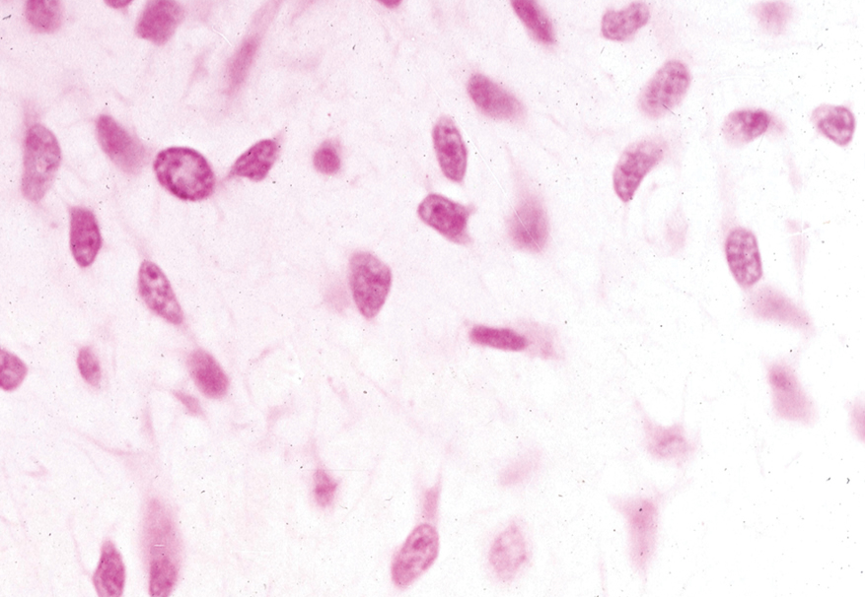
Mesenchyme: bland cells in lots of ground substance

Slide 10
Connective Tissue Lecture Outline
Introduction
Extracellular matrix of connective tissue

Slide 11
Composition of Extracellular Matrix (ECM)
Protein fibers
Collagen fibers
Elastic fibers
Ground substance
Glycosaminoglycans
Proteoglycans
Glycoproteins

Slide 12
Two Main Protein Fibers in ECM
Collagen fibers
Flexible, non-extensible
Over 20 types!
Made of polypeptide chains
Elastic fibers
Thinner and stretchier than collagen
Made of elastin and fibrillin

Slide 13
Main Types of Collagen in the Body
Type | Microscopic Appearance | Main Function | Main Locations
I | Thick fibers and bundles | Resistance to tension | Skin, tendons, bone, organ capsules
II | Thin fibrils (very hard to see) | Resistance to pressure | Cartilage
III | Also called reticular fibers. Need silver stain to see. | Delicate, flexible structural support | Lymph nodes, spleen, bone marrow, basement membrane
IV | Invisible | Support, filtration | Basement membrane

Slide 14
Main Types of Collagen in the Body
Type | Microscopic Appearance | Main Function | Main Locations
I | Thick fibers and bundles | Resistance to tension | Skin, tendons, bone, organ capsules
II | Thin fibrils (very hard to see) | Resistance to pressure | Cartilage
III | Also called reticular fibers. Need silver stain to see. | Delicate, flexible structural support | Lymph nodes, spleen, bone marrow, basement membrane
IV | Invisible | Support, filtration | Basement membrane
“Fibrillar” collagen

Slide 15
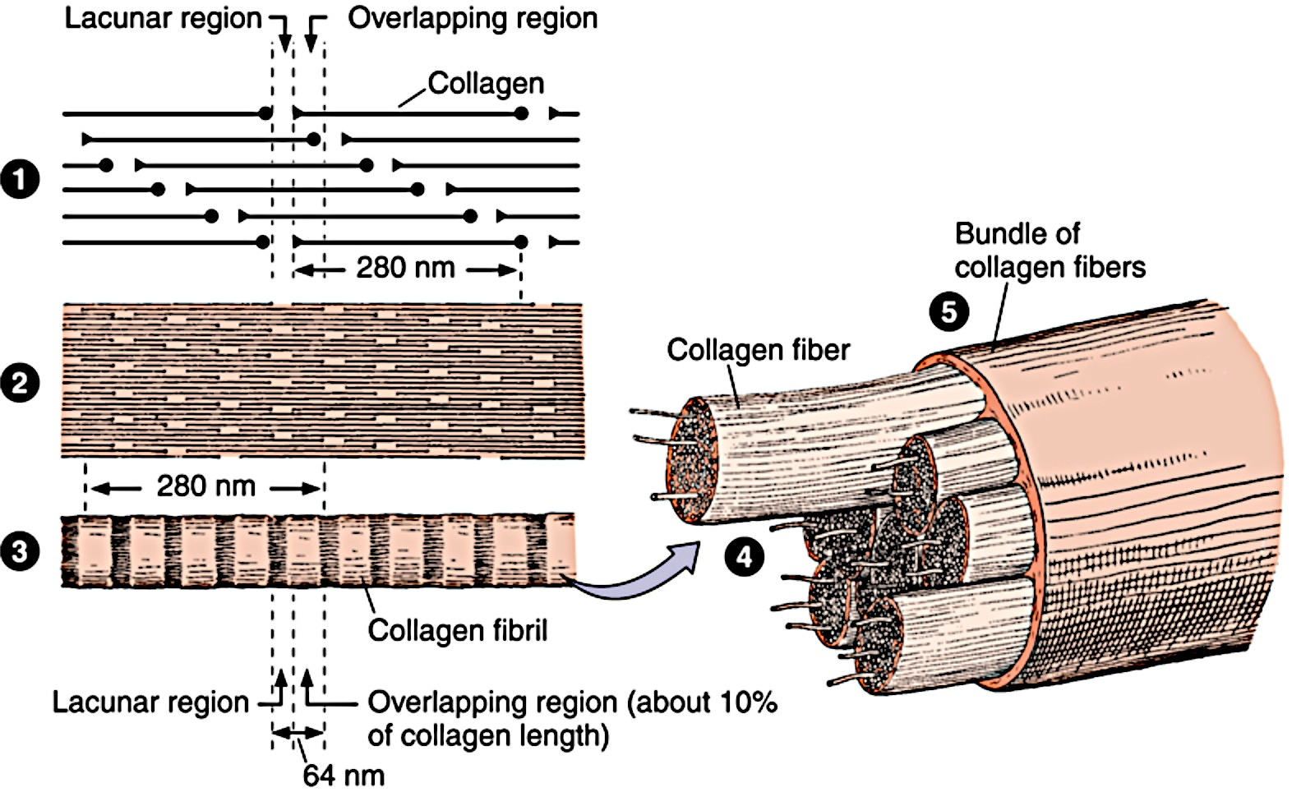
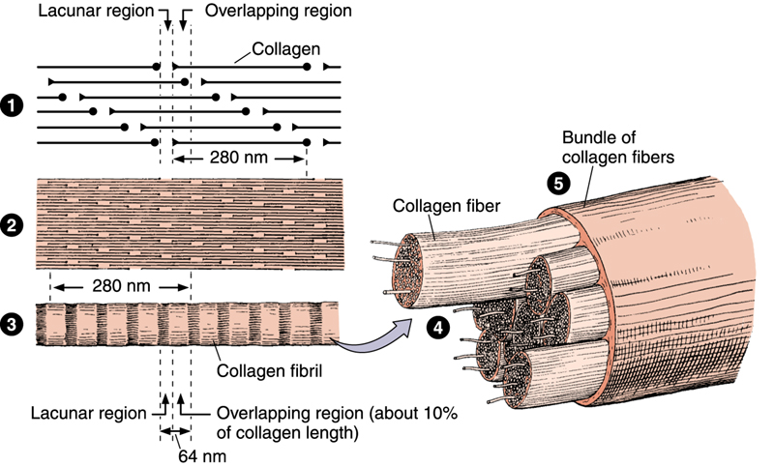

Structure of fibrillar collagen
collagen
molecules
Bundle of
collagen fibers
collagen fiber
collagen fibril

Slide 16
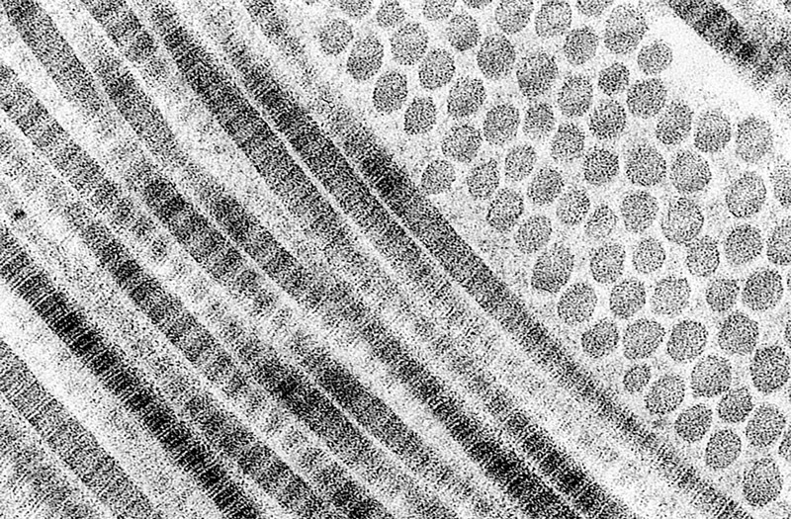
Collagen fibrils, longitudinal and in cross-section, by EM

Slide 17
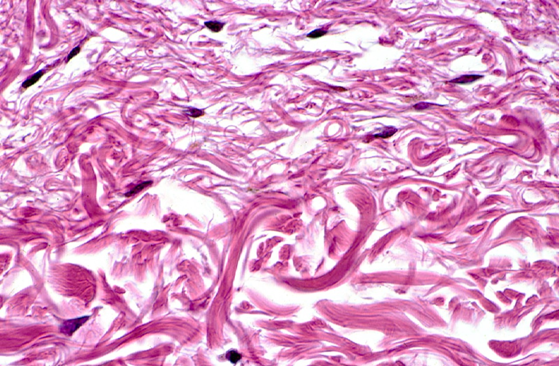
Type I collagen fibers and bundles

Slide 18
Type III collagen (reticular) fibers stained with silver.

Slide 19
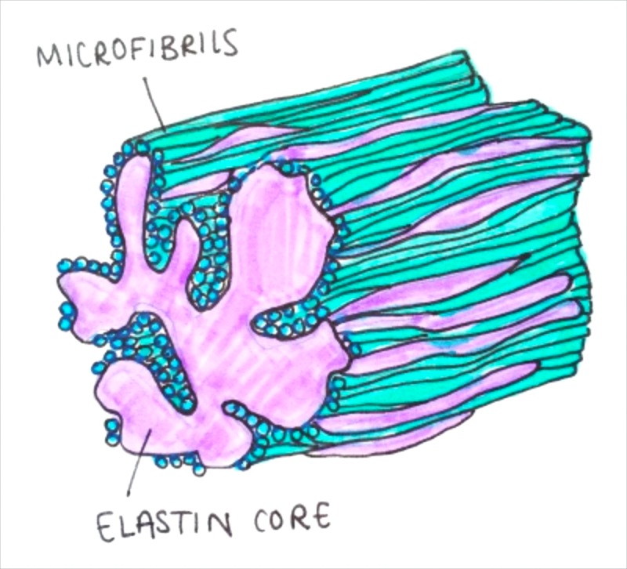
Elastic fibers are composed of an elastin core surrounded by microfibrils (composed of fibrillin)
Structure of elastic fibers

Slide 20
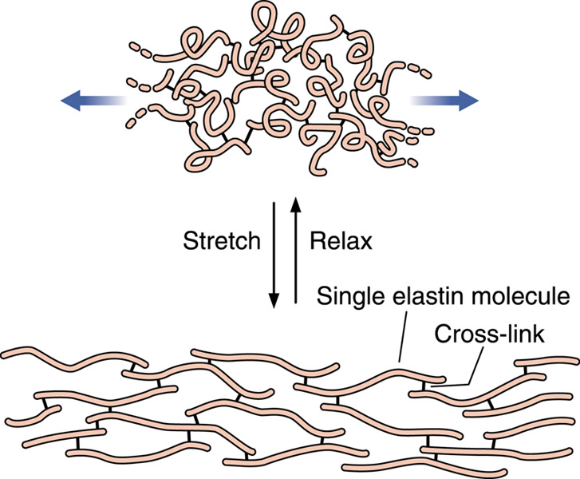
Elastin can expand and contract.

Slide 21
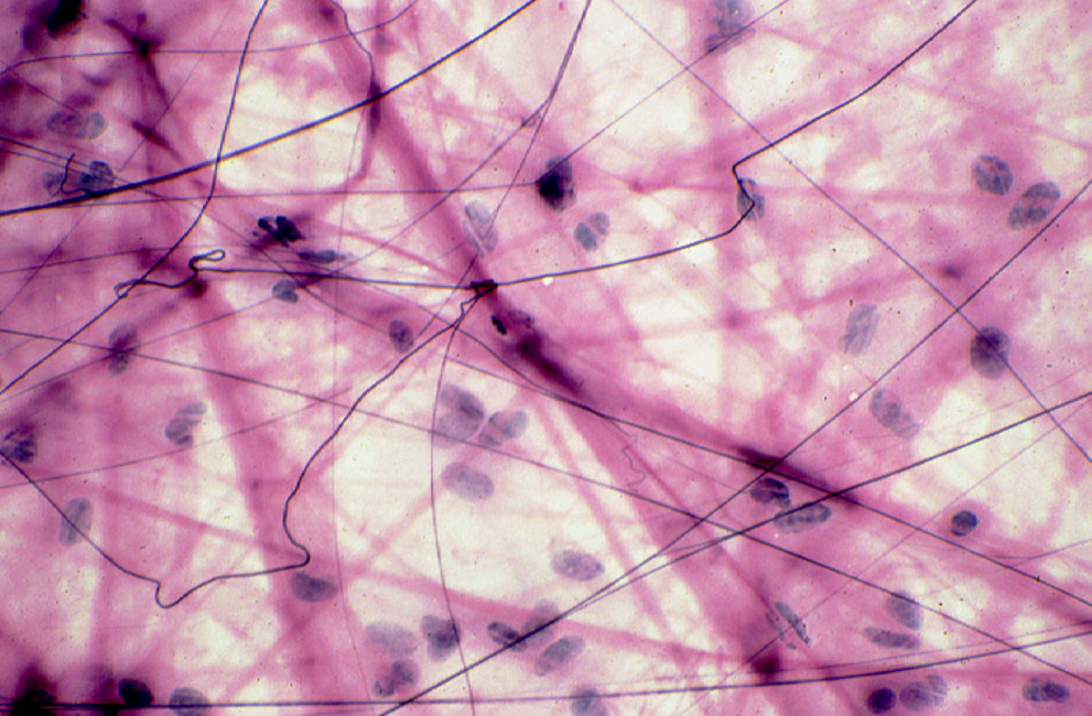
Elastic fibers

Slide 22
Ground substance
A viscous gel that fills spaces between cells and fibers in connective tissue.
Functions: binds water, fills space, acts as a barrier to infection, binds fibers and anchors cells to ECM.
Not well seen in histologic sections (looks clear).
Main constituents: glycosaminoglycans, proteoglycans, glycoproteins.

Slide 23
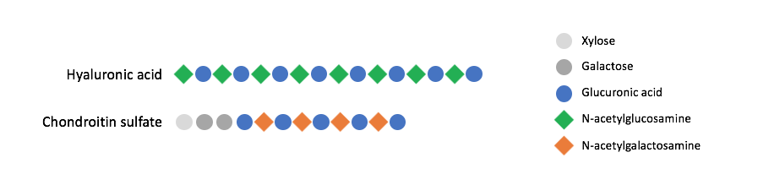
Glycosaminoglycans (GAGs) are just chains of disaccharides
(one plain sugar + one amino sugar).
Examples only! Don’t memorize.
Xylose
N-acetylglucosamine
Galactose
N-acetylgalactosamine
Glucuronic acid
There are two kinds of GAGs:
Hyaluronic acid
REALLY long, doesn’t need a core protein.
All the other GAGs (e.g., chondroitin sulfate)
Shorter, and always bound to a core protein.

Slide 24
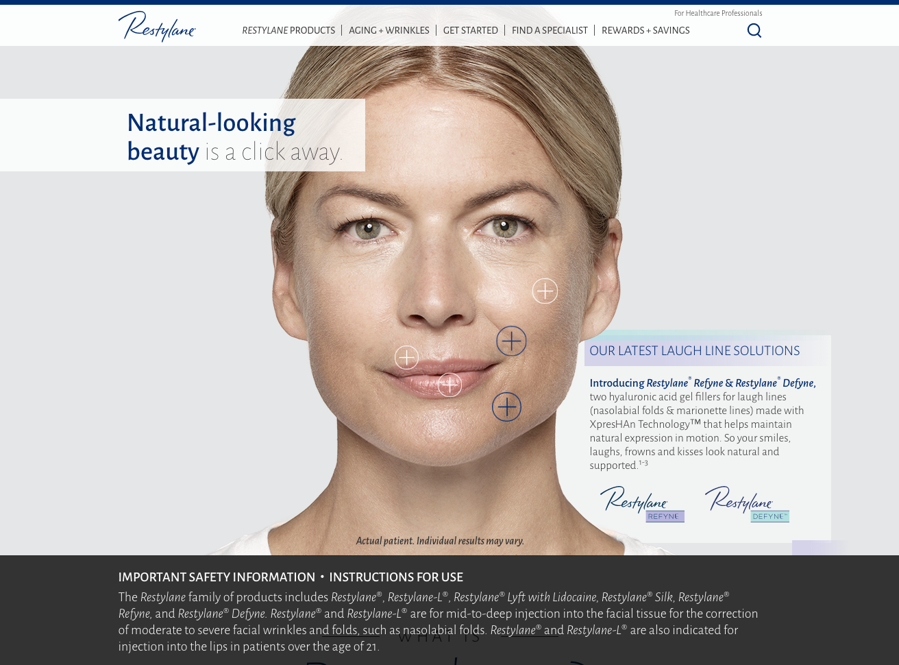

Slide 25
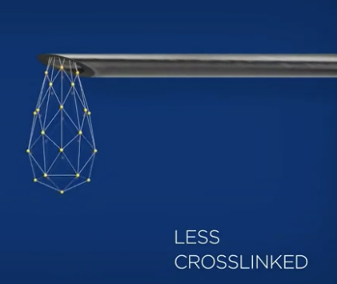
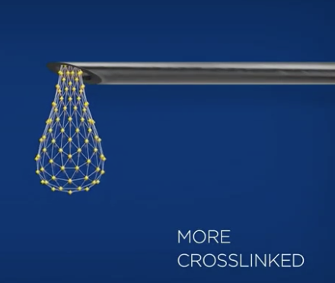
Restylane Refyne
Restylane Defyne

Slide 26
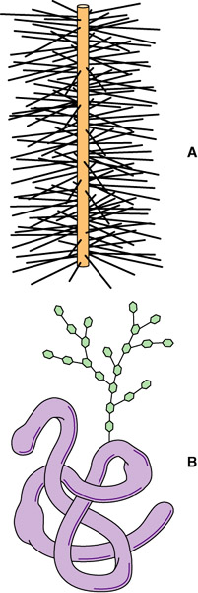
Proteoglycans consist of a protein core with a bunch of attached GAGs. They contain more carbohydrate than protein.
.
Glycoproteins are globular proteins with attached carbohydrates.
They contain more protein
than carbohydrate.

Slide 27
Connective Tissue Lecture Outline
Introduction
Extracellular matrix of connective tissue
Cells of connective tissue

Slide 28
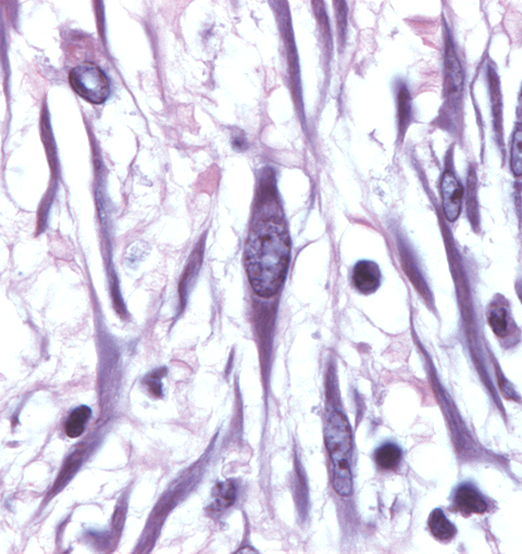
Fibroblasts are the most common cell in connective tissue. Super active: make collagen, elastin, ground substance.
Fibroblasts
Spindle-shaped
(long, with tapered ends)
and kind of boring

Slide 29
Connective Tissue Lecture Outline
Introduction
Extracellular matrix of connective tissue
Cells of connective tissue
Classification and examples of connective tissue

Slide 30
Classification of connective tissue proper
Connective Tissue
Specialized Connective Tissue
Supporting Connective Tissue
Connective Tissue Proper
Loose
Dense
Areolar
Reticular
Regular
Irregular

Slide 31
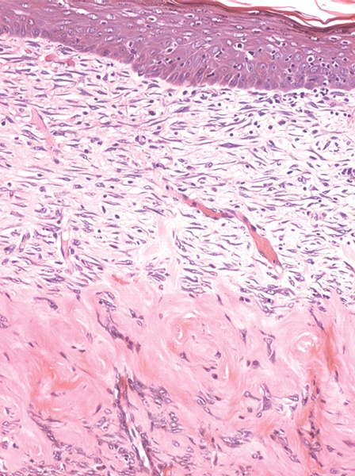
Connective Tissue Proper in a Nutshell
Epithelium
Loose connective tissue provides delicate support
Dense connective tissue resists stretching forces

Slide 32
The Four Types of Connective Tissue Proper
Type | Microscopic Appearance | Main Function | Main Locations
Dense regular | Thick, pink collagen bundles all parallel to each other. | Resists stretching forces in one direction. | Tendons, ligaments
Dense irregular | Thick, pink collagen bundles running in different directions. | Resists stretching forces in multiple directions. | Dermis, organ capsules
Loose areolar | Lots of ground substance with scattered cells and thin fibers. | Provides delicate support and cushioning. | Under epithelium, around blood vessels
Loose reticular | Delicate network of fine type III collagen (reticular) fibers. | Provides a flexible structural framework. | Lymph nodes, spleen, bone marrow

Slide 33
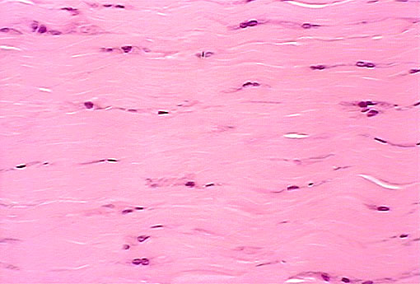
Bundles of collagen
Fibroblast
Ground substance
Dense regular connective tissue

Slide 34
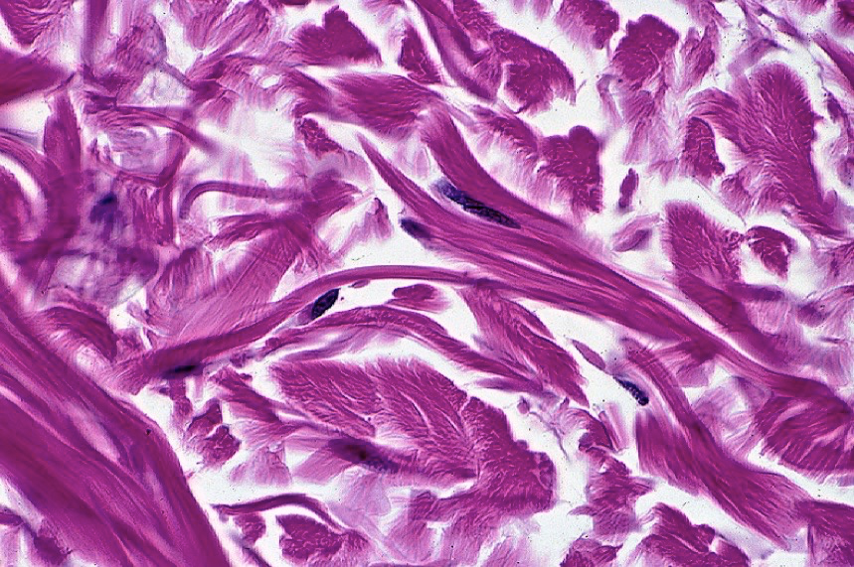
Dense irregular connective tissue
Bundles of collagen
Fibroblast
Ground substance

Slide 35
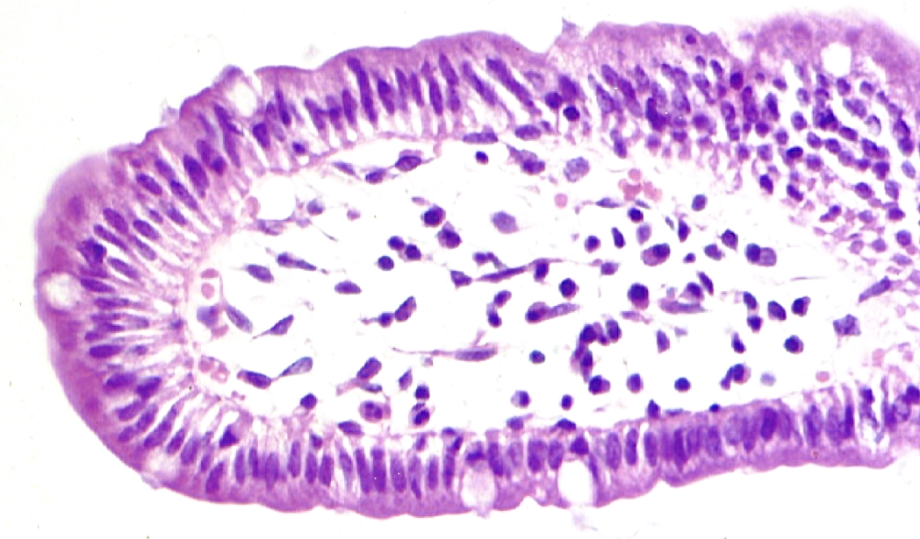
Loose areolar connective tissue
Simple columnar epithelium
Ground substance
Delicate collagen fiber
Fibroblast

Slide 36
Loose reticular connective tissue
Ground substance
Type III collagen (reticular) fibers

