Slide 1
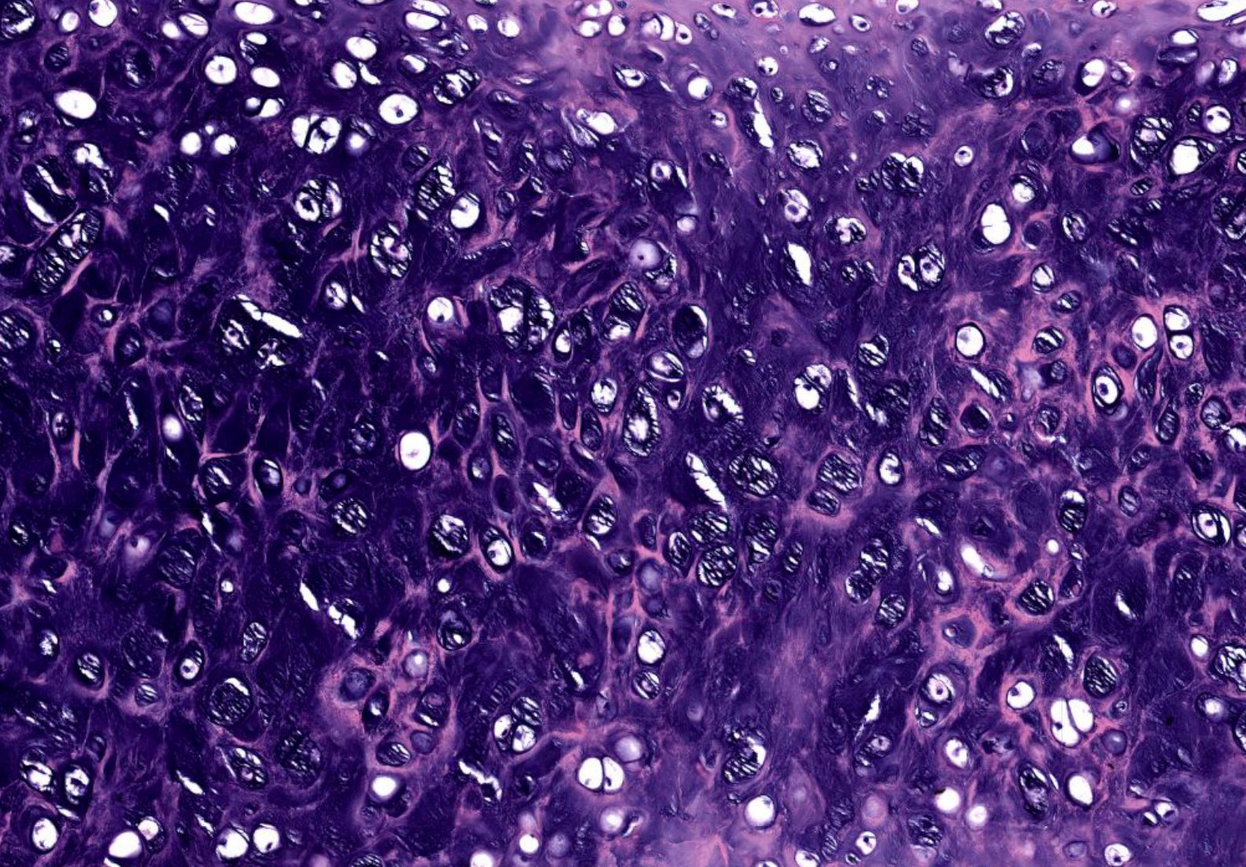
Cartilage and Bone
Kristine Krafts, M.D.

Slide 2
Cartilage and Bone Lecture Objectives
Describe the general functions of cartilage and bone.
Compare the function and composition of the three types of cartilage.
Describe the two methods of cartilage formation.
Describe the cells and extracellular matrix of bone.
Compare and contrast immature and mature bone.
Describe the two methods of bone formation.

Slide 3
Cartilage and Bone Lecture Outline
Cartilage
Function and characteristics of cartilage
Composition of cartilage
Three types of cartilage
Formation of cartilage
Bone
Function and characteristics of bone
Composition of bone
Two (okay, four) types of bone
Formation of bone

Slide 4
Cartilage and Bone Lecture Outline
Cartilage
Function and characteristics of cartilage

Slide 5
Functions and Characteristics of Cartilage
Cartilage is strong and sort of rigid but also flexible.
It can withstand force, but it can also bend.
It’s made of cells (chondroblasts and chondrocytes) and extracellular matrix.
Forms the supporting framework of some organs.
Lines the surface of articulating bones.
Forms the template for growth and development of long bones.

Slide 6
Cartilage and Bone Lecture Outline
Cartilage
Function and characteristics of cartilage
Composition of cartilage

Slide 7
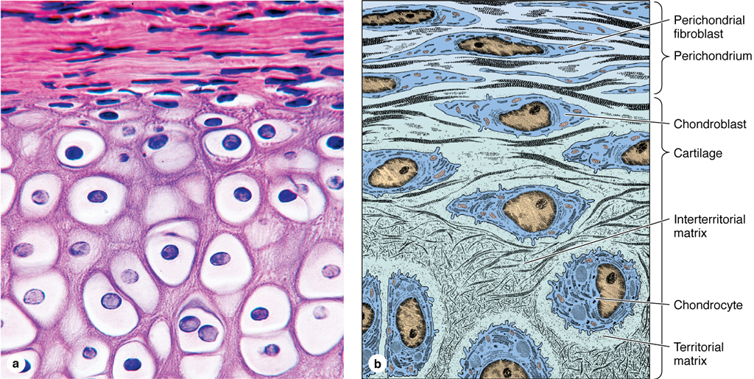
Cartilage Composition
Chondroblasts
Precursor cells that differentiate into chondrocytes.
Chondrocytes
Mature cartilage cells that lie in little artifactual lacunae.
Extracellular matrix:
Collagen and/or elastic fibers
Lots of GAGs and proteoglycans

Slide 8
Cartilage is avascular. So what?
Cartilage itself has no blood vessels or nerves in its extracellular matrix (bone is a different story).
Nutrients must diffuse from perichrondrium through extracellular matrix to chondrocytes.
This means metabolic activity is low, the width of cartilage is limited, and cartilage heals poorly.

Slide 9
Cartilage and Bone Lecture Outline
Cartilage
Function and characteristics of cartilage
Composition of cartilage
Three types of cartilage

Slide 10
The fibers of the extracellular matrix determine the type of cartilage.
Hyaline cartilage | Type II collagen fibers
Elastic cartilage | Type II collagen fibers and elastic fibers
Fibrocartilage | Type I collagen fibers

Slide 11
Three Types of Cartilage
Hyaline cartilage
Most common.
Articular surfaces of joints, large respiratory passages, and epiphyseal plate.
Functions: support soft tissue, line joints, aid in growth of long bones.

Slide 12
Hyaline Cartilage: Histologic Features
Chondroblasts
Extracellular matrix
Chondrocytes

Slide 13
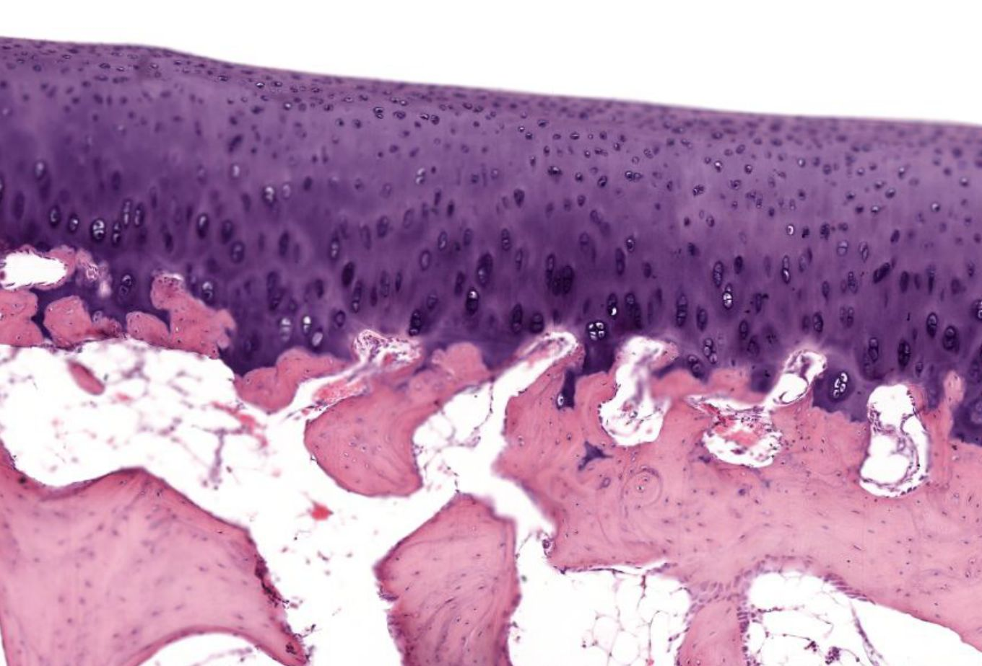
Hyaline articular cartilage

Slide 14
Three Types of Cartilage
Hyaline cartilage
Elastic cartilage
Located in areas that are pliable and flexible
External ear, eustachian tube, epiglottis

Slide 15
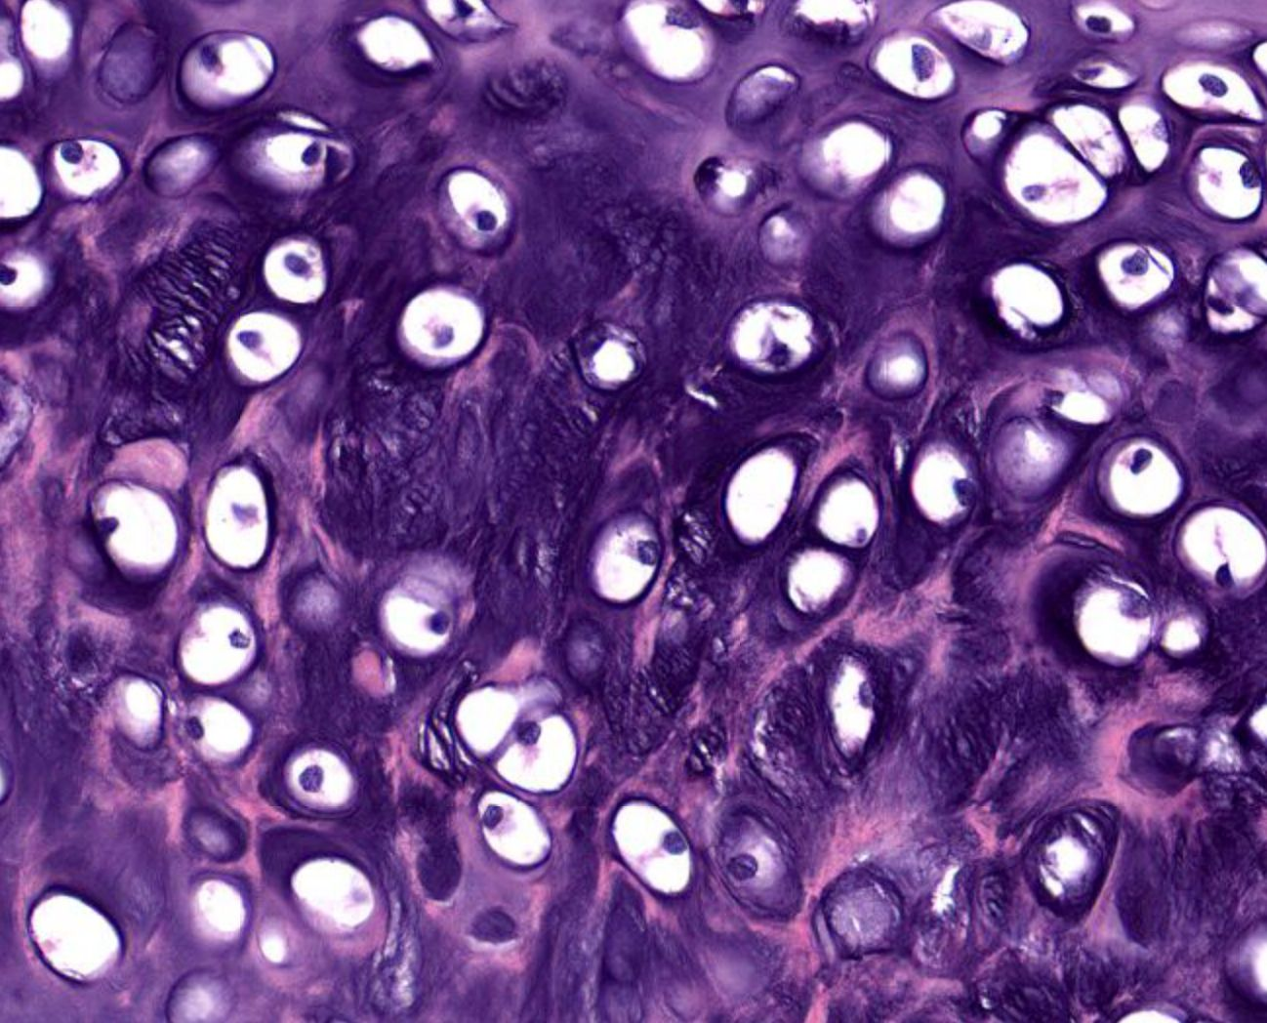
Elastic cartilage: chondrocytes and matrix

Slide 16
Three Types of Cartilage
Hyaline cartilage
Elastic cartilage
Fibrocartilage
Located in areas subjected to pulling forces
Intervertebral discs, pubic symphysis

Slide 17
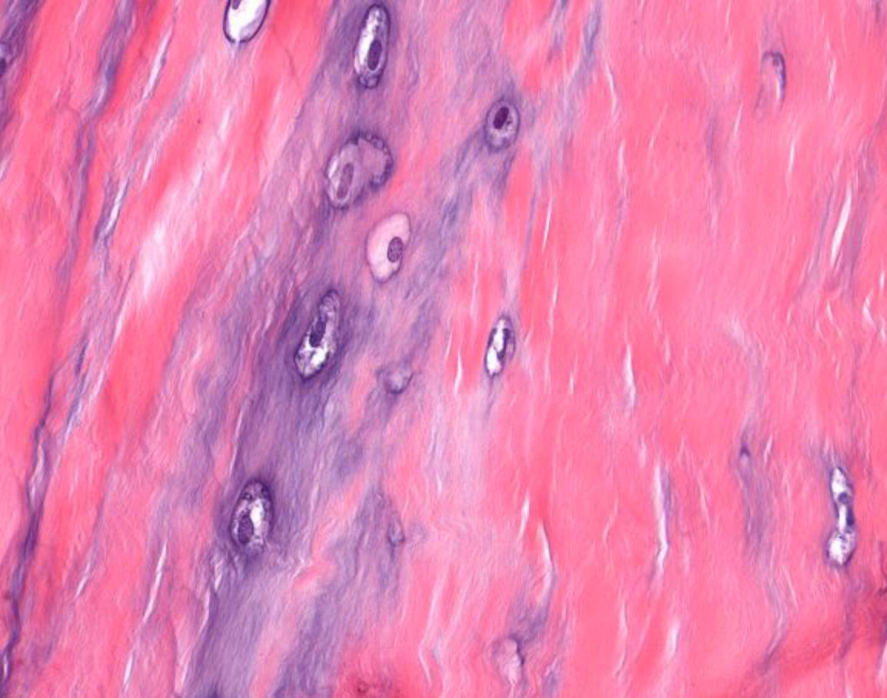
Fibrocartilage: chondrocytes and matrix

Slide 18
Cartilage and Bone Lecture Outline
Cartilage
Function and characteristics of cartilage
Composition of cartilage
Three types of cartilage
Formation of cartilage

Slide 19
Two Methods of Cartilage Formation
Interstitial growth
Growth from within cartilage.
Chondrocytes divide and secrete matrix.
Appositional growth
Growth along the outside of cartilage. Chondroblasts secrete matrix and differentiate into chondrocytes.

Slide 20
Cartilage and Bone Lecture Outline
Cartilage
Function and characteristics of cartilage
Composition of cartilage
Three types of cartilage
Formation of cartilage
Bone
Function and characteristics of bone

Slide 21
Functions of Bone
Supports and protects soft tissues
Attaches to muscles for movement
In some places, it houses bone marrow (where blood cells are produced)
Stores and releases calcium, phosphate and other ions

Slide 22
Characteristics of Bone
Bone is highly vascularized and very metabolically active.
Bone remodels (turns over) constantly throughout life. Ideally, bone removal occurs at same rate as bone production.
Inhibition of bone turnover leads to poor quality, unhealthy bone.

Slide 23
Cartilage and Bone Lecture Outline
Cartilage
Function and characteristics of cartilage
Composition of cartilage
Three types of cartilage
Formation of cartilage
Bone
Function and characteristics of bone
Composition of bone

Slide 24
Composition of Bone
Cells
Osteoblasts: produce bone matrix
Osteocytes: lie in lacunae
Osteoclasts: resorb bone
Extracellular matrix
Two parts: organic part and inorganic part.
Organic part (“osteoid”) consists of
type I collagen fibers and ground substance
Inorganic part consists of hydroxyapatite crystals: Ca₁₀(PO₄)₆(OH)₂

Slide 25
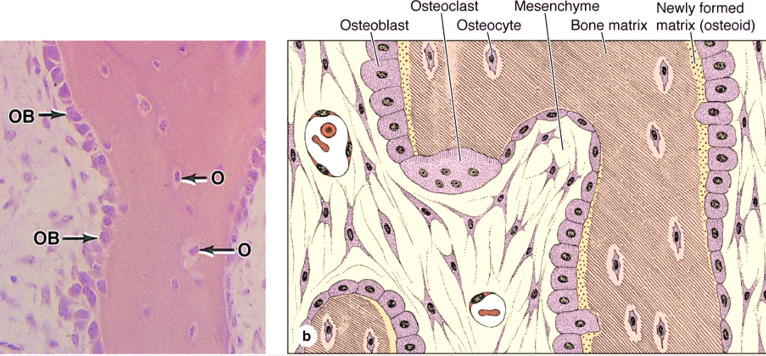
Osteoblasts
Found along edge of bone, with osteoid underneath.
Active osteoblasts are cuboidal-columnar; inactive osteoblasts are more flattened.

Slide 26
Osteoblast Functions
Make bone!
Produce organic part of matrix, then deposit inorganic part.
Bone formation promoted by testosterone, estrogen, growth hormone, weight-bearing exercise and muscle use.

Slide 27
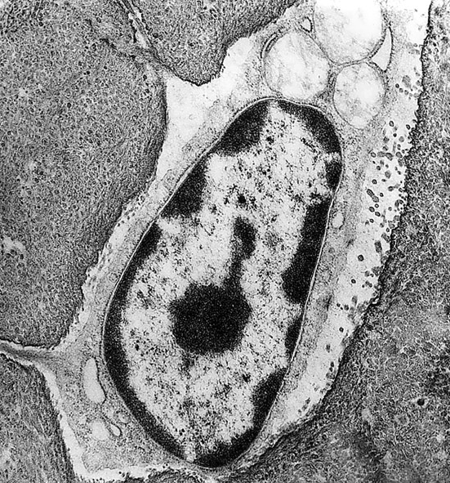
Osteocytes
Osteocytes are involved in maintenance of bone matrix. Their death results in resorption of matrix.
Each osteocyte sits in its own lacuna.
Osteocytes have small, dark, flattened nuclei with minimal rough ER and Golgi.

Slide 28
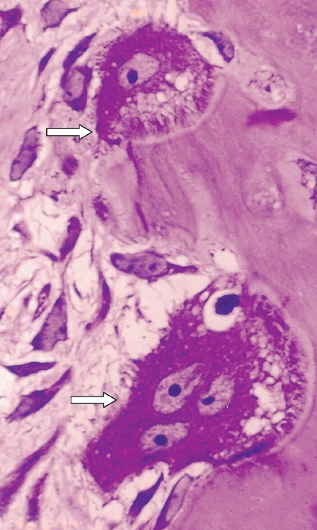



Osteoclasts
Ruffled border
Multinucleated giant cells (20-100 μm). Lie in Howship’s lacunae.
Arise from fusion of blood monocytes.
Numerous lysosomes.
Actively resorbing osteoclasts adjacent to bone have cytoplasmic membrane branching (“ruffled border”).
Howship’s lacunae
Lysosomes

Slide 29
Cartilage and Bone Lecture Outline
Cartilage
Function and characteristics of cartilage
Composition of cartilage
Three types of cartilage
Formation of cartilage
Bone
Function and characteristics of bone
Composition of bone
Two (okay, four) types of bone

Slide 30
Two Gross Types of Bone
Compact bone
Very dense, solid structure.
Spongy bone
Open, loose structure.

Slide 31
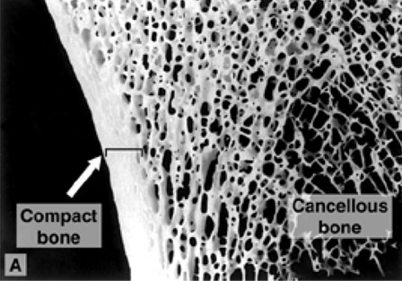
Compact Bone and Spongy Bone
Spongy
bone
Compact bone

Slide 32
Two Microscopic Types of Bone
Immature (primary, woven) bone
The first bone laid down. Formed quickly. Later replaced by mature bone.

Slide 33
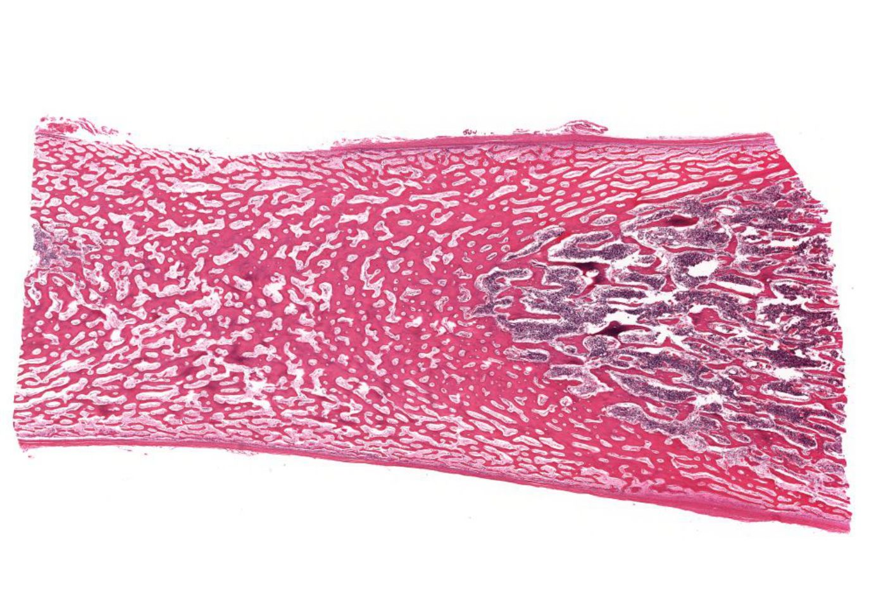
Immature bone: super low-power view
Notes:
Example of a developing bone before replacement of woven immature (or primary) bone with mature (or secondary) bone.

Slide 34
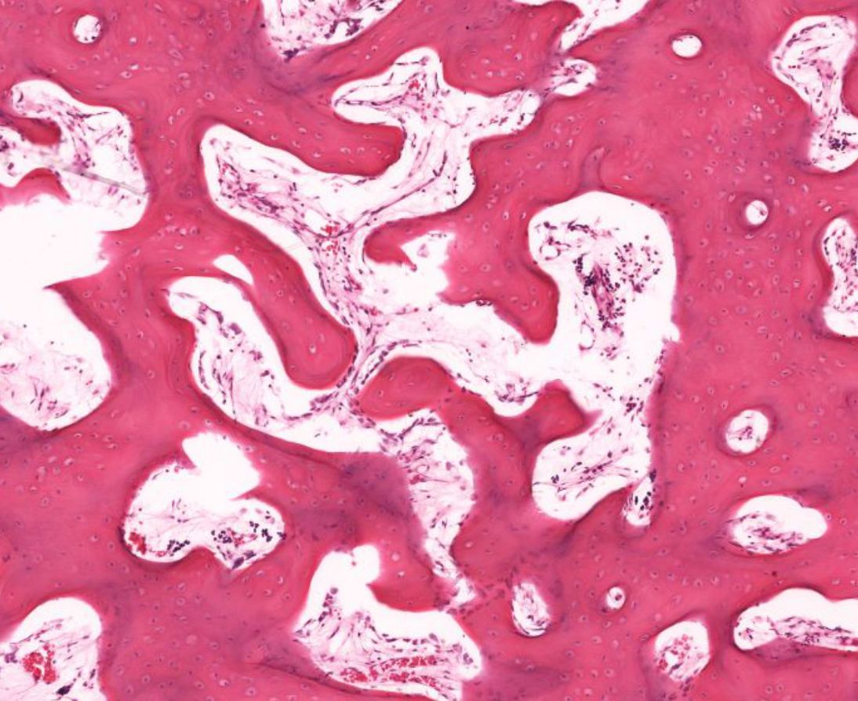
Immature bone: high-power view

Slide 35
Two Microscopic Types of Bone
Immature (primary, woven) bone
The first bone laid down. Formed quickly. Later replaced by mature bone.
Mature (secondary, lamellar) bone
Arranged in osteons: layers (lamellae) of bone around little canals.

Slide 36
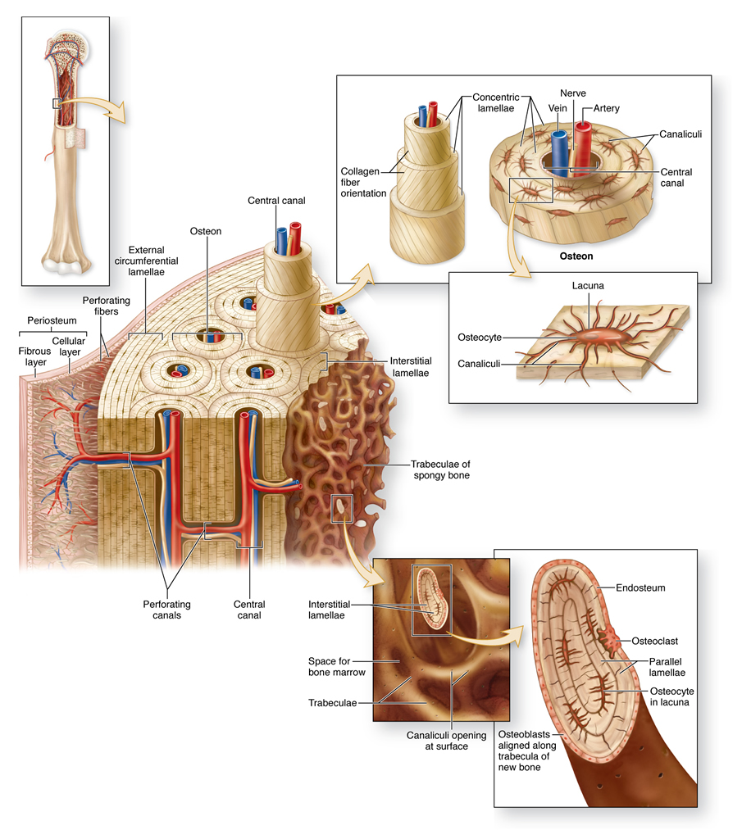

Slide 37
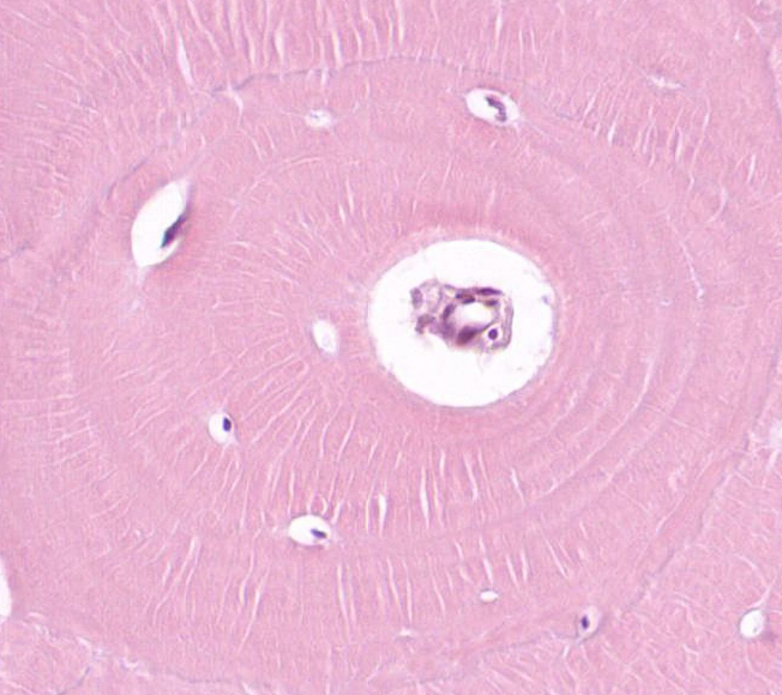
Osteon
Central (Haversian) canal
Osteocytes
Lamellae

Slide 38
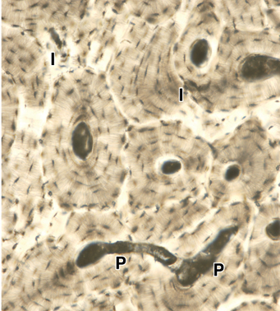
Volkmann (perforating) canals connect osteons

Slide 39
Periosteum and Endosteum
Periosteum lines the outer surface of compact bone.
  Two layers: outer dense connective tissue layer and inner layer of osteoprogenitor cells.
  Collagen fibers tightly attach the periosteum to the bone matrix.
  Contains blood vessels for nutrition of bone.
  Contains osteoblasts for bone growth, repair and remodeling.

Slide 40
central
canal
osteon
external
lamellae
collagen
fibers
Periosteum
inner layer
outer layer
interstitial
lamellae
trabeculae of
spongy bone

Slide 41
Periosteum and Endosteum
Periosteum lines the outer surface of compact bone.
Endosteum lines the inner surface of compact bone.
  Also lines the surface of bony trabeculae of spongy bone, and the Haversian canals.
  Contains osteoblasts for bone growth, repair
  and remodeling.

Slide 42
Endosteum

Slide 43
Cartilage and Bone Lecture Outline
Cartilage
Function and characteristics of cartilage
Composition of cartilage
Three types of cartilage
Formation of cartilage
Bone
Function and characteristics of bone
Composition of bone
Two types of bone
Formation of bone

Slide 44
Bone Development (Osteogenesis)
Bone can be formed in two ways:
Intramembranous ossification
Occurs in flat bones (most of skull, including maxilla and mandible).
Endochondral ossification
Occurs in long bones and irregular bones.

Slide 45
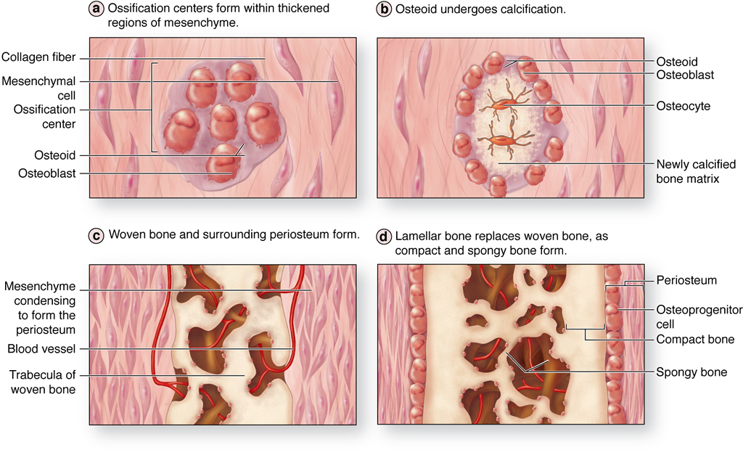
Intramembranous Ossification

Slide 46
Intramembranous Ossification

Slide 47
Intramembranous Ossification

Slide 48
Intramembranous Ossification

Slide 49
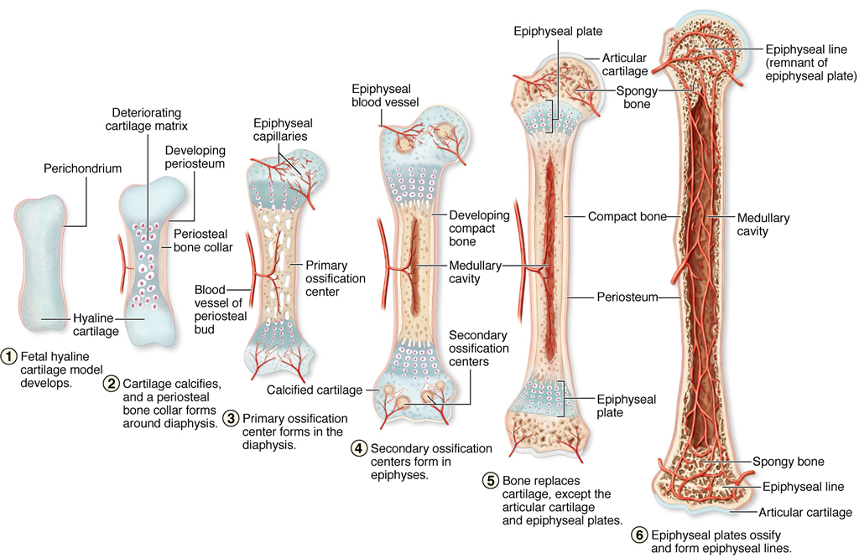
Endochondral Ossification

Slide 50
Endochondral Ossification
Notes:
This is the primary ossification center.
Secondary ossification centers start in the epiphyses
This defines the beginning of the epiphyseal plate

Slide 51
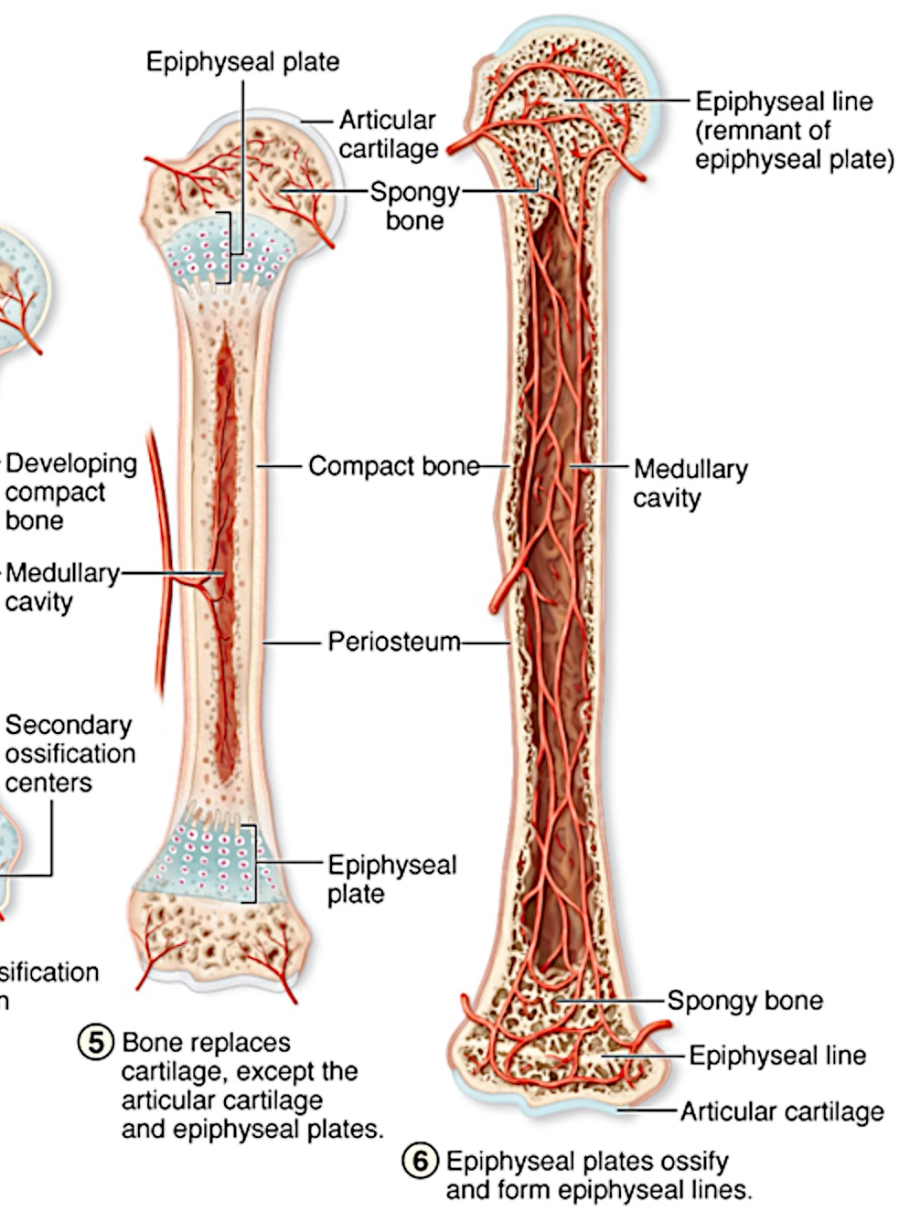
Endochondral Ossification
Epiphysis: the end of a long bone. Consists primarily of spongy bone, with a layer of compact bone on the outside.
Diaphysis: the shaft of a long bone. Consists of compact bone on the outside and a marrow cavity inside.

Slide 52
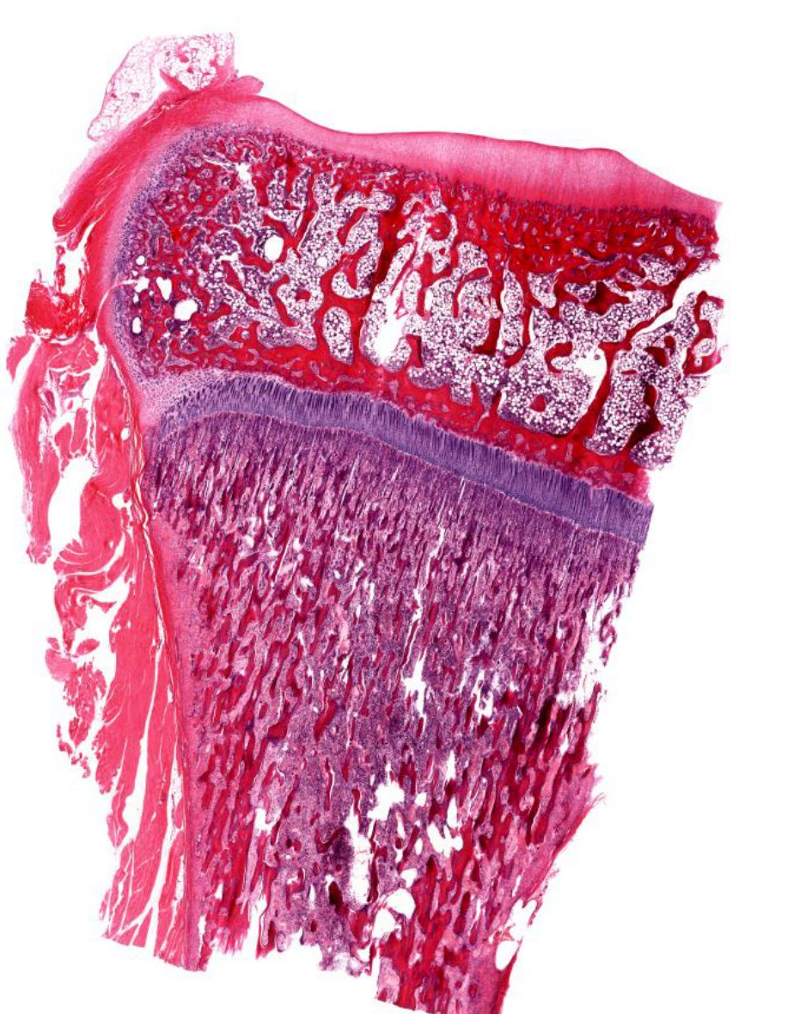
Endochondral bone formation: super low-power view

Slide 53
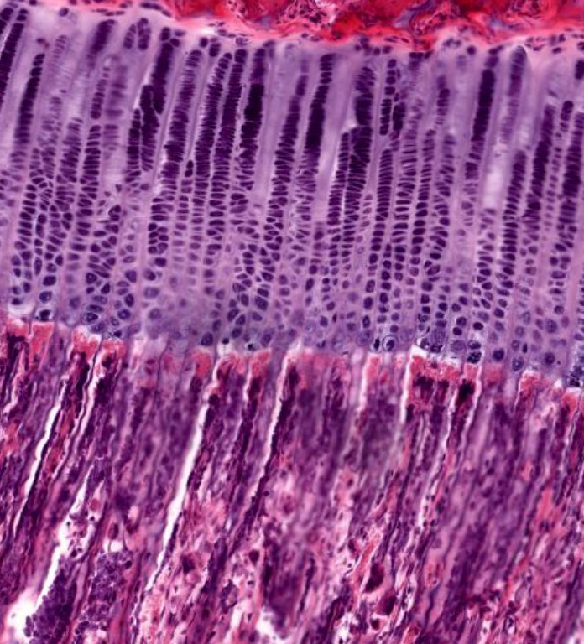
Epiphyseal plate: zones of maturation

Slide 54
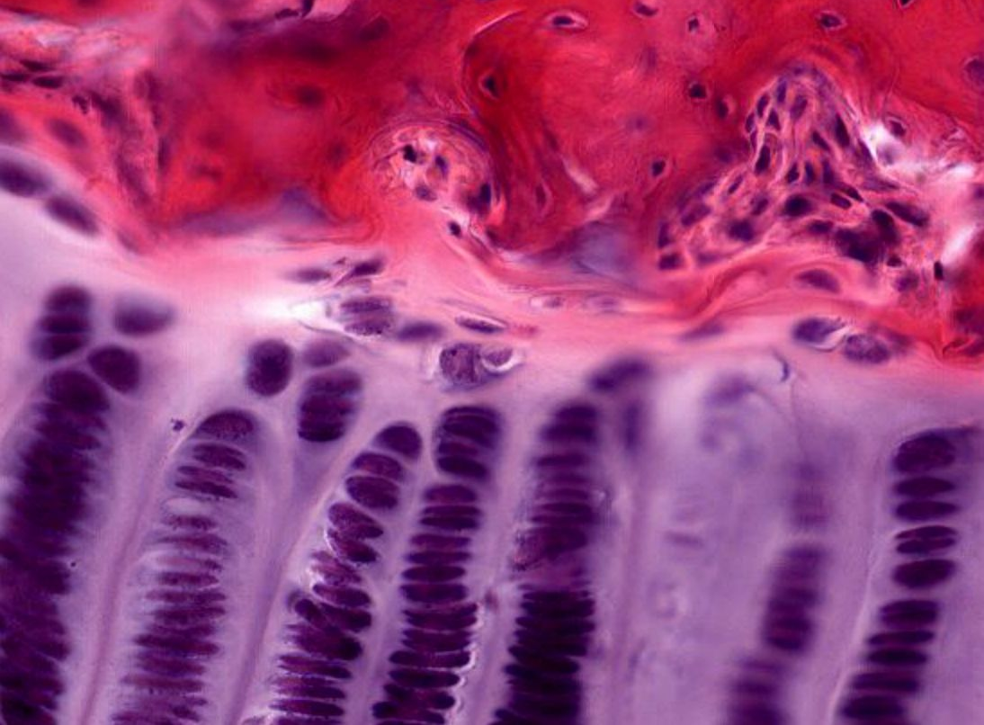
Resting zone

Slide 55
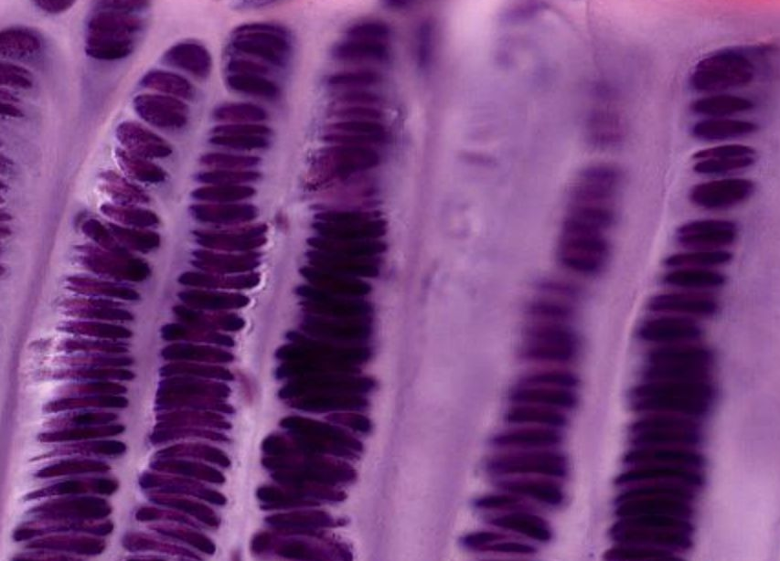
Proliferative zone

Slide 56
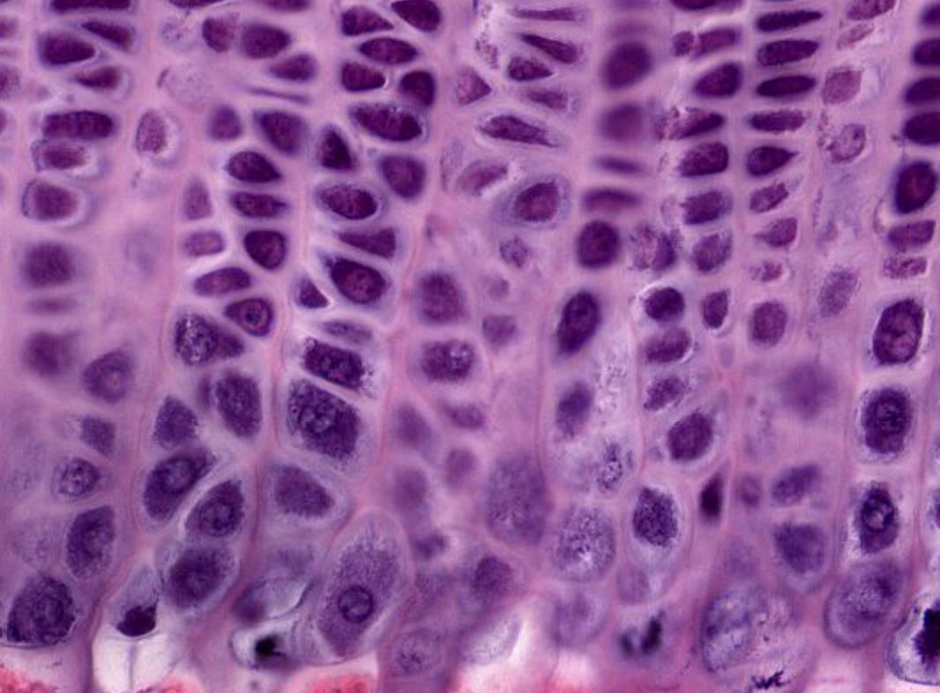
Zone of hypertrophy

Slide 57
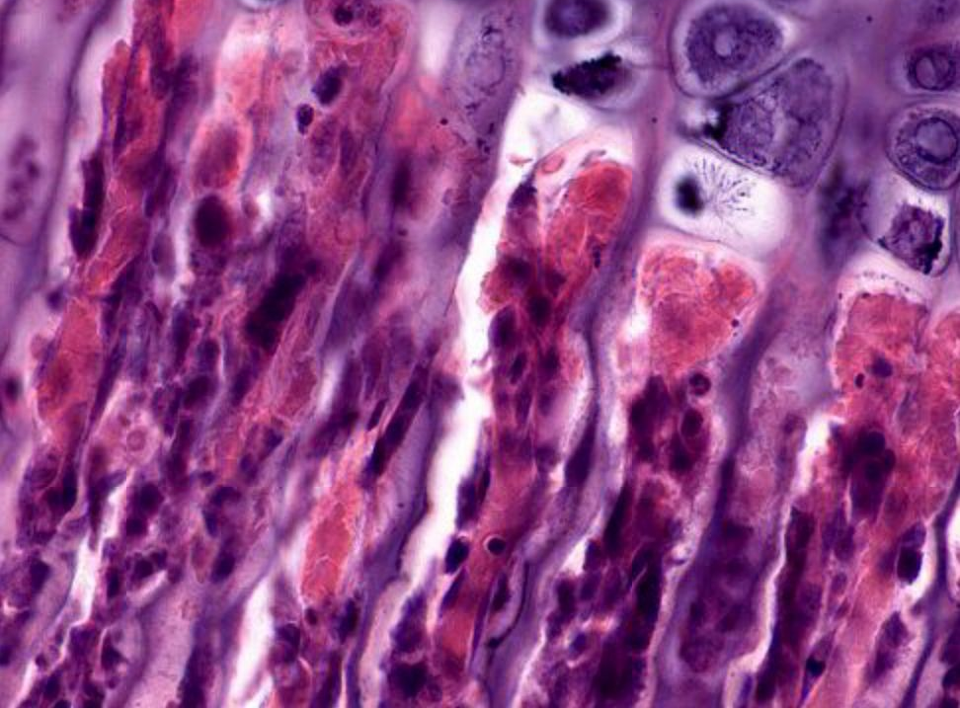
Zone of calcification

Slide 58
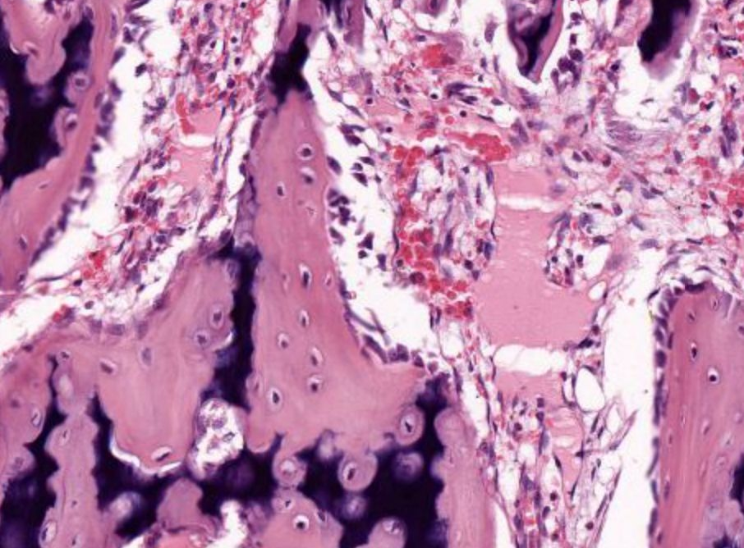
Zone of ossification

Slide 59
Cartilage and Bone Lecture Outline
Cartilage
Function and characteristics of cartilage
Composition of cartilage
Three types of cartilage
Formation of cartilage
Bone
Function and characteristics of bone
Composition of bone
Two types of bone
Formation of bone

