Slide 1
Male Reproductive System
Kristine Krafts, M.D.

Slide 2
Male Reproductive System Objectives
Describe and compare the characteristic microscopic features and functions of the following components of the male reproductive system:
  Testes
  Genital ducts, including straight tubules, rete testis, efferent ductules, epididymis, ductus deferens and urethra
  Accessory genital glands, including seminal vesicle and prostate gland
  Penis

Slide 3
Male Reproductive System Objectives
Discuss and compare the characteristic microscopic features of the following cells of the male reproductive system: spermatogonia, primary and secondary spermatocytes, spermatids, spermatocytes, Sertoli cells, Leydig cells.
Trace the path of sperm, in order, from seminiferous tubules to penile urethra.
Discuss how the sperm fertilizes the egg.

Slide 4
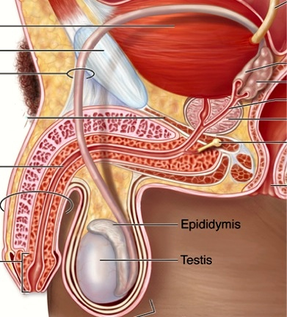
The Male Reproductive System
Ureter
Ductus of vas deferens
Ampulla of vas deferens
Seminal vesicle
Ejaculatory duct
Prostate
Bulbourethral gland
Penis
Urethra

Slide 5
Male Reproductive System Lecture Outline
Testis
Genital ducts
Accessory genital glands
Penis

Slide 6
Male Reproductive System Lecture Outline
Testis

Slide 7
Components of the Testis
Tunica albuginea: thick capsule of dense connective tissue surrounding each testis
Mediastinum testis: thickening of posterior part of tunica albuginea
Seminiferous tubules: series of long tubules in which sperm are produced and mature
Interstitial connective tissue: loose connective tissue that surrounds seminiferous tubules and contains blood, lymphatics and interstitial cells of Leydig

Slide 8
Testis

Slide 9
Seminiferous tubules

Slide 10
Seminiferous tubule

Slide 11
Spermatogenesis
Spermatogonia: small, round stem cells located next to basal lamina.
Primary spermatocytes: larger, located more towards lumen.
Secondary spermatocytes: short-lived; hard to see.
Spermatids: Close to lumen. Sperm precursors.

Slide 12
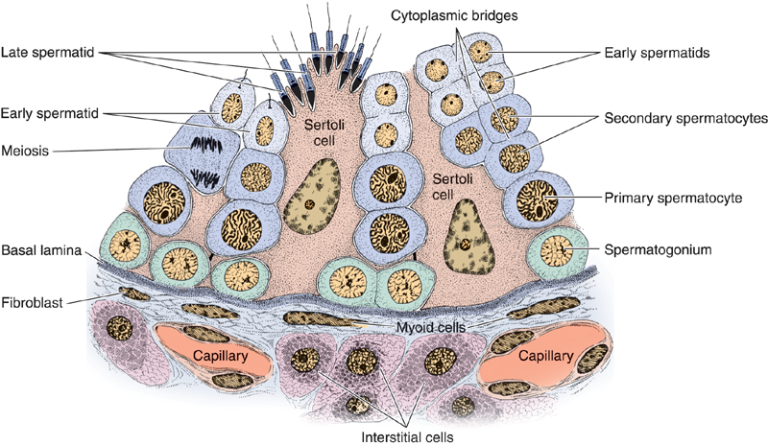
Seminiferous Tubule and Epithelium

Slide 13
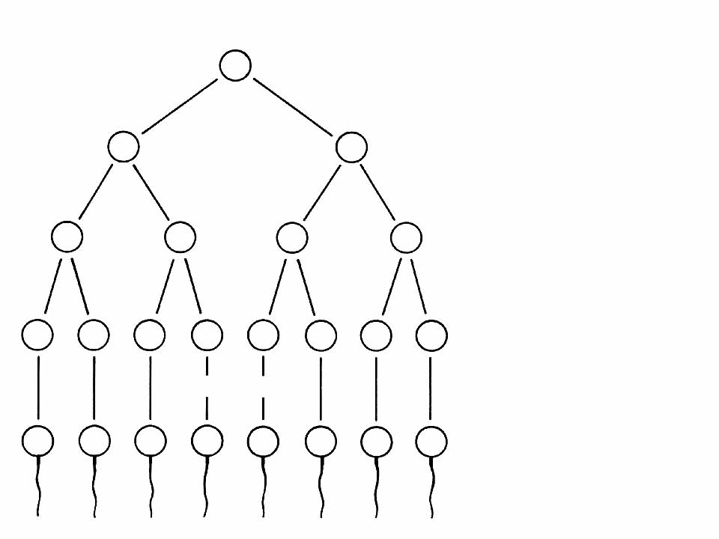
Father
XY
Spermatogonia
(44 + X + Y) = 46
XY
XY
Primary spermatocytes
(44 + X + Y) = 46
Meiosis I
X
Y
X
Y
Secondary spermatocytes
(22 + X; or 22 + Y) = 23
Meiosis II
X
X
Y
Y
X
X
Y
Y
Spermatids
(22 + X; or 22 + Y) = 23
Maturation
X
X
Y
Y
X
X
Y
Y
Spermatozoa
(22 + X; or 22 + Y) = 23

Slide 14
Spermatogenesis
Spermatogonium
Primitive germ cell next to basal lamina.
Primary spermatocytes
More mature.
Very large; dark nuclei.
Spermatids
Soon-to-be sperm.

Slide 15
Interstitial Cells of Leydig
In connective tissue between seminiferous tubules.
Usually present in clusters.
Produce testosterone.

Slide 16
Leydig cells

Slide 17
Sertoli Cells
Form tight junctions: “blood-testis barrier.”
Provide support, protection, and nutrition for developing sperm.
Produce fluid in lumen of seminiferous tubules.
Secrete hormones that facilitate spermatogenesis.

Slide 18
Sertoli cells

Slide 19
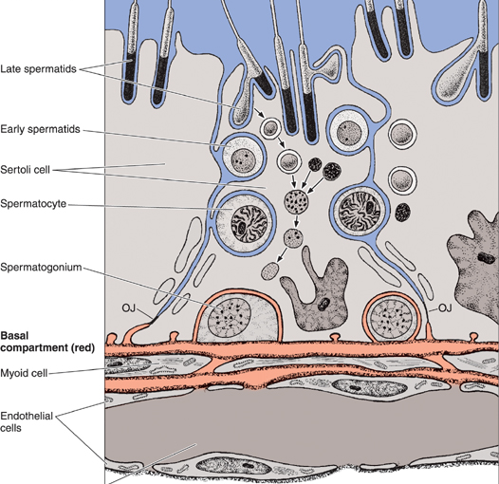
Sertoli cells form the blood-testis barrier

Slide 20
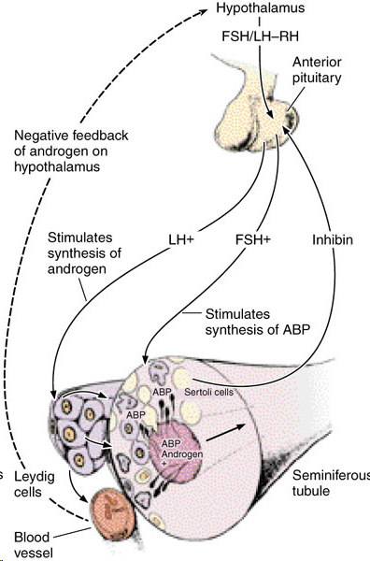
Pituitary control of spermatogenesis
FSH stimulates Sertoli cells to secrete ABP
LH stimulates Leydig cells to secrete androgen (testosterone)
Inhibin (from Sertoli cells) inhibits FSH
Androgen (from Leydig cells) inhibits LH

Slide 21
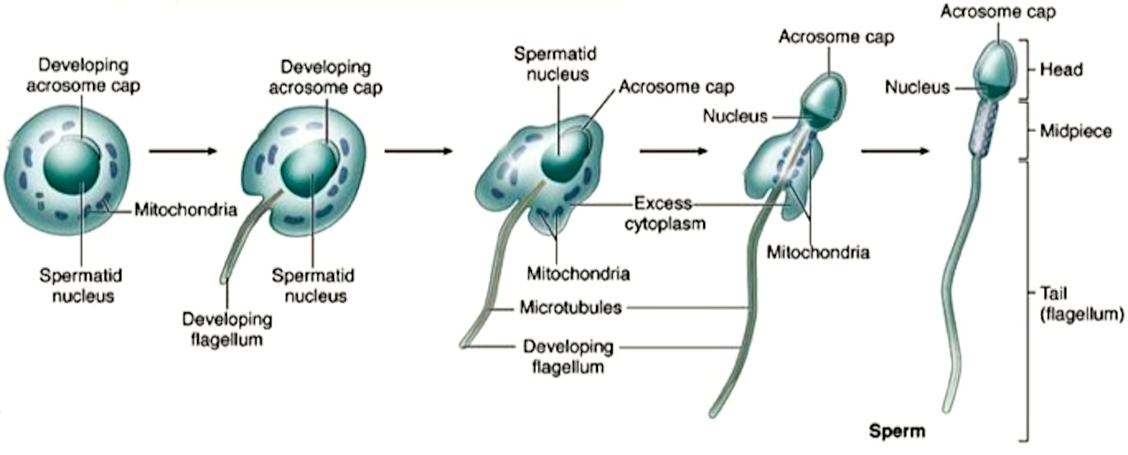
Spermatid maturing into sperm
Note the flattening of the nucleus, formation of acrosome, growth of flagellum, reorganization of mitochondria in midpiece & shedding of residual cytoplasm.

Slide 22
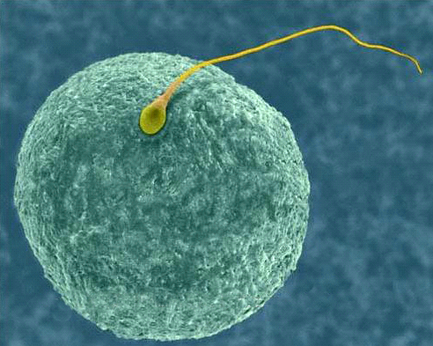
Human egg (oocyte) and sperm (spermatozoon)

Slide 23
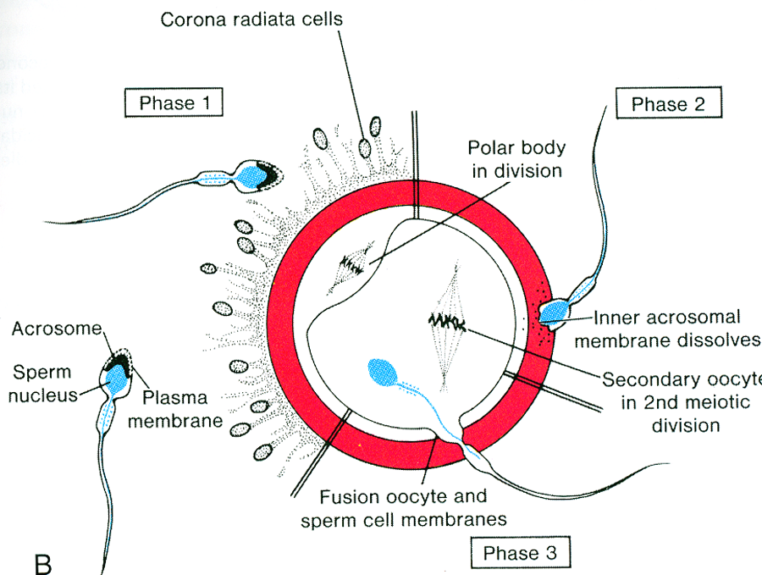
Fertilization
The acrosome contains hydrolytic enzymes.
During fertilization the acrosomal reaction causes dissociation of cells of corona radiata and digestion of zona pellucida surrounding the oocyte. oocyte.

Slide 24
Male Reproductive System Lecture Outline
Testis
Genital ducts
  Intratesticular ducts
  Excretory genital ducts

Slide 25
Male Reproductive System Lecture Outline
Testis
Genital ducts
  Intratesticular ducts
    Straight tubules
    Rete testis
    Efferent ductules

Slide 26
The Path of Sperm
Seminiferous tubules
Straight tubules
Rete testes
Efferent ductules
Epididymis
Ductus (vas) deferens
Ejaculatory duct
Prostatic urethra

Slide 27
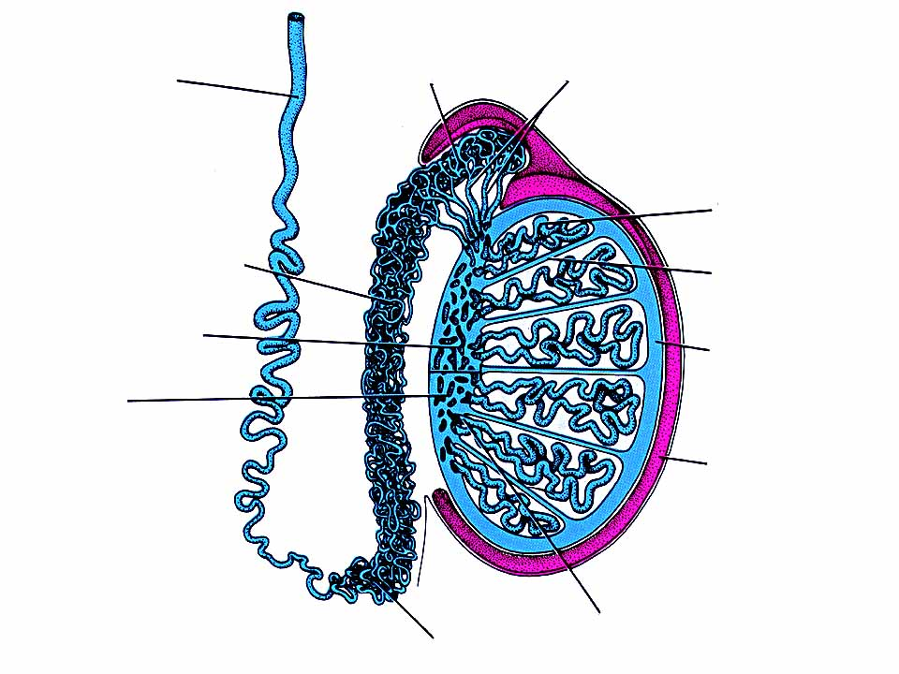
Head of the
epididymis
Ductuli efferentes
Ductus deferens
Seminiferous tubule
Body of the epididymis
Septum
Mediastinum testis
Tunica albuginea
Rete testis
Tunica vaginalis
Tail of the
epididymis
Tubuli recti

Slide 28
Rete testis
Straight tubule
Seminiferous tubule
Mediastinum testis

Slide 29
Lined by Sertoli cells and cuboidal epithelium
Straight tubules

Slide 30
Lined by cuboidal epithelium
Rete testis

Slide 31
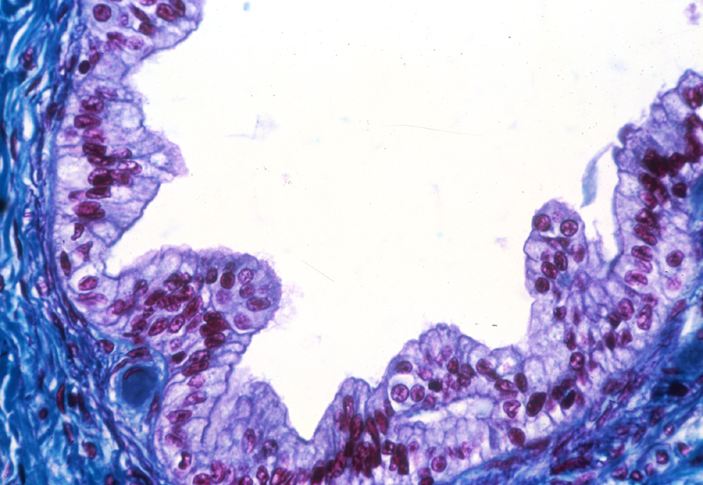
Non-ciliated cells absorb fluid
Ciliated cells sweep sperm towards epididymis
Efferent ductule

Slide 32
Male Reproductive System Lecture Outline
Testis
Genital ducts
  Intratesticular ducts
  Excretory genital ducts
    Ducts of the epididymis
    Ductus (vas) deferens
    Urethra

Slide 33
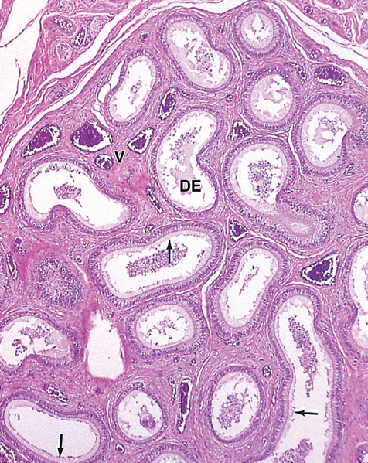
Highly coiled tube 4-6 meters long.
Sperm undergo final maturation here.
Epithelium lined by pseudostratified columnar epithelium with long stereocilia (microvilli) which absorb fluid.
Epididymis

Slide 34
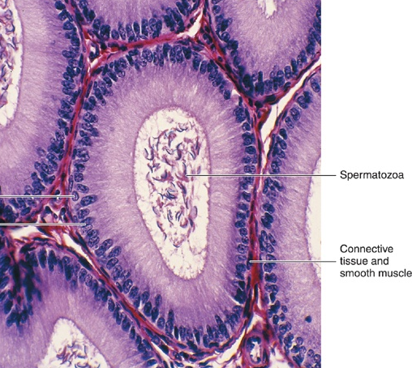
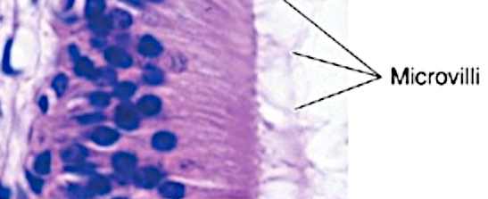
Microvilli
Spermatozoa
Smooth muscle
(causes peristalsis and movement of sperm)
Epididymis

Slide 35
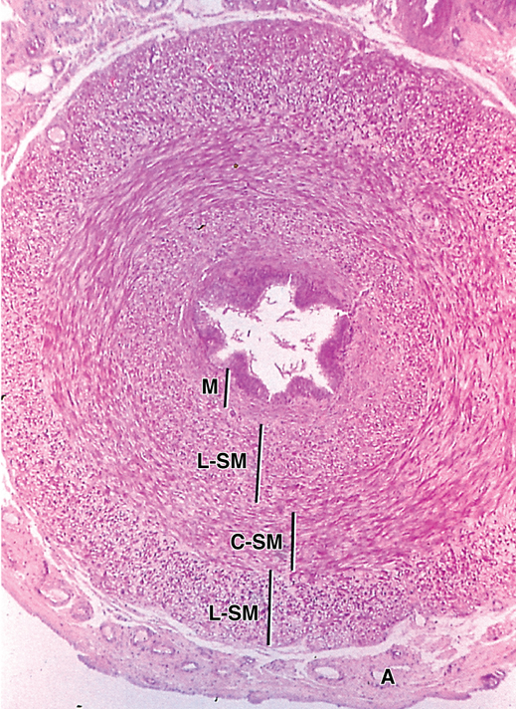
Mucosa (with pseudostratified columnar epithelium)
Longitudinal layer of smooth muscle
Circular layer of
smooth muscle
Check out the relative thickness of the smooth muscle wall compared to the lumen! Lots of smooth muscle = strong peristaltic movement of sperm.
Ductus (vas) deferens

Slide 36
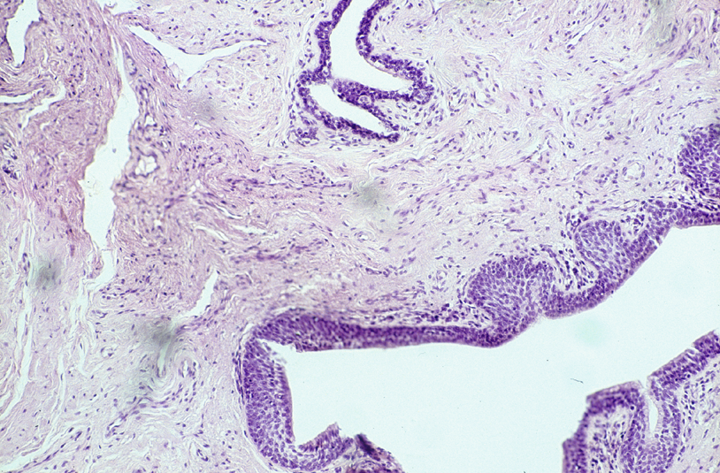
Urethral epithelium varies from pseudostratified columnar to stratified squamous at the terminal end
Urethral glands produce mucus
to lubricate the urethra
Lumen of urethra
Urethra

Slide 37
Male Reproductive System Lecture Outline
Testis
Genital ducts
Accessory genital glands
  Seminal vesicles
  Prostate
  Bulbourethral glands

Slide 38
The Male Reproductive System
Seminal vesicle
Prostate
Bulbourethral gland

Slide 39
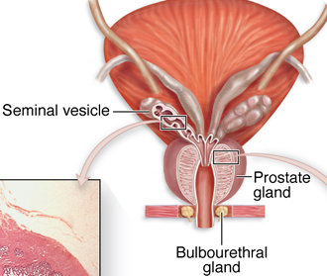
Accessory glands of the male reproductive tract

Slide 40
Seminal Vesicle
Really a diverticulum of the distal end of the vas.
Highly coiled duct surrounded by 2 layers of smooth muscle that expel luminal contents during ejaculation.
Intricately folded mucosa with secretory vesicles that produce fluid comprising most of volume of ejaculate.
Rich in fructose (energy drink for sperm).

Slide 41
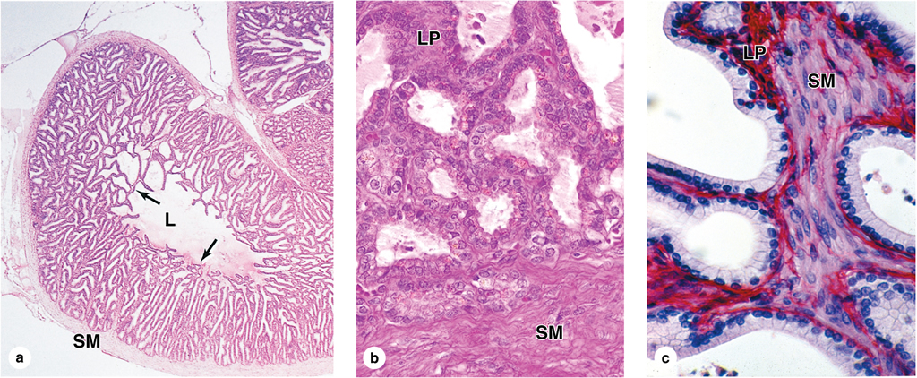
Seminal vesicle

Slide 42
Seminal vesicle
Lamina propria
Epithelium is simple or pseudostratified columnar
Smooth muscle

Slide 43
Prostate
Produces thin, milky fluid containing lipids and enzymes.
Fluid comprises about 25% of seminal fluid.
Three zones of glands: peripheral, central and transitional (all empty into prostatic urethra).
Peripheral zone is largest and most common site of prostatic carcinoma.

Slide 44
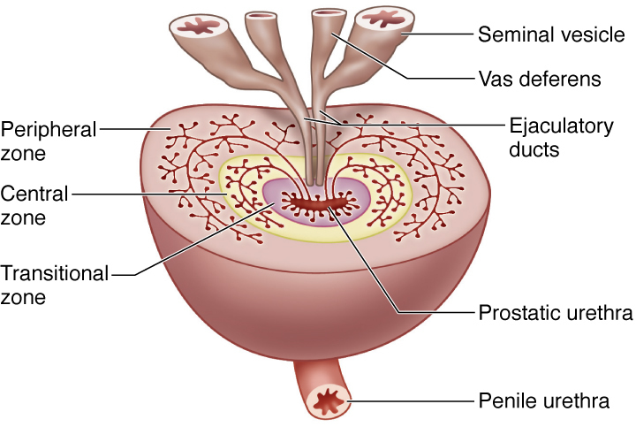
Prostate

Slide 45
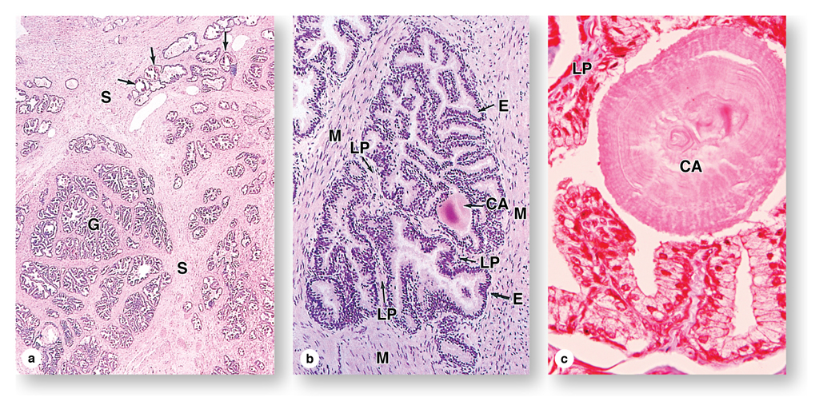
Prostate
Stroma
Fibrous tissue and smooth muscle
Glands
Simple or pseudostratified columnar epithelium

Slide 46
Prostate gland with corpus amylaceum
(calcified concretion)

Slide 47
Bulbourethral Glands
Paired glands also known as Cowper’s glands.
About the size of peas.
Secrete clear viscous material to lubricate the penile urethra.

Slide 48
Semen
1.5 – 3 ml per ejaculate
40 – 300 MILLION spermatozoa per milliliter
(<10 million considered poor)
Epididymal, seminal vesicle and prostatic secretions

Slide 49
Male Reproductive System Lecture Outline
Testis
Genital ducts
Accessory genital glands
Penis

Slide 50
Penis
Three cylindrical bodies of erectile tissue
(irregular vascular spaces, collapsed in flaccid state)
  Two corpora cavernosa (dorsally situated)
  Corpus spongiosum (ventrally situated)
Blood vessels
  Arteries (smooth muscle occludes lumens when there is muscle tone) open into cavernous spaces
  Venules drain cavernous spaces
Tunica albuginea (sheath: fibrous around cavernosa, elastic around spongiosum)

Slide 51
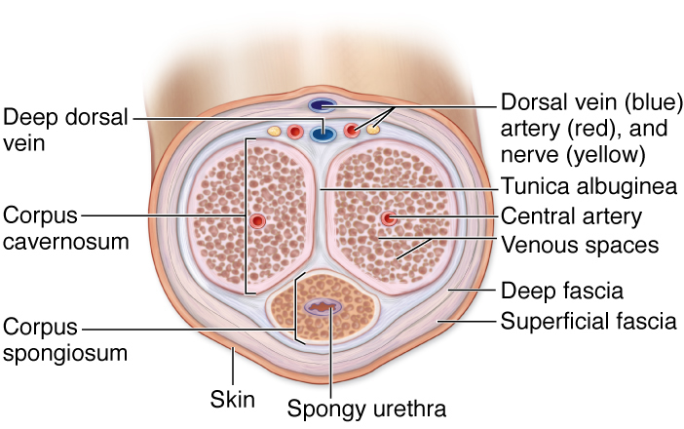
Penis

Slide 52
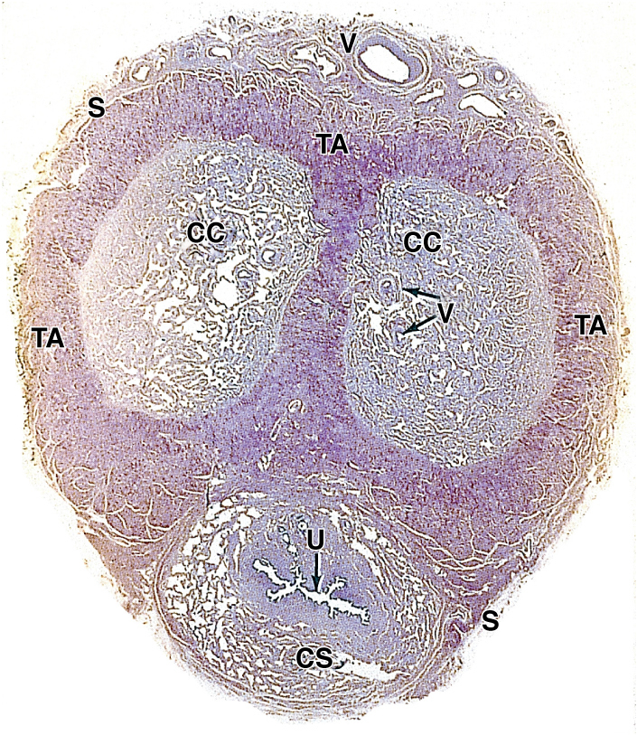
Penis
Corpus cavernosum
Tunica albuginea
Penile urethra
Corpus spongiosum

Slide 53
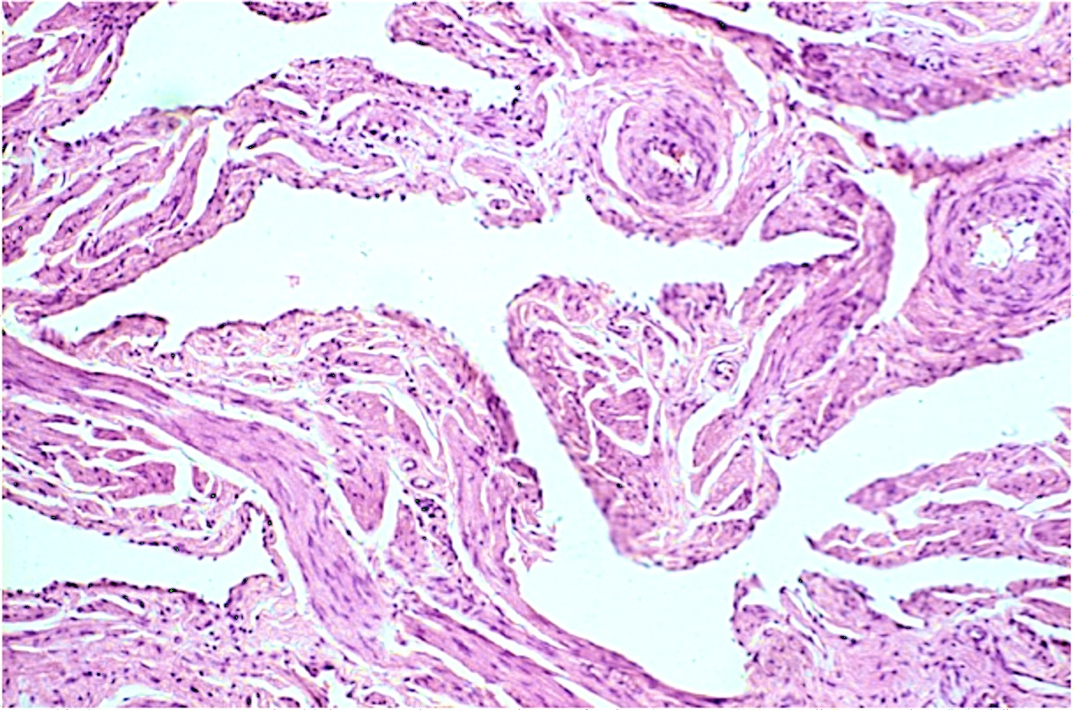
Corpora cavernosum
Connective tissue
Veins: cavernous spaces
Smooth muscle

Slide 54
Male Reproductive System Lecture Outline
Testis
Genital ducts
Accessory genital glands
Penis

