Slide 1
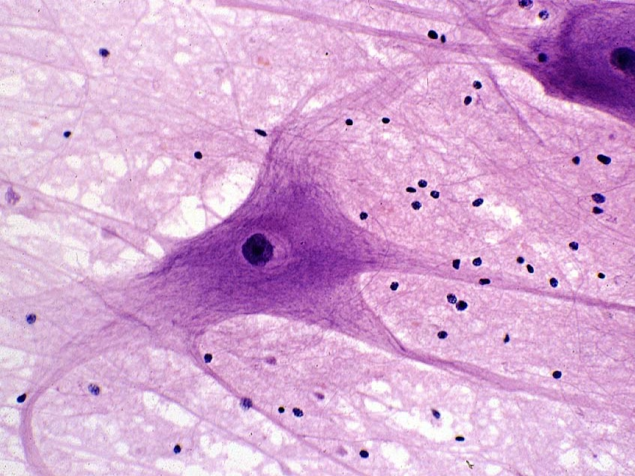
Nervous Tissue/Nervous System
Kristine Krafts, M.D.

Slide 2
Nervous System Lecture Objectives
Describe the anatomical and functional organization of the nervous system.
Describe the histologic features of neurons, their processes, and synapses.
Describe the histologic features and functions of glial cells.

Slide 3
More Nervous System Lecture Objectives
Describe how what myelin does and how it is produced in the central vs. peripheral nervous system.
Describe the histologic structure of gray vs. white matter in the cerebrum, cerebellum, and spinal cord.
Describe the structure of the meninges. Where does the cerebrospinal fluid reside?
Describe the structure and function of the blood brain barrier and glymphatics.

Slide 4
Nervous System Lecture Outline
Organization of the nervous system
Cells of the nervous system
Central nervous system

Slide 5
Nervous System Lecture Outline
Organization of the nervous system

Slide 6
Organization of Nervous System
Central nervous system (CNS) = brain + spinal cord
Peripheral nervous system (PNS) = peripheral nerves + nerve ganglia (groups of nerve cell bodies outside the CNS)
Peripheral nervous system has motor and sensory components.

Slide 7
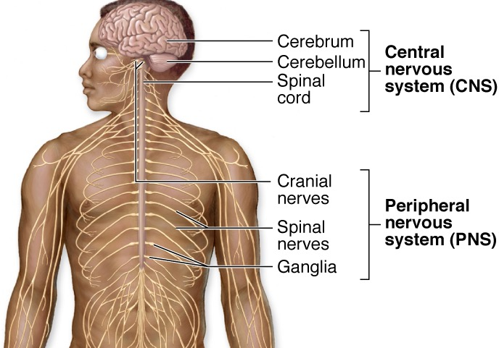

Slide 8
Nervous System Lecture Outline
Organization of the nervous system
Cells of the nervous system
  Neurons
  Glial cells

Slide 9
Nervous System Lecture Outline
Organization of the nervous system
Cells of the nervous system
  Neurons

Slide 10
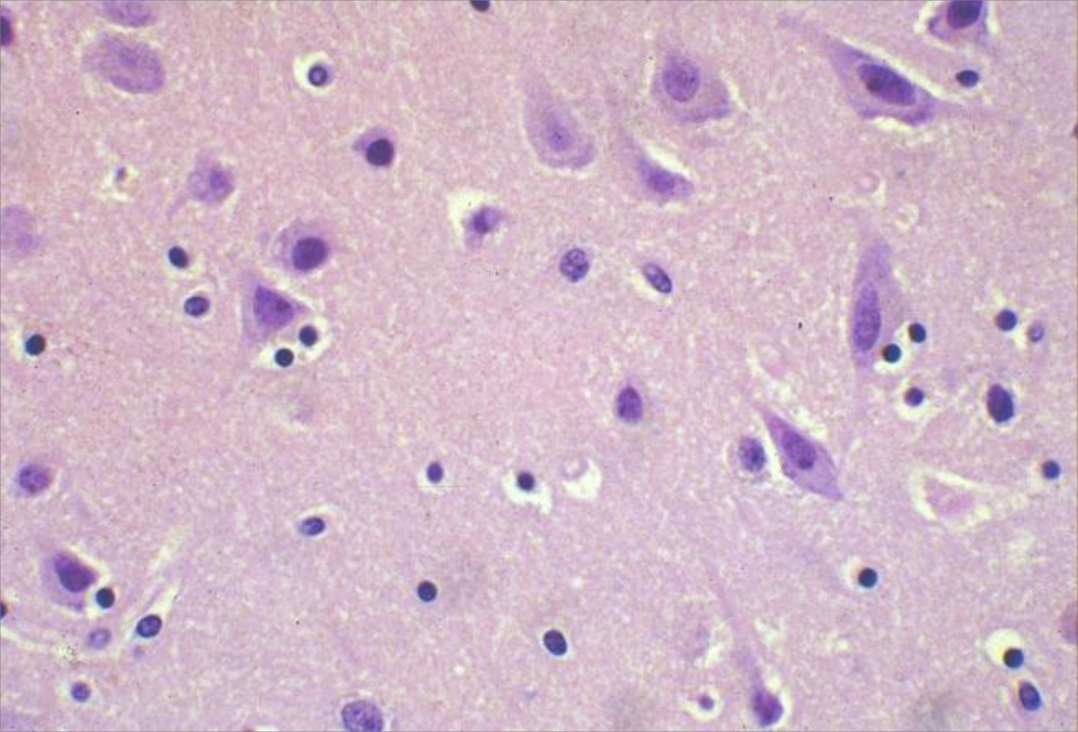
Neurons

Slide 11
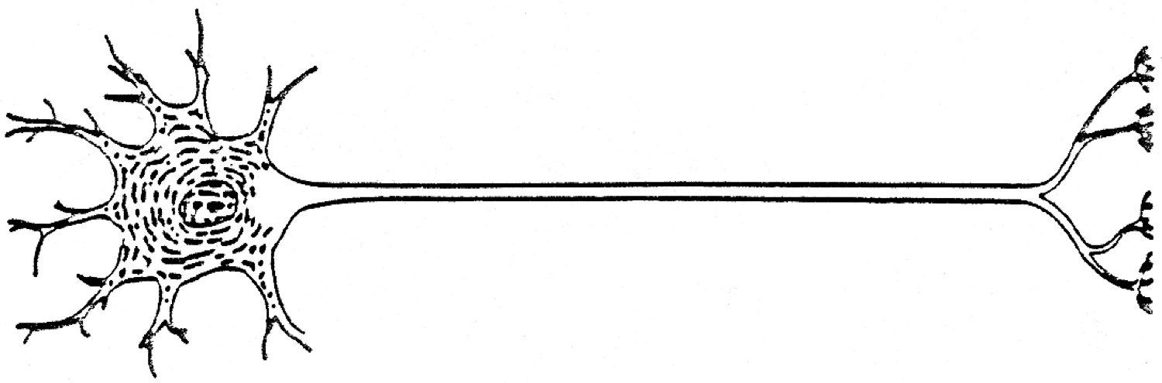
dendrites
Axon hillock
axon
Nissl substance
cell body
Cell body maintains the cell; can receive synaptic input
Tons of Nissl substance (rough ER)
Multiple dendrites (receive impulses)
One axon (sends out impulses) – originates at “axon hillock”
Cytoskeleton contains neurofilaments (for structure) and microtubules (for transport along axons)

Slide 12
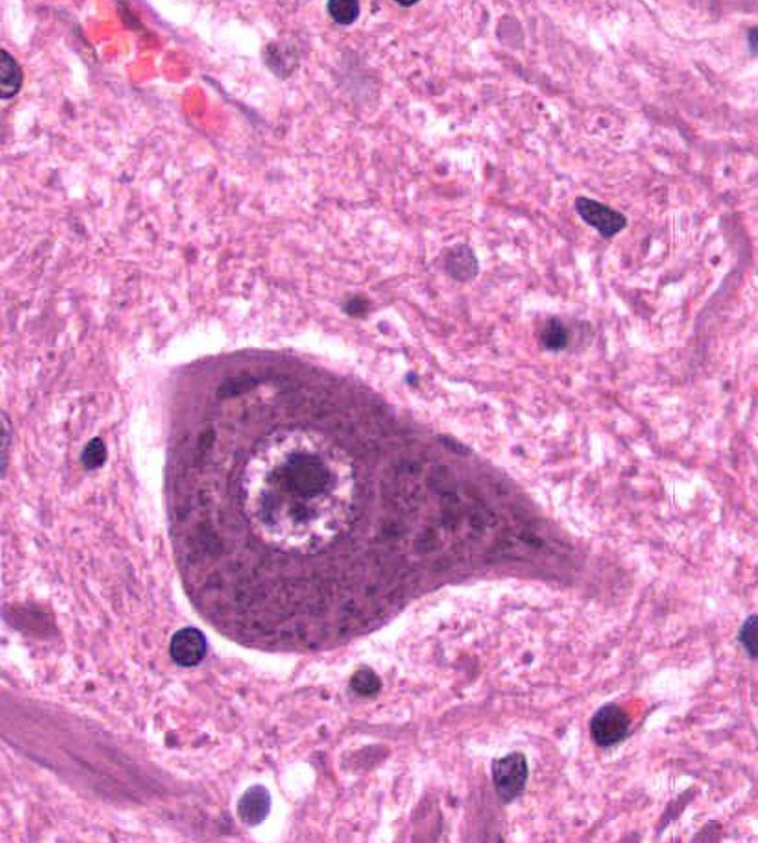
Neuron cell body
Large pale nucleus
Nucleolus
Nissl substance

Slide 13
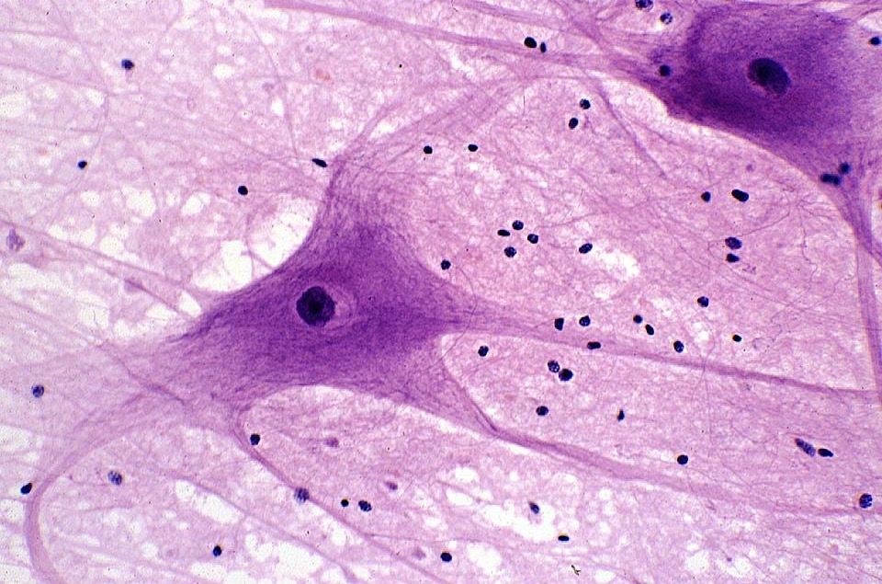
Gorgeous, sexy neuron and neuropil

Slide 14


Gorgeous, sexy J. Crew shimmer net skirt

Slide 15


Gorgeous, sexy Louis Vuitton tulle skirt

Slide 16

This year’s September issue!

Slide 17

Gorgeous, sexy Michael Kors tulle skirt

Slide 18

Bella Hadid
in a gorgeous, sexy Loewe net dress

Slide 19

Gorgeous, sexy Precious Lee, Paloma Elsesser, & Devyn Garcia in gorgeous, sexy John Galliano sheer net tulle dresses

Slide 20
Nervous System Lecture Outline
Organization of the nervous system
Cells of the nervous system
  Neurons
  Glial cells

Slide 21
Glial Cells
10x more abundant than neurons in brain
Support and protect neurons
Five types, each with different functions:
  Astrocyte
  Oligodendrocyte
  Schwann cell
  Ependymal cell
  Microglial cell

Slide 22
Location and Function of Glial Cells
Glial cell type | Location | Main functions
Astrocyte | CNS | Provides structural support, participates in blood-brain barrier
Oligodendrocyte | CNS | Makes myelin
Schwann cell | PNS | Makes myelin
Ependymal cell | CNS | Lines cavities of CNS
Microglial cell | CNS | Eats up debris and dead cells

Slide 23
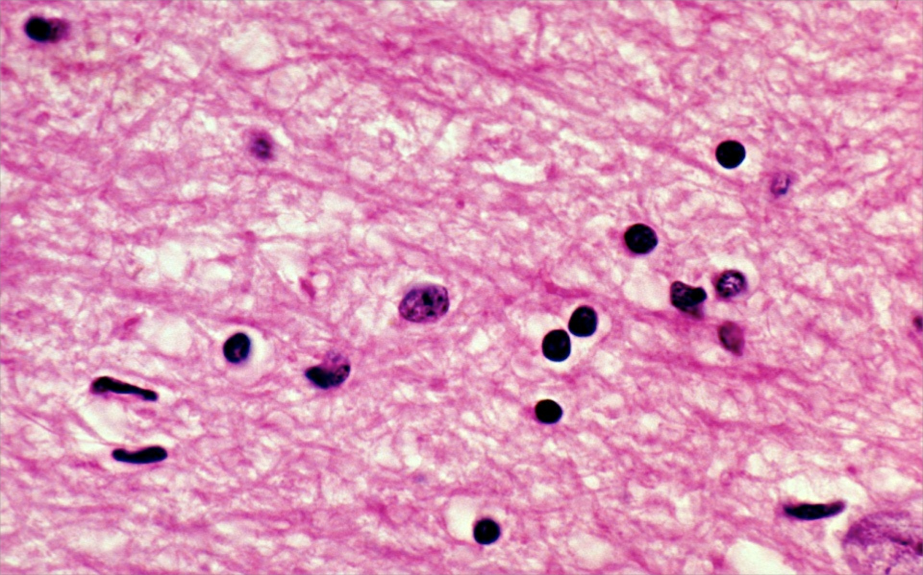
Neuropil and an astrocyte

Slide 24
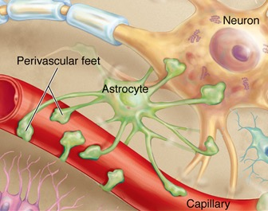
Astrocyte foot processes bind to capillaries and neurons

Slide 25
Oligodendrocytes are smaller and darker than astrocytes.

Slide 26
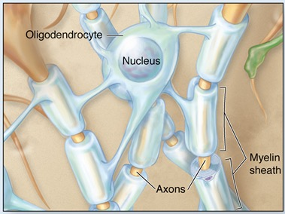
Oligodendrocytes produce myelin in the CNS.

Slide 27
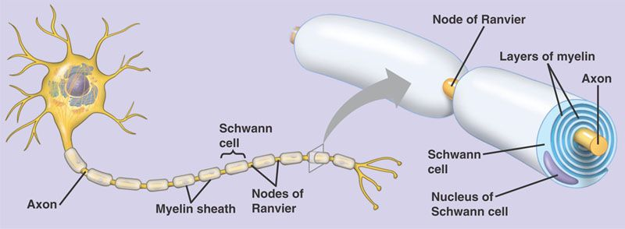
Schwann Cells
Schwann cells produce myelin in the PNS.

Slide 28
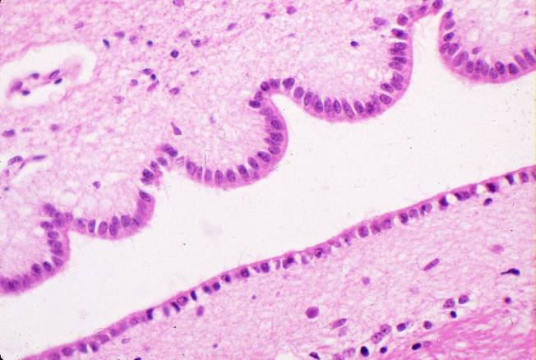
Ependymal cells

Slide 29
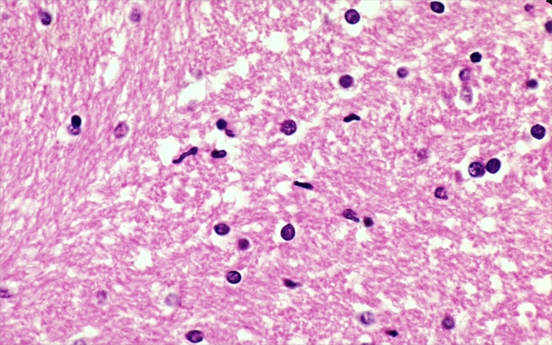
Microglial cells

Slide 30
Nervous System Lecture Outline
Organization of the nervous system
Cells of the nervous system
Central nervous system
  Cerebrum
  Cerebellum
  Spinal cord
  Meninges
  Glymphatics and blood brain barrier

Slide 31
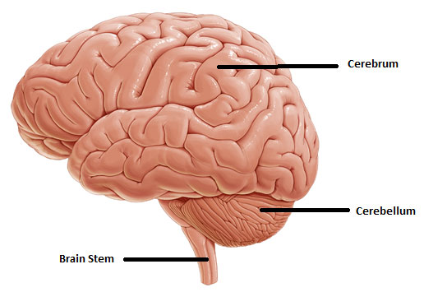
Gross anatomy of brain

Slide 33
Gray Matter and White Matter
Gray matter contains neuron cell bodies, dendrites, unmyelinated axons, glial cells and synapses
White matter contains myelinated axons and oligodendrocytes
Brain: gray matter outside (and way deep inside), white matter inside
Spinal cord: white matter outside, gray matter inside

Slide 34
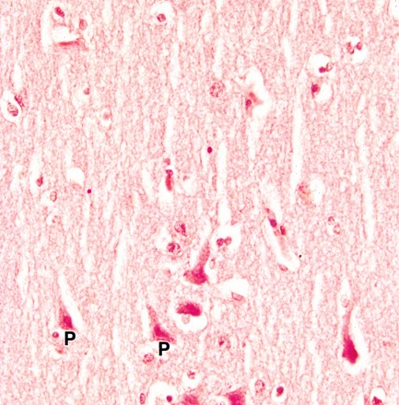
Cerebral Cortex
Cerebral cortex
(= gray matter of the cerebrum) has 6 poorly-defined layers.
Pyramidal neurons are the most abundant neurons in the cerebral cortex.

Slide 35
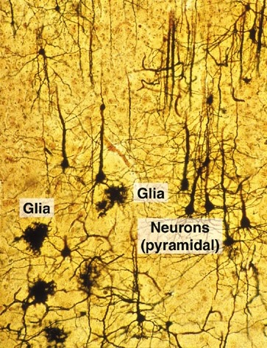
Cerebral Cortex
Note long dendrites of pyramidal neurons extending toward surface
of cortex.
This is a silver stain which really highlights neural cells.

Slide 36
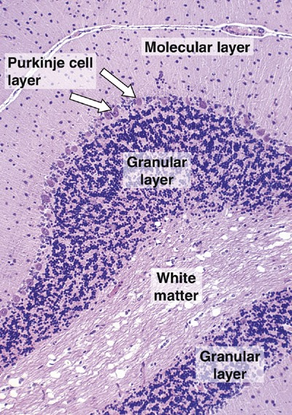

Cerebellum
Gray matter (outside) has 3 layers:
Molecular layer.
Outermost layer. Contains granular cell axons, Purkinje dendrites, and glial cells.
Purkinje cell layer.
Middle layer. Contains large, prominent “Purkinje” neurons.
Granular layer.
Innermost layer. Contains very small neurons.
White matter is on the inside.

Slide 37
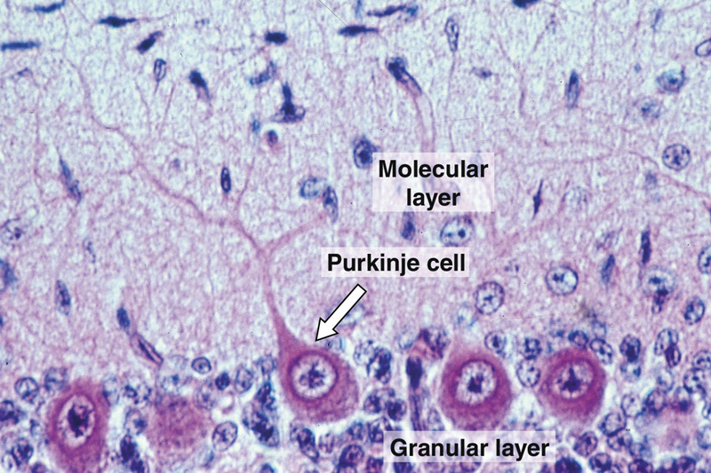
Cerebellum: gray matter

Slide 38
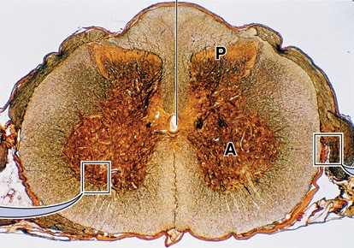
Spinal Cord Cross Section
Gray matter inside
White matter outside

Slide 39
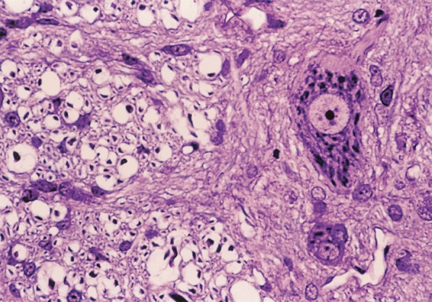
Spinal Cord
White matter: myelinated axons and oligodendrocytes.
Gray matter: neurons
and glial cells.

Slide 40
Meninges
Protective tissue layers surrounding brain and spinal cord.
Dura mater (“tough mother”)
Outermost layer. Dense connective tissue.
Arachnoid (“spider-like”)
Middle layer. Two parts: one is in contact with dura mater. Other contains trabeculae (like spider legs)
which connect arachnoid with pia.
Pia mater (“tender mother”)
Innermost layer. Loose connective tissue tightly adherent to surface of brain/spinal cord.

Slide 41
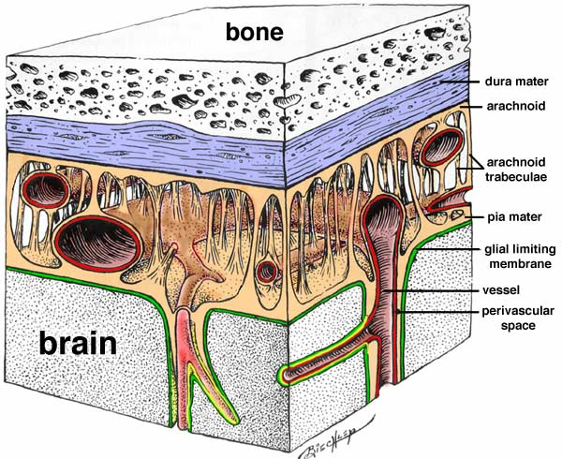

Slide 42
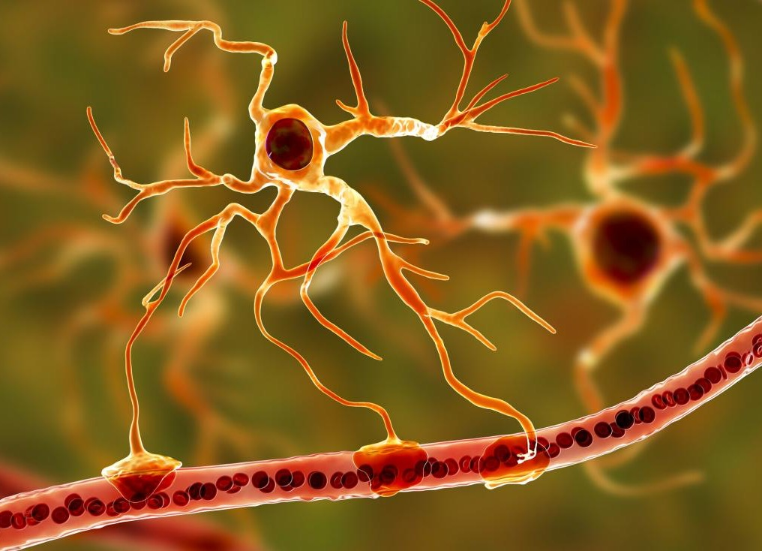

Slide 43
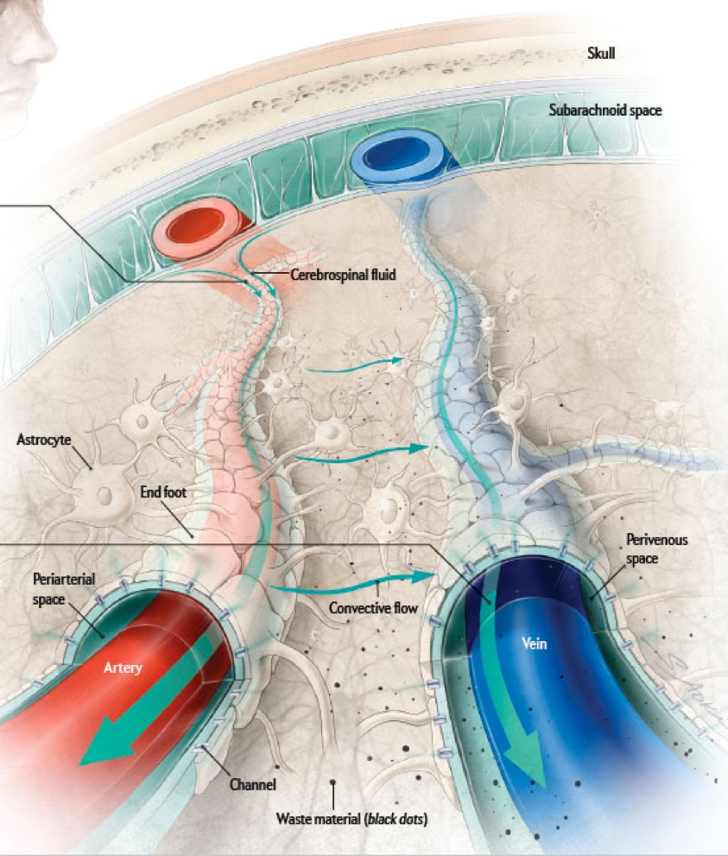

Glymphatic system
At night, space around arteries opens, allowing CSF to flow in.
Brain waste material is dumped into veins and taken out like trash!

Slide 44
Blood-Brain Barrier
Prevents passage of some drugs and toxins from blood into CNS tissue
Exists because capillaries in brain are less permeable than capillaries elsewhere.
  Brain capillaries have tight (occluding) junctions between endothelial cells.
  Astrocyte foot processes surround capillaries and form part of barrier.

Slide 45
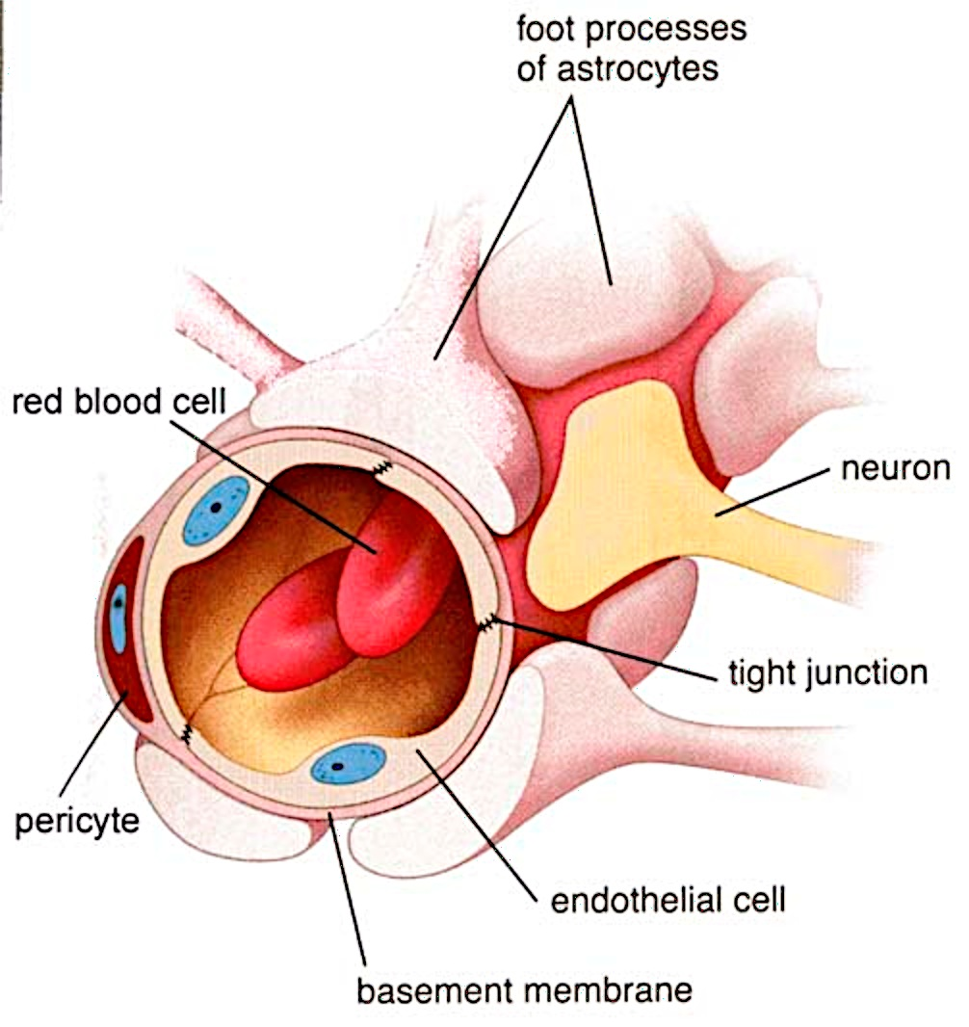
1. Astrocyte foot processes
Blood-Brain
Barrier
2. Endothelial cell
tight junctions

Slide 46
Nervous System Lecture Outline
Organization of the nervous system
Cells of the nervous system
Central nervous system

