Slide 1
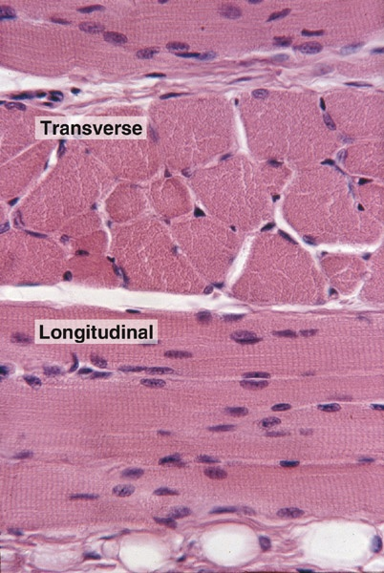
Muscle Tissue
Kristine Krafts, M.D.

Slide 2
Muscle Tissue Lecture Objectives
Describe, compare, and contrast the histologic structure of the three types of muscle, as seen with the light and electron microscope.
For skeletal muscle, know what the following terms mean: myofiber, myofibril, myofilament.
Describe, compare, and contrast the structure and organization of the sarcomere in skeletal vs. cardiac muscle, including the banding pattern, transverse tubules, and sarcoplasmic reticulum.

Slide 3
Muscle Tissue Lecture Objectives
Describe the unique structural features of smooth muscle which distinguish it from skeletal and cardiac muscle.
Describe the connective tissue sheaths that surround skeletal muscle.
Compare the ability of the three types of muscle to regenerate.

Slide 4
Muscle Tissue Lecture Outline
Introduction
Skeletal muscle
Cardiac muscle
Smooth muscle

Slide 5
Muscle Tissue Lecture Outline
Introduction

Slide 6
Fun facts about muscle terminology
“Sarco-” is from the Greek sarx (flesh)
“Myo-” is from the Greek mys (muscle)
Muscle cells are longer than they are wide, so they are also called “fibers”
There are three types of muscle cells: smooth, skeletal and cardiac. Smooth muscle cells are non-striated; skeletal and cardiac muscle cells are striated.
Notes:
Sarco- from the Greek Sarx (flesh)
“striated” does not equal “skeletal”

Slide 7
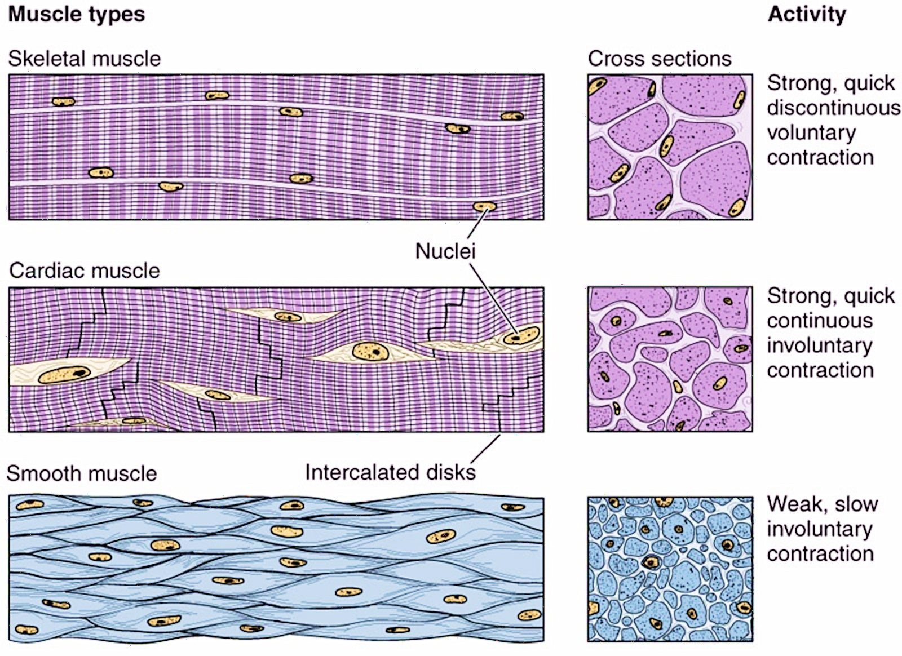
Muscle types and activity

Slide 8
Muscle Tissue Lecture Outline
Introduction
Skeletal muscle

Slide 9
Skeletal muscle
Abundant eosinophilic cytoplasm
Peripheral nuclei

Slide 10
Skeletal muscle
Cells are long, unbranched tubes
Can just barely see striations
Peripheral, flattened nuclei
Notes:
Striated = striped, layered
Several hundred nuclei/cell

Slide 11
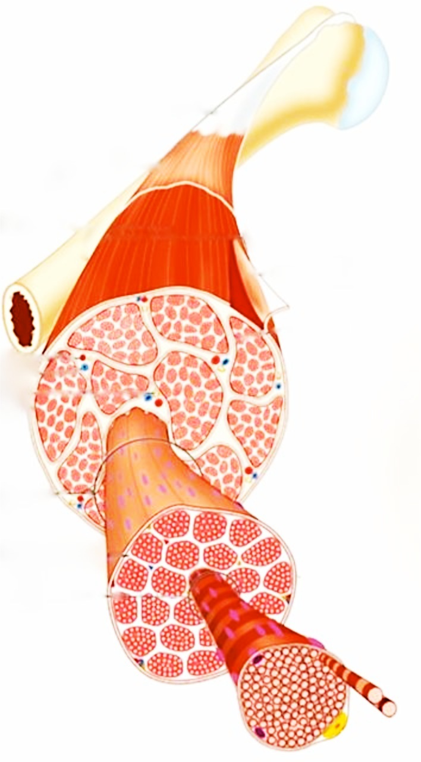
What’s in an actual
skeletal muscle?
A bunch of fascicles.
Each fascicle is
composed of a bunch of muscle cells (myofibers).
Each muscle cell contains
a bunch of myofibrils.
Notes:
Satellite cells (yellow cell in the myofiber) are stem cells

Slide 12
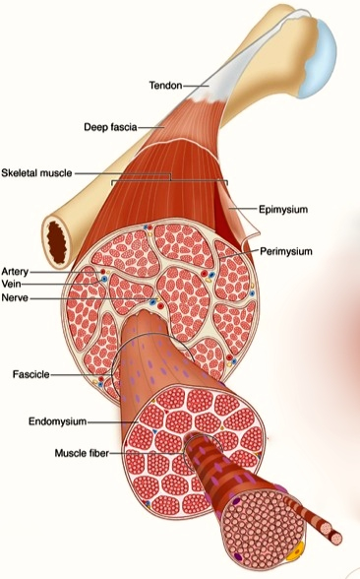
Connective tissue surrounds the cells, fascicles, and entire muscle.
Epimysium
Dense layer of connective tissue that surrounds entire muscle
Perimysium
Connective tissue that surrounds each fascicle
Endomysium
Delicate connective tissue that surrounds each muscle cell

Slide 13
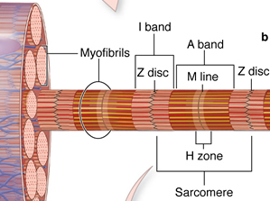
Myofibrils have stripes (striations)

Slide 14
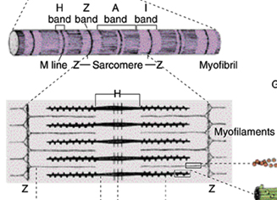
Q. What is it that makes that super-specific repeating pattern of light and dark bands?
Thin (actin) filaments
Thick (myosin) filaments
Notes:
Myofibril is smallest structure within one muscle fiber that demonstrates cross striations.
dArk, lIght, Myosin/Middle
Actin goes from Z line to edge of H band
Myosin goes from A band to A band
Binding of calcium shifts things (troponin), exposing binding sites so myosin can bind to actin. Myosin pulls actin fibers together. Z lines move together! H bands are obliterated!
We don’t have time to discuss this in more detail but you will in physiology.
More detail:
F (fibrous) actin composed of G (globular) actin

Slide 15

A. The arrangement of thick and thin myofilaments!
Thin (actin) filaments
Thick (myosin) filaments
Notes:
Myofibril is smallest structure within one muscle fiber that demonstrates cross striations.
dArk, lIght, Myosin/Middle
Actin goes from Z line to edge of H band
Myosin goes from A band to A band
Binding of calcium shifts things (troponin), exposing binding sites so myosin can bind to actin. Myosin pulls actin fibers together. Z lines move together! H bands are obliterated!
We don’t have time to discuss this in more detail but you will in physiology.
More detail:
F (fibrous) actin composed of G (globular) actin

Slide 16
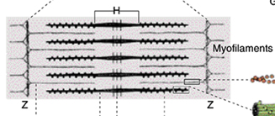
When muscles contract, sarcomeres shorten!
Thin (actin) filaments
Thick (myosin) filaments
Actin filaments get pulled toward each other.
The distance between the Z lines shortens,
and the H band disappears.

Slide 17
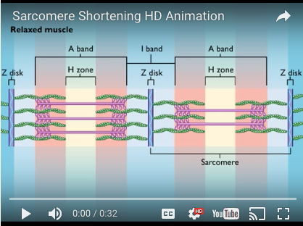
Check out this video to see how the sarcomere shortens! https://youtu.be/U2TSaz8-yNQ

Slide 18
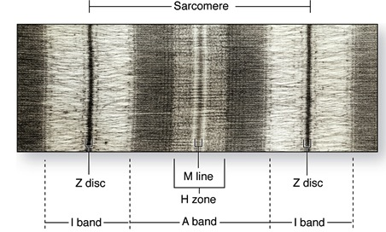
Sarcomere and bands

Slide 19
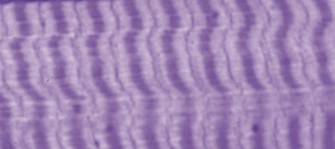
Skeletal muscle with A bands, I bands, Z lines
A band
I band
Z line

Slide 20
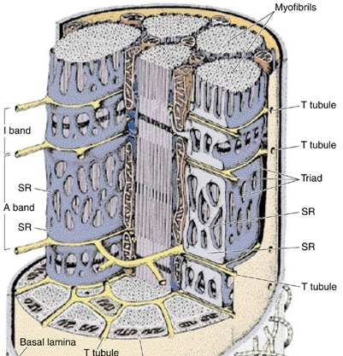
Sarcoplasmic reticulum
Sarcoplasmic reticulum is the smooth endoplasmic reticulum in skeletal muscle.
It is specialized to sequester & release calcium ions.
It ensheathes or surrounds each myofibril.
Notes:
SR surrounds each MYOFIBRIL!!!
SR = network of cisterns/tubules that hold calcium (which you need for contraction)
SR forms “collars” at AI junctions
ER normally is a series of smooth tubes that makes lipids and steroids, breaks down toxins and drugs, and stores steroids and ions.

Slide 21
Transverse (T) tubules
At each A-I band junction, a tubular invagination of the sarcolemma termed a transverse (T) tubule penetrates the muscle fiber and lies next to the surface of myofibrils.
Notes:
“collars” are separated by T-tubules

Slide 22
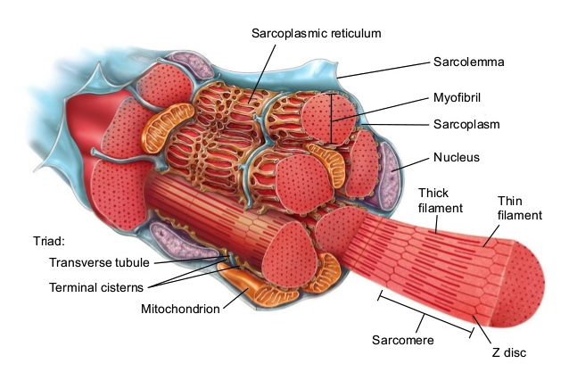

Slide 23
Muscle Tissue Lecture Outline
Introduction
Skeletal muscle
Cardiac muscle

Slide 24
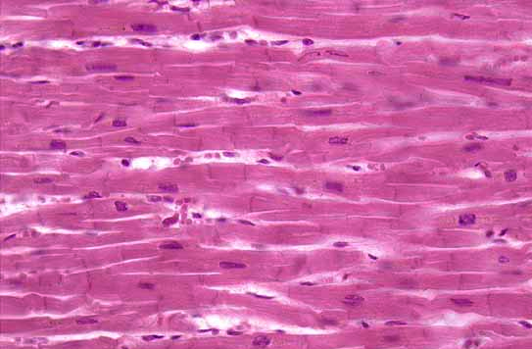
Cardiac muscle
Notes:
I = intercalated disk = DIAGNOSTIC
N = nucleus ONE PER CELL

Slide 25
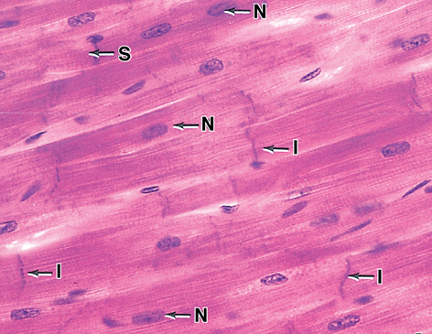
Cardiac muscle cells with nuclei (N), intercalated discs (I), and striations (S)

Slide 26
Structure of cardiac muscle cells
Cardiac muscle cells are branched and striated.
Intercalated disks glue adjacent cells together.
Sarcoplasmic reticulum is kind of sparse.

Slide 27
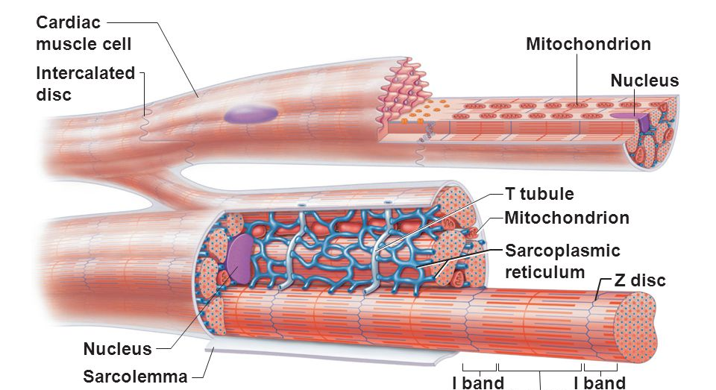
Cardiac Muscle Cells

Slide 28
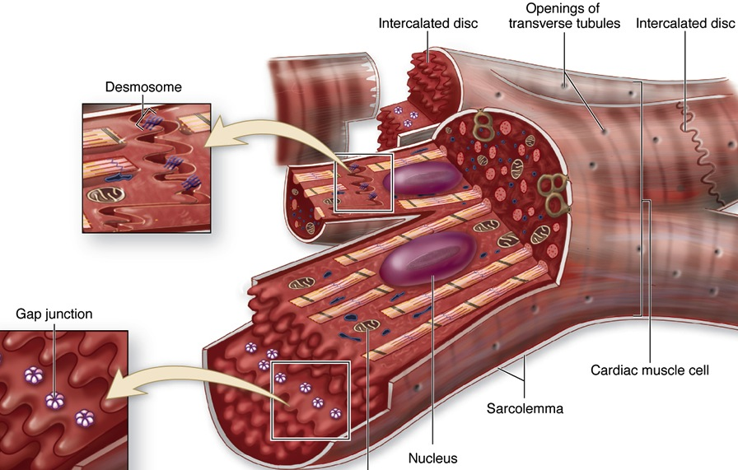
Close-up of intercalated discs

Slide 29
Muscle Tissue Lecture Outline
Introduction
Skeletal muscle
Cardiac muscle
Smooth muscle

Slide 30
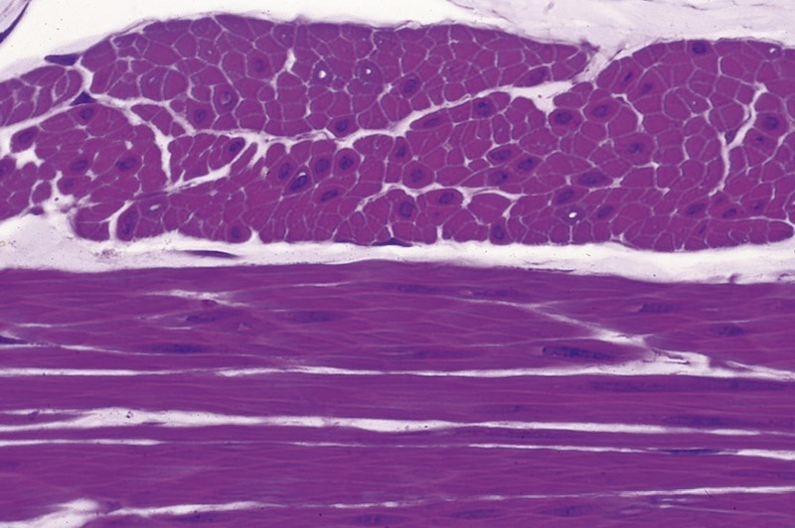
Smooth muscle
Transverse section
Longitudinal section

Slide 31
Where is smooth muscle in the body?
Most smooth muscle is present in walls of hollow organs (such as intestine and uterus).
Smooth muscle is also present in walls of larger blood vessels and in the eye.

Slide 32
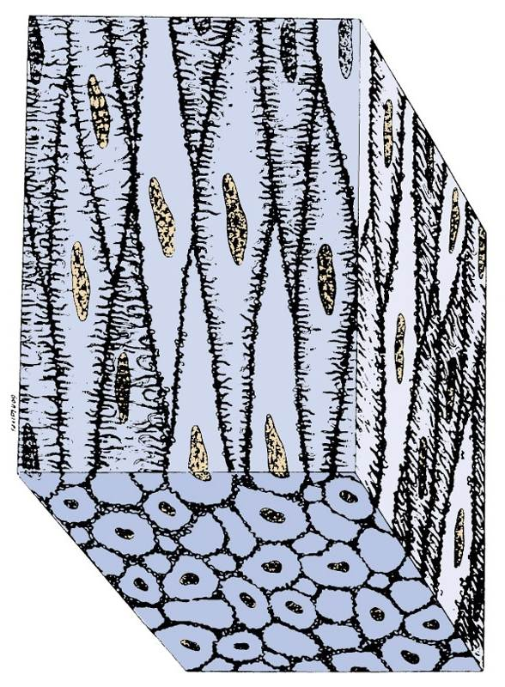
Smooth muscle morphology
Smooth muscle cells (fibers) are fusiform (spindle-shaped) with single central nucleus.
The width of the fiber or cell is only slightly greater than the width of the nucleus.
They are packed together tightly.

Slide 33
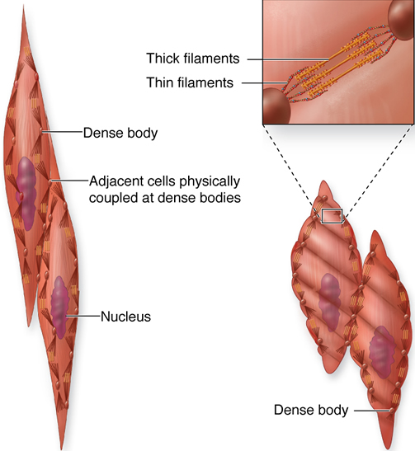
Smooth muscle: thin and thick filaments

Slide 34
Wait, what are dense bodies?
Anchor sites for actin-myosin filament bundles.
Comparable to Z-disks of skeletal and cardiac muscle.
Located along inside of sarcolemma and scattered throughout cytoplasm.

Slide 35
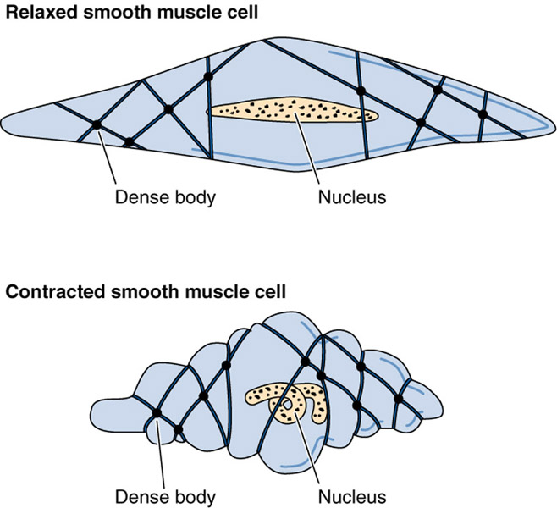
Contraction of smooth muscle
Relaxed smooth muscle cell
Contracted smooth muscle cell

Slide 36
Regeneration of muscle tissue
Cardiac muscle has no regenerative ability. Death of cardiac muscle leads to replacement by dense connective tissue scar.
Skeletal muscle can undergo limited regeneration. Satellite cells are inactive myoblasts that become activated and proliferate and fuse after injury.
Smooth muscle is capable of active regeneration. Muscle fibers undergo mitosis and replace damaged tissue.

Slide 37
Summary that will make sense later
 | Skeletal | Cardiac | Smooth
Location | Near bones | Heart wall | Walls of hollow organs and blood vessels
Nuclei | Many. Flat. Peripheral. | 1-2 per cell. Plump. Central. | One per cell. Central.
Cell diameter | Largest | Intermediate | Smallest
Striations | Yes | Yes | No
Sarcoplasmic reticulum | Yes | Yes | No
T tubules | At junction of A-I bands. Form triads. | At Z lines. Form diads. | None

Slide 38
More summary that will make sense later
 | Skeletal | Cardiac | Smooth
Motor control | Voluntary | Involuntary | Involuntary
Contraction | Quick and strong | Quick, strong, rhythmic | Slow, in waves
Blood supply | Moderate | Extensive | Less abundant
Other features | Prominent fascicles | Intercalated disks, branching cells | Cells overlap; can synthesize collagen and elastin

Slide 39
Muscle Tissue Lecture Outline
Introduction
Skeletal muscle
Cardiac muscle
Smooth muscle

