Slide 1
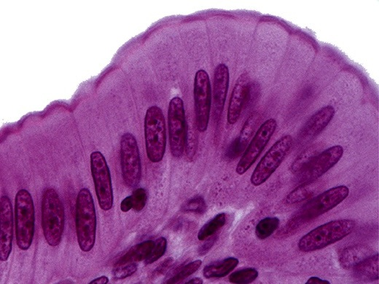
Epithelium
Kristine Krafts, M.D.

Slide 2
Epithelium Lecture Objectives
Describe the structural and functional relationship between:
  epithelium and connective tissue, and
  epithelium and basal lamina.
Describe the structural and functional features of epithelial intercellular junctions and specializations of the apical surface of epithelial cells.

Slide 3
More Epithelium Lecture Objectives
Describe the structural and functional diversity of epithelium.
Describe the classification system of covering/lining epithelium.
Describe the histologic features of glandular epithelium.

Slide 4
Epithelium Lecture Outline
Function and types of epithelium
Structure of epithelium
Types of covering/lining epithelium
Types of glandular epithelium

Slide 5
Epithelium Lecture Outline
Function and types of epithelium

Slide 6
Functions of Epithelium
Covering of external surfaces
Lining of internal surfaces
Protection
Absorption
Secretion
Sensation
Contraction

Slide 7
Two Main Kinds of Epithelium
Covering and lining epithelium
Covers outer surfaces of body and lines internal body passages
Glandular epithelium
Contains cells specialized for secretion

Slide 8
Unique Characteristics of Epithelium
Basal lamina anchors epithelium to underlying connective tissue.
Epithelial cells are very cohesive due to intercellular junctions.
Epithelial cells vary a lot in shape and size.
Epithelial tissues are avascular.
Epithelial cells demonstrate polarity.

Slide 9
Epithelium Lecture Outline
Function and types of epithelium
Structure of epithelium
  Basement membrane
  Connections between cells
  Specialized apical structures

Slide 10
Epithelium Lecture Outline
Function and types of epithelium
Structure of epithelium
  Basement membrane

Slide 11
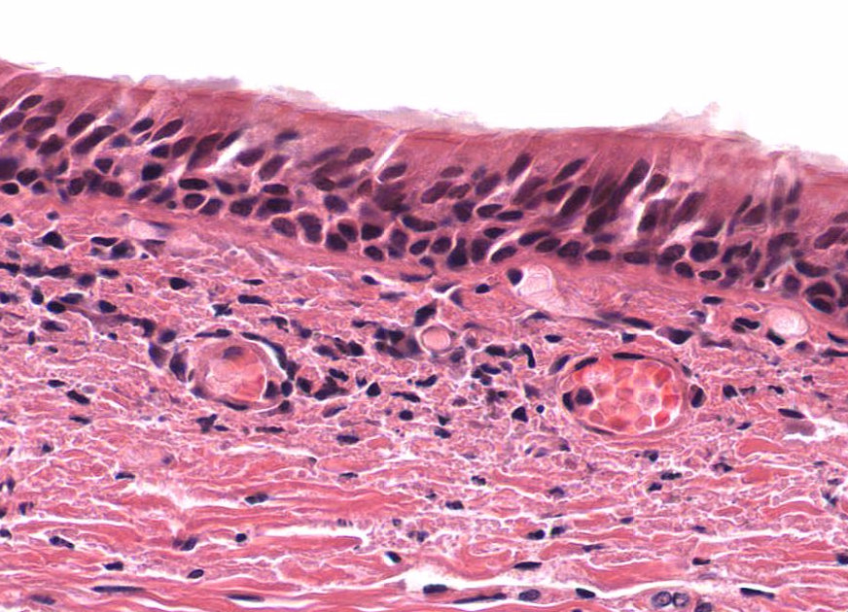
Epithelial cells
Basement membrane

Slide 12
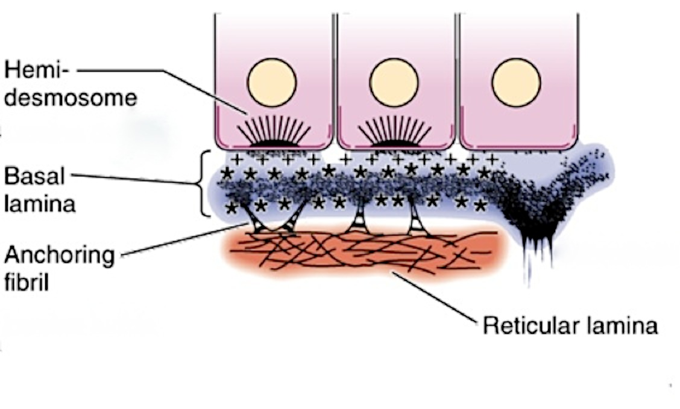
Basement membrane =
Basal Lamina + Reticular Lamina
Epithelium
Basal
lamina
Basement membrane
Reticular lamina

Slide 13
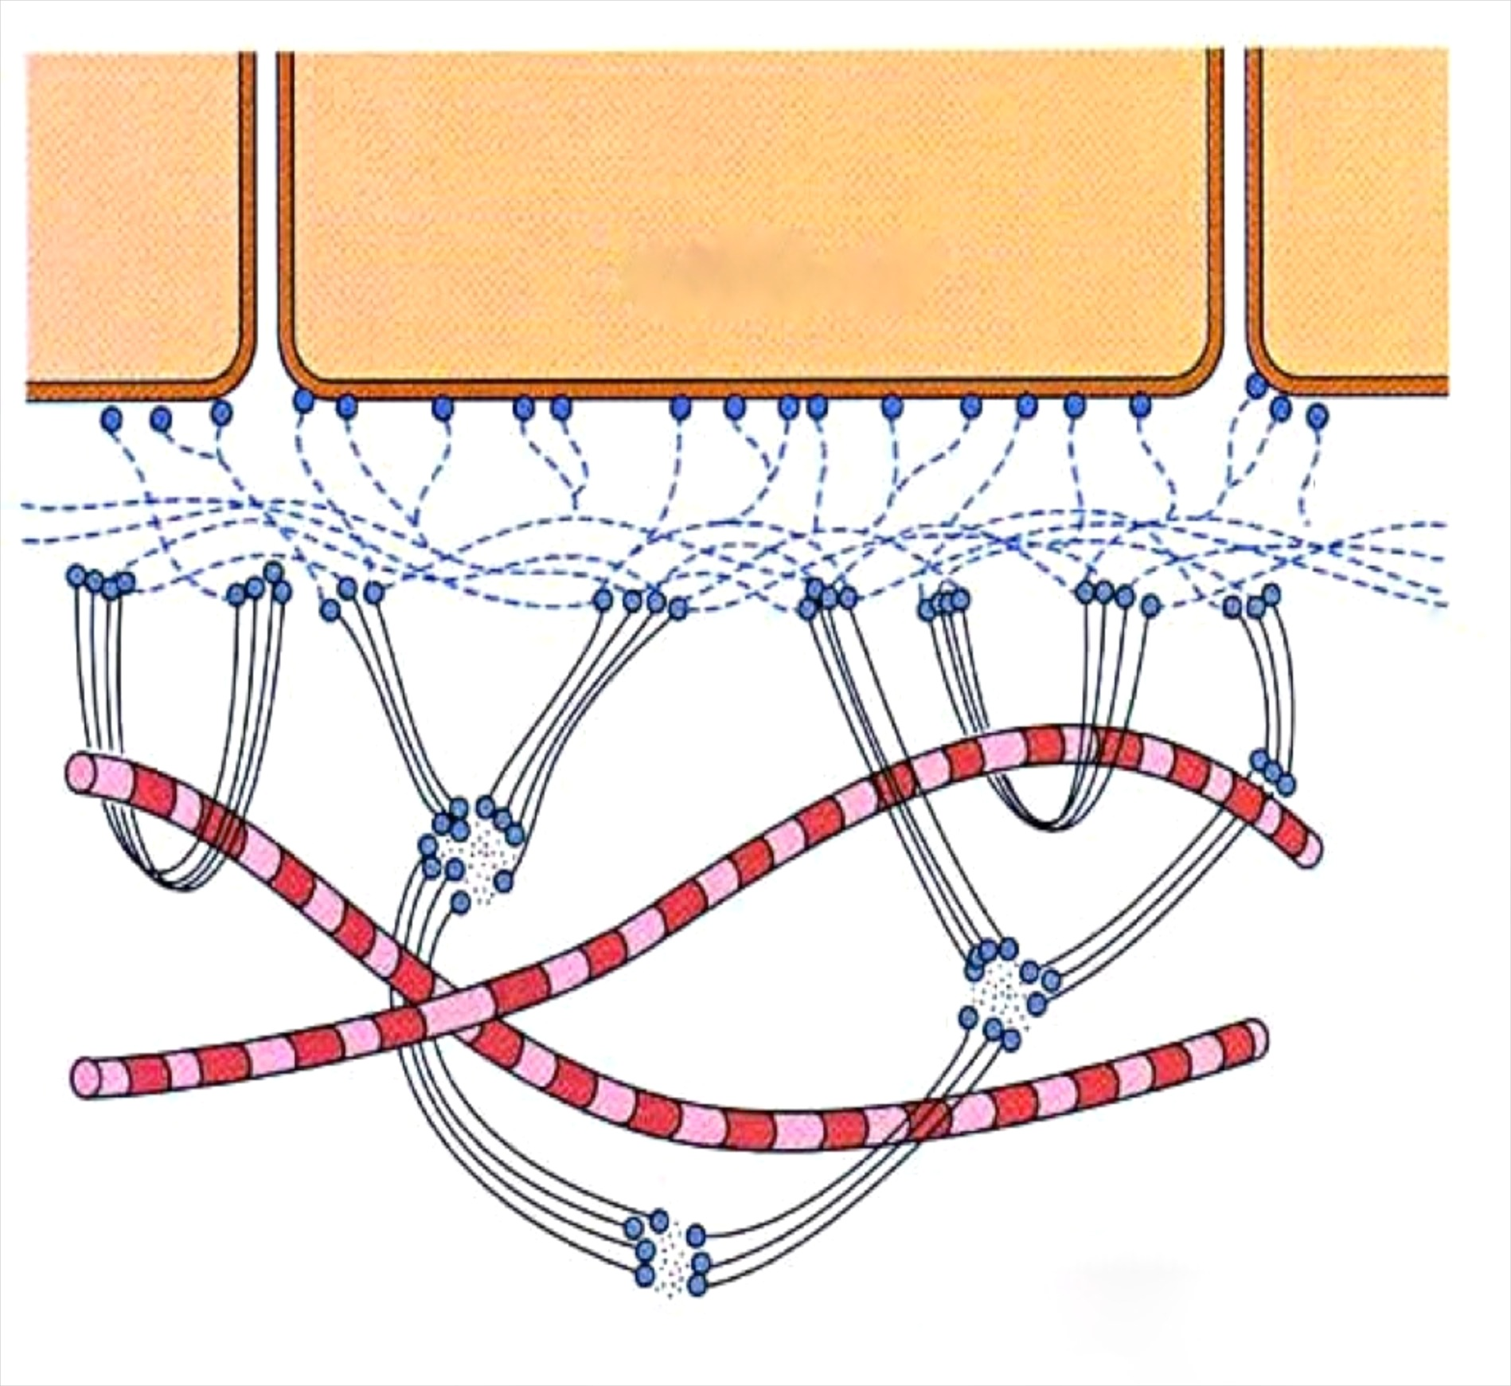
Composition of Basal Lamina and Reticular Lamina
Laminin
(a glycoprotein)
Epithelial cell
lamina lucida
Basal
lamina
lamina densa
Type IV collagen and perlecan
(a proteoglycan)
Reticular lamina
Reticular fibers
(type III collagen)
Anchoring fibrils
(type VII collagen)
Anchoring plaques
(type IV collagen)

Slide 14
Functions of Basal Lamina
Structure: attaches epithelium to connective tissue
Organization: arranges plasma membrane proteins in the basal membrane
Filtration: regulates movement of material between epithelium and connective tissue

Slide 15
Don’t make this mistake!
“Basal lamina” and “basement membrane”
are sometimes used interchangeably.
This is wrong, wrong, wrong!
The basal lamina is part of the basement membrane. They are not the same thing.

Slide 16
Epithelium Lecture Outline
Function and types of epithelium
Structure of epithelium
  Basement membrane
  Intercellular junctions

Slide 17
Intercellular junctions connect epithelial cells
Intercellular junctions are present in most tissues but are especially numerous and prominent in epithelium.
Zonula occludens (tight junction)
Zonula adherens (belt desmosome)
Macula adherens (desmosome)
Hemidesmosomes
Gap junction (nexus)

Slide 18
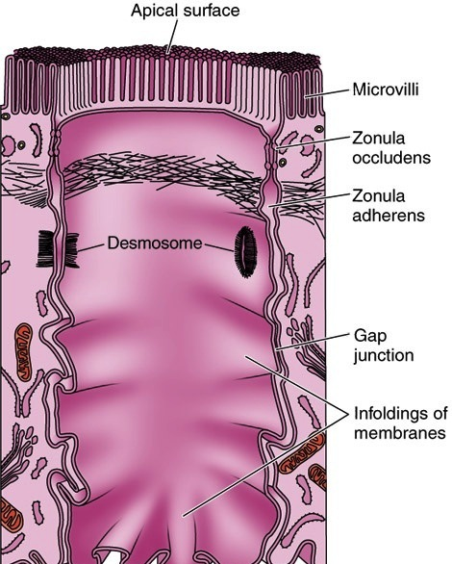
Intercellular Junctions

Slide 19
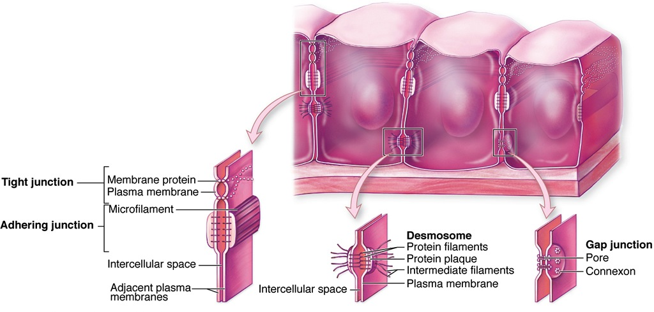
Intercellular junctions
(Zonula occludens)
(Zonula adherens)

Slide 20
Zona occludens (tight junction)
Most apical junction in epithelium
Form bands (zonula) that completely encircle each cell
Membranes of adjacent cells fuse to seal off the intercellular space

Slide 21
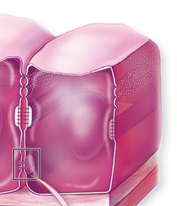
Zona occludens (tight junction)
Claudins and occludins are two families of proteins that form a seal to prevent flow of materials between epithelial cells
More zona occludens = tighter seal

Slide 22


Slide 23
Zonula adherens (belt desmosome)
Form bands that completely encircle each cell
Cadherin and catenin proteins provide adhesion between adjacent cells
Actin filaments in cytoplasm insert into attachment plaques

Slide 24
Macula adherens (spot desmosome)
Spot adhesion between cells
Desmosomes on adjacent cells line up
Cadherins present in intercellular space

Slide 25
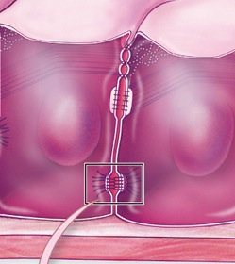
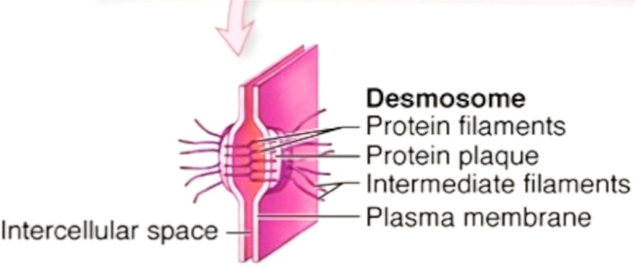
Macula adherens (spot desmosome)
Cytokeratin intermediate filaments insert into attachment plaques containing desmoplakin
and plakoglobin
Super strong attachment points between cells
The more desmosomes, the more tightly the epithelial cells are attached

Slide 26
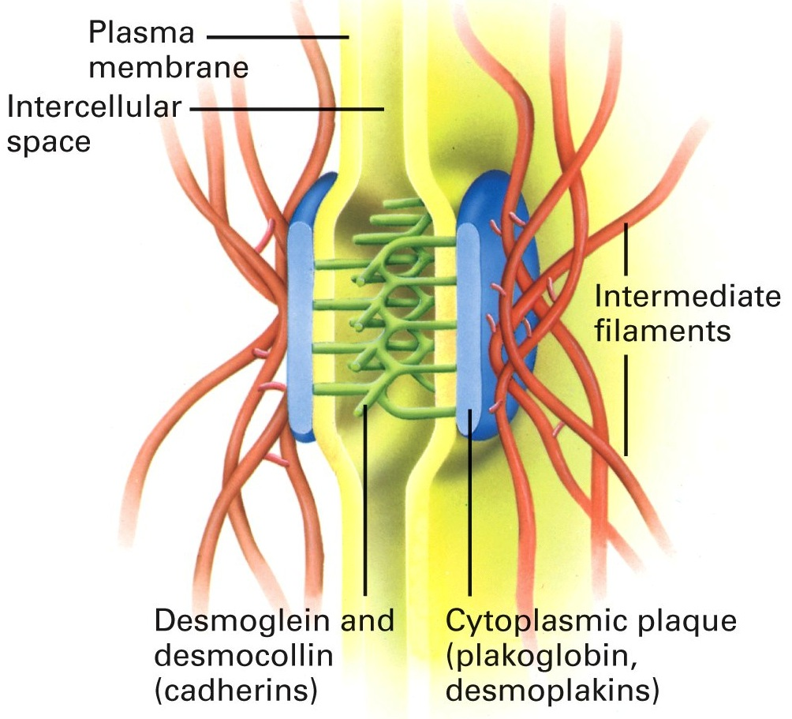
Macula adherens (spot desmosome)

Slide 27
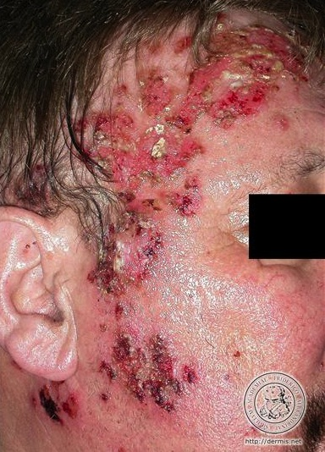
Pemphigus vulgaris
A blistering disease in which patients make autoantibodies to desmoglein proteins
Epithelial cell connections (spot desmosomes) loosen, causing fluid accumulation and superficial blisters

Slide 28
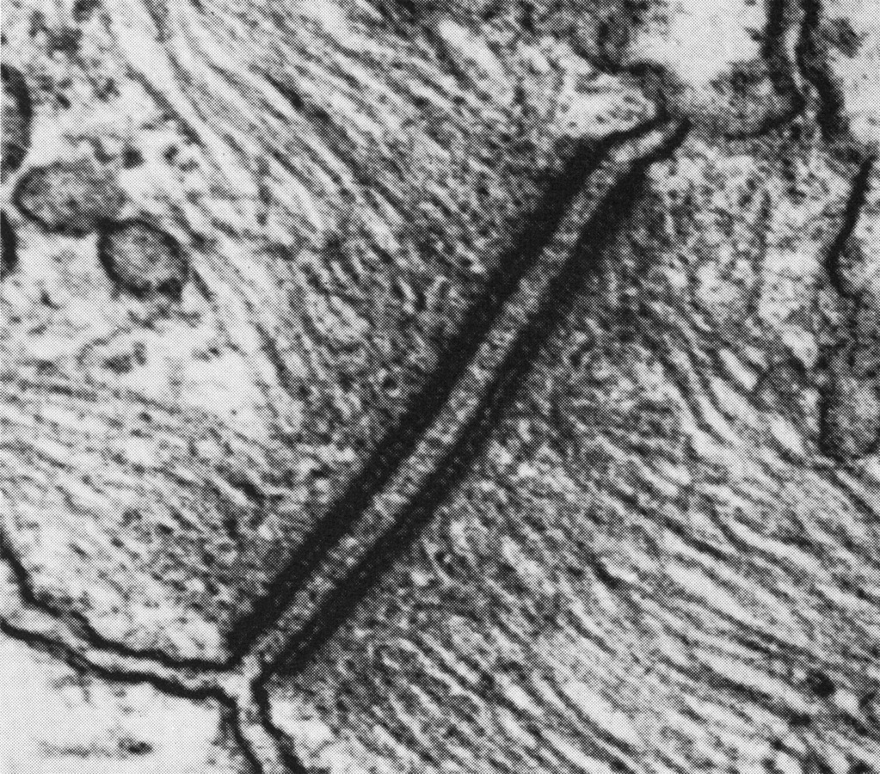
Macula adherens (spot desmosome)
Cytoplasmic
attachment
plaques
Cytokeratin
intermediate
filaments
Plasma membranes

Slide 29
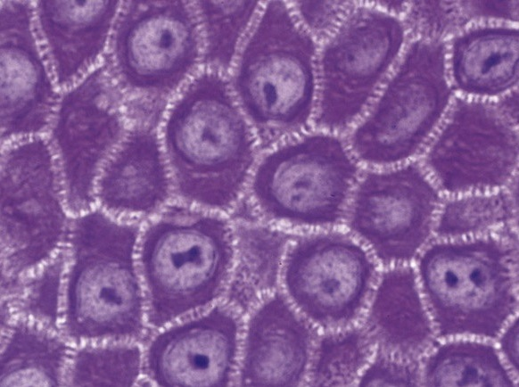
Spot desmosomes in stratum spinosum of skin

Slide 30
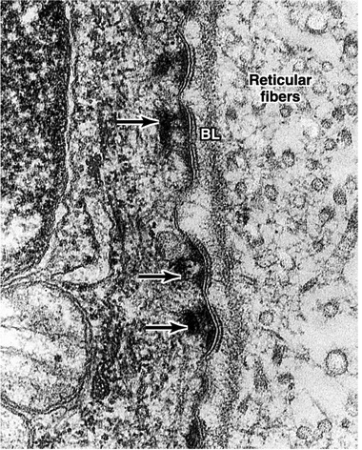
Hemidesmosomes
Hemidesmosomes attach epithelial cells to basal lamina.
Integrins attach the basal portion of the cell to the basal lamina.

Slide 31
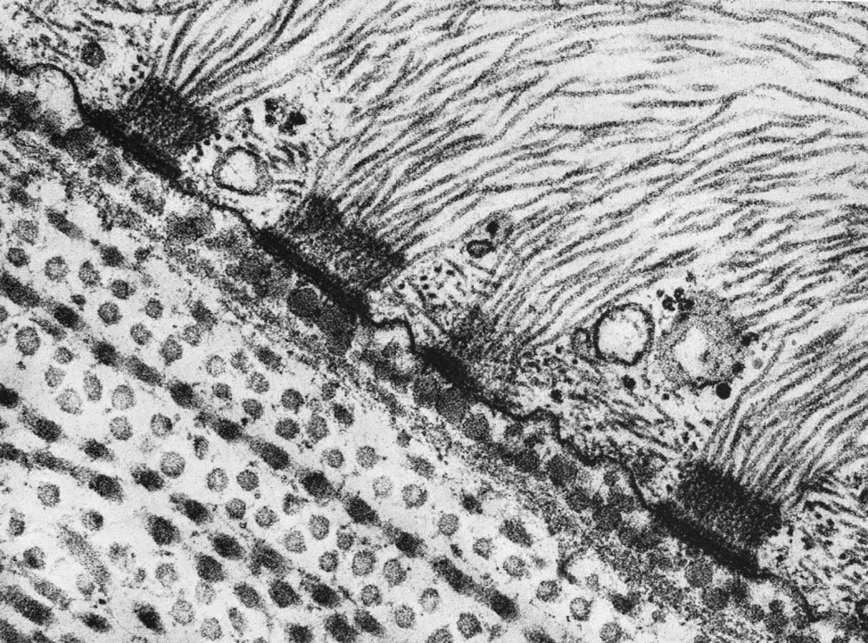
Hemidesmosomes
Keratin intermediate filaments in epithelial cell
Attachment plaque
Reticular lamina

Slide 32
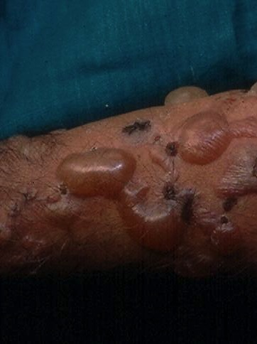
Bullous pemphigoid
A blistering disease in which patients make autoantibodies to “bullous pemphigoid antigen” in hemidesmosome attachment plaques
Epithelial cells detach from basal lamina, causing fluid accumulation and blister formation

Slide 33
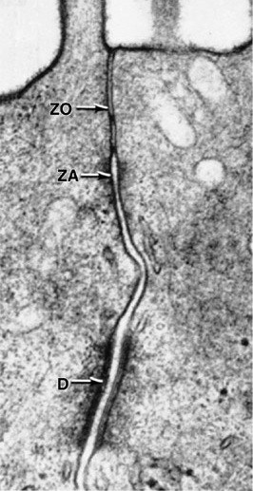
Junctional complex of intercellular junctions
ZO: zonula occludens
ZA: zonula adherens
D: desmosome
In some types of epithelia
(simple columnar of digestive tract) junctions occur in this order

Slide 34
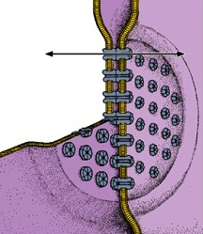
Gap (communicating) junction
Occur almost anywhere along lateral surfaces of epithelial cells and also in other cells, such as cardiac muscle cells
Connexons are protein channels with central pores connecting plasma membranes
Allow ions and other small molecules to pass through to adjacent cells to facilitate communication

Slide 35
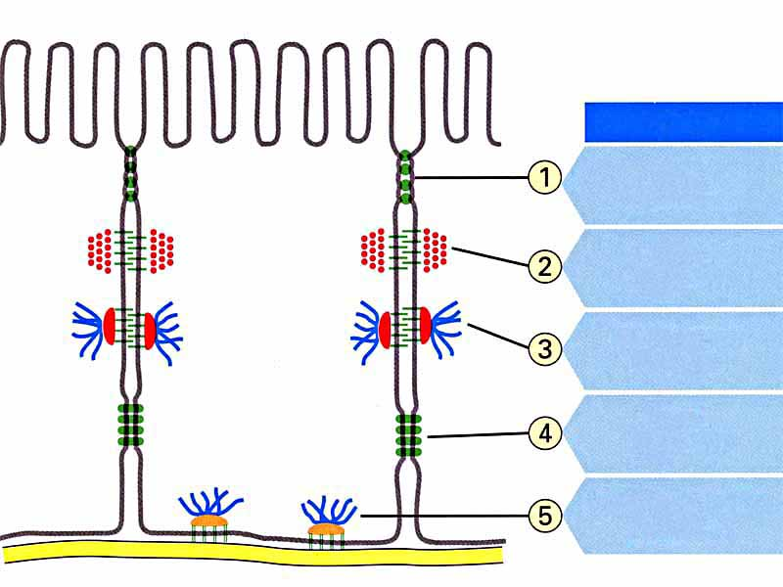
name
tight
junction
adherens
junction
desmosome
junction
gap
junction
hemidesmosome
junction

Slide 36
Epithelium Lecture Outline
Function and types of epithelium
Structure of epithelium
  Basement membrane
  Intercellular junctions
  Specialized apical structures

Slide 37
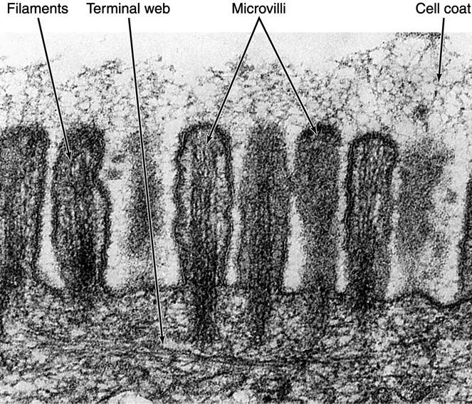
Microvilli
Microvilli + cell coat (or glyocalyx) = brush border or striated border
Purpose of microvilli: increase surface area for absorption or secretion

Slide 38
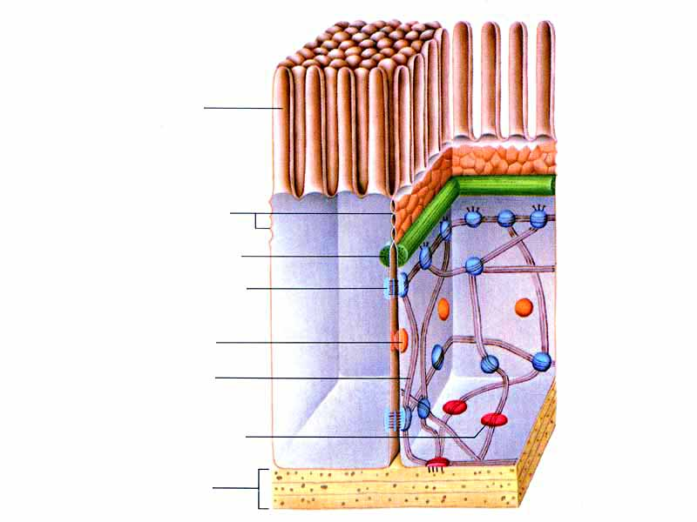
Microvillus
Tight junctions
Belt desmosome
Spot desmosome
Gap junction
Intermediate
filament
Hemidesmosome
Basal lamina

Slide 39
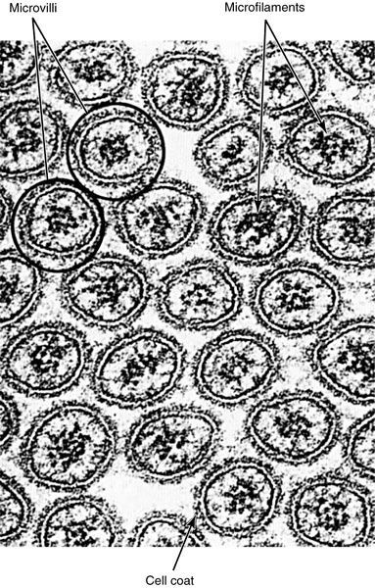
Microvilli
Microvilli have a
central core of
actin microfilaments
Microvilli don’t wave back and forth like cilia.

Slide 40
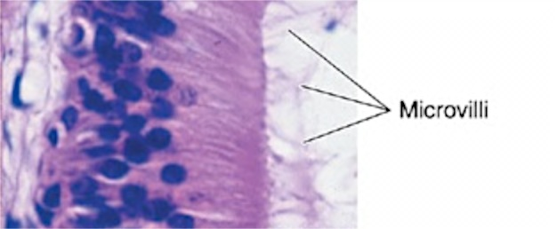
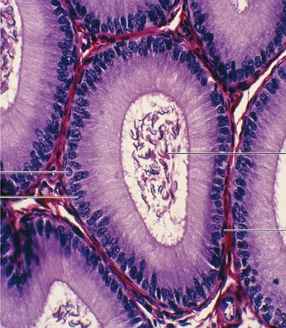
Stereocilia
Stereocilia
Stereocilia are long,
non-motile microvilli found in parts of the male reproductive system
Spermatozoa

Slide 41
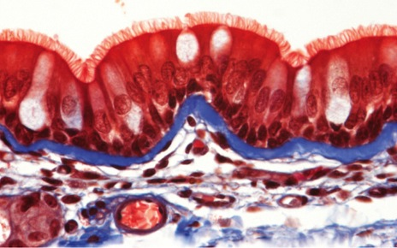
Cilia
Cilia are much longer and wider than microvilli.
They move back and forth to propel fluid along the epithelial surface.
Cilia on respiratory epithelial cells

Slide 42
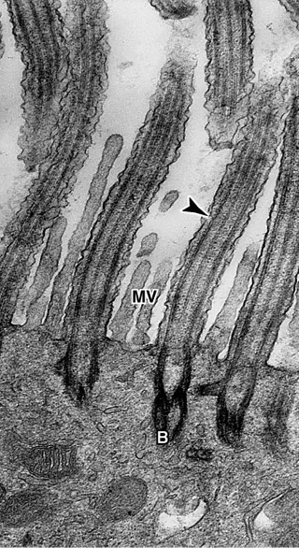
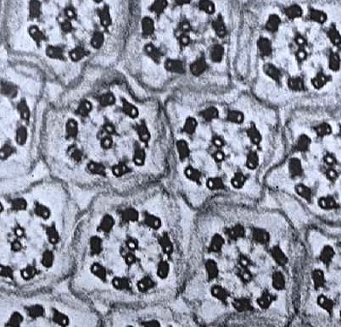
Cilia
Cilia contain microtubules in a 9 + 2 configuration called an “axoneme”
2 central microtubules surrounded by 9 pairs of microtubules
Cilia insert into basal bodies
with 9 triplets of microtubules

Slide 43
Epithelium Lecture Outline
Function and types of epithelium
Structure of epithelium
Types of covering/lining epithelium

Slide 44
How is covering/lining epithelium categorized?
Shape of superficial cells
Number of cell layers
Presence of specialized structures

Slide 45
How is covering/lining epithelium categorized?
Shape of superficial cells
Squamous: width > height (flattened)
Cuboidal: width = height (square, round)
Columnar: width < height (tall and slender)

Slide 46
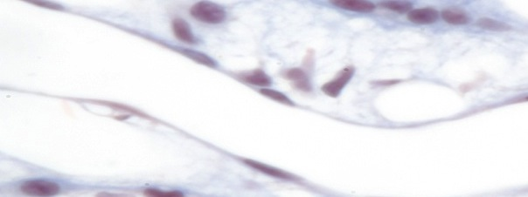
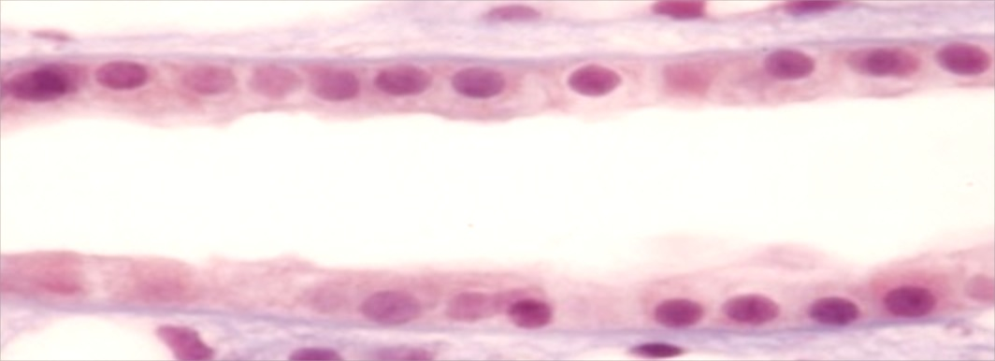
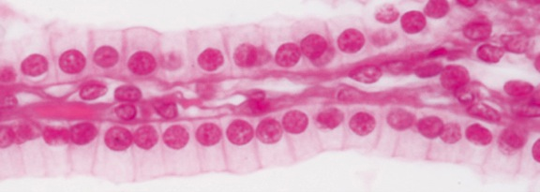
Epithelial cells have different shapes
squamous cells are flat
cuboidal cells are cute and boxy
columnar cells are tall and regal

Slide 47
How is covering/lining epithelium categorized?
Shape of superficial cells
Number of cell layers
Simple: one layer of cells
Stratified: two or more layers of cells
Pseudostratified: all cells contact basal lamina,
but not all cells reach lumen

Slide 48
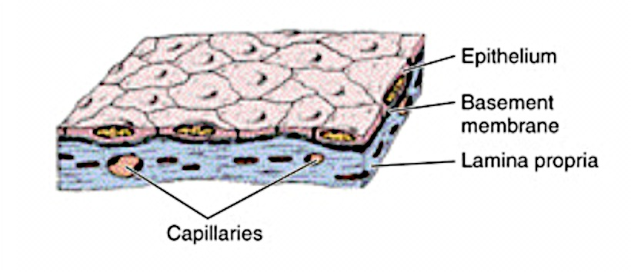
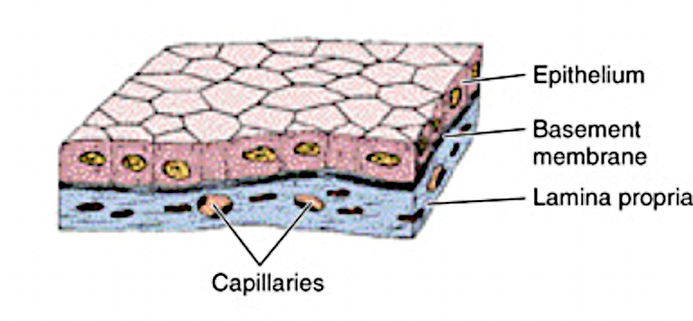
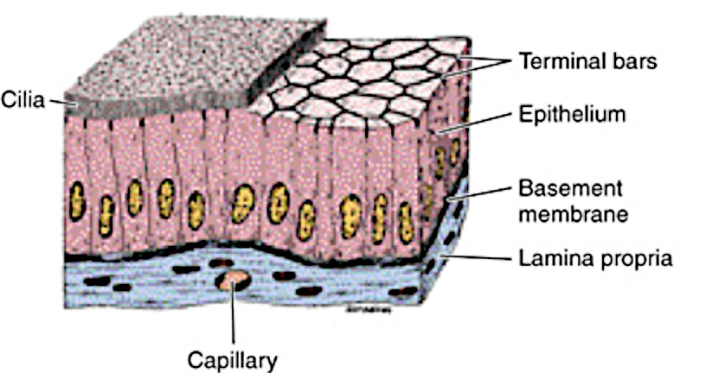
Simple epithelium: one layer of cells
Simple squamous epithelium
Simple cuboidal epithelium
Simple ciliated columnar epithelium

Slide 49
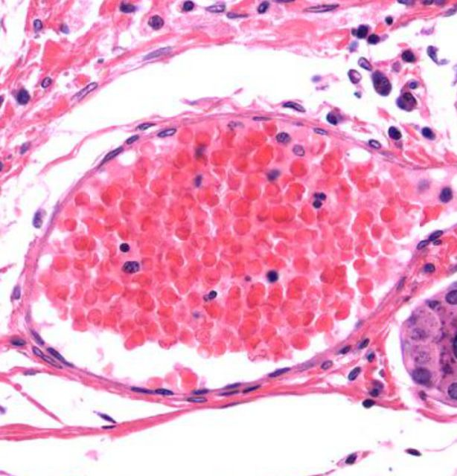
Simple Squamous Epithelium
Flattened squamous cells
in a single layer
Endothelium is simple squamous epithelium.
It lines blood and lymphatic vessels.

Slide 50
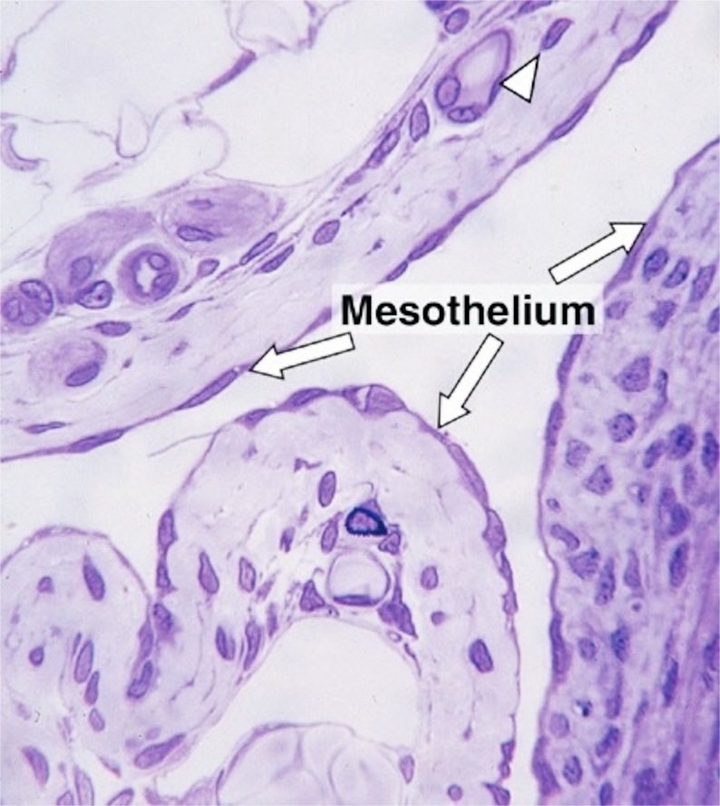
Simple Squamous Epithelium
Flattened squamous cells
in a single layer
Mesothelium is simple squamous epithelium.
It lines serous cavities (pleura, pericardium, peritoneum).

Slide 51
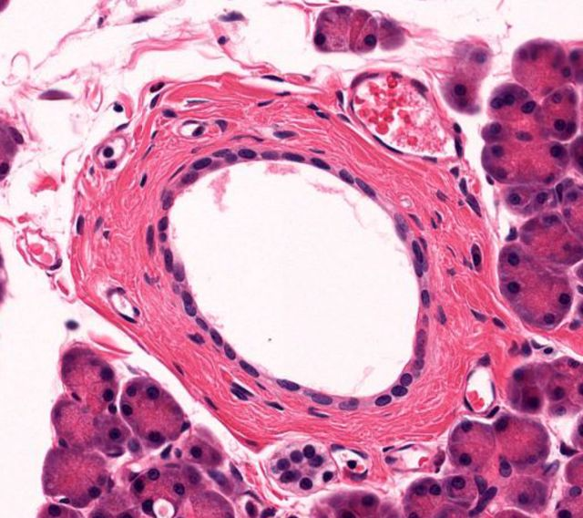
Simple Cuboidal Epithelium
Cuboidal cells
in one cute layer
Duct linings often have simple cuboidal epithelium,
like this smallish duct in the pancreas.

Slide 52
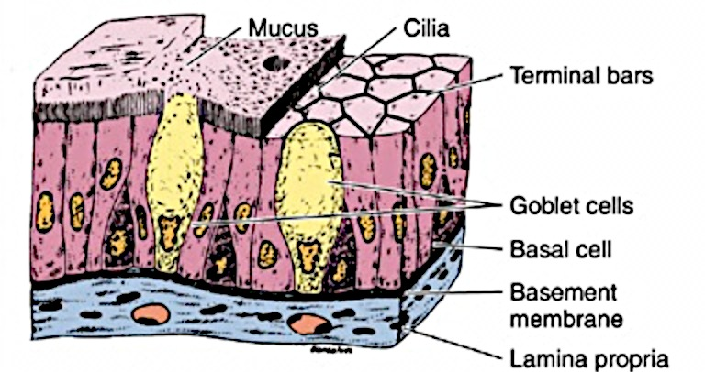
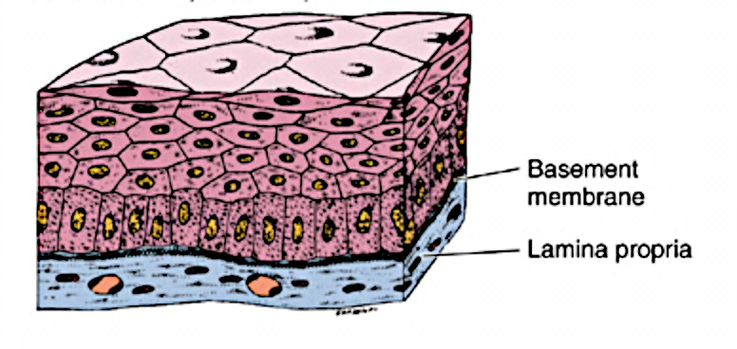
Stratified and pseudostratified epithelium
Stratified squamous epithelium
Pseudostratified columnar epithelium

Slide 53
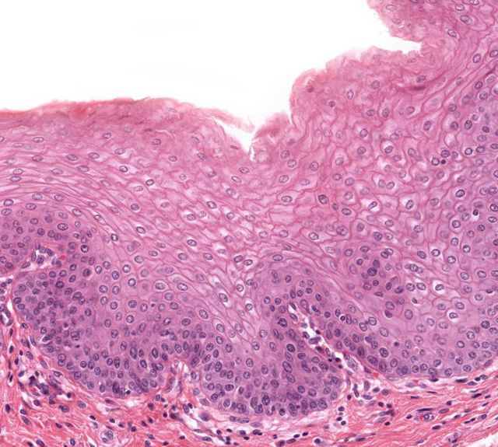
Stratified Squamous Epithelium
Several layers of squamous epithelial cells
Mucous membranes are composed of stratified squamous epithelium.

Slide 54
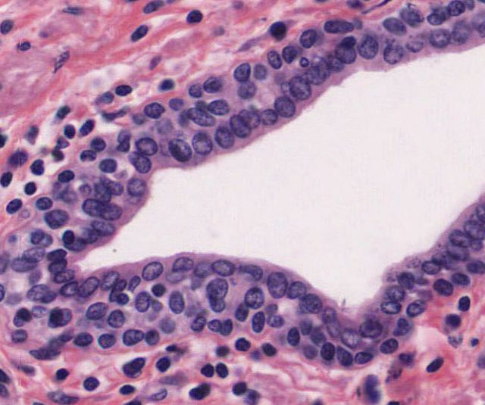
Stratified Cuboidal Epithelium
Cuboidal cells
in a few layers
Some ducts are lined by stratified cuboidal epithelium,
like this larger duct in the pancreas.

Slide 55
How is covering/lining epithelium categorized?
Shape of superficial cells
Number of cell layers
Presence of specialized structures
Cilia
Microvilli
Keratin

Slide 56
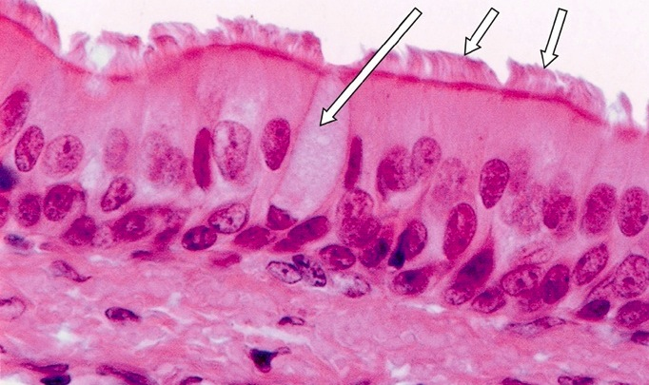
Pseudostratified Ciliated Columnar Epithelium
goblet cell
cilia
Respiratory epithelium is pseudostratified columnar,
with goblet cells and ciliated cells.

Slide 57
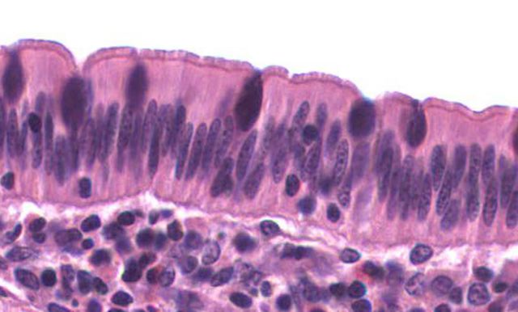
Simple Columnar Epithelium
goblet cell
microvilli
The epithelium of the small intestine is simple columnar,
with goblet cells and absorptive cells with microvilli.

Slide 58
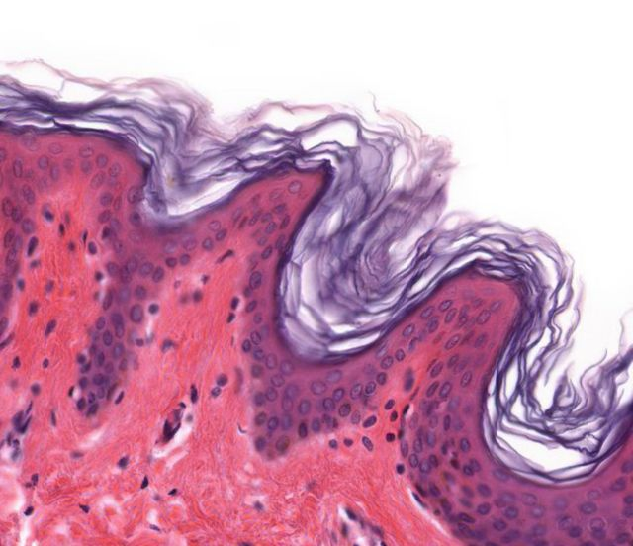
Keratinized Stratified Squamous Epithelium
Keratin
Squamous cells
in several layers
Keratin covers areas where skin is thin but needs protection.

Slide 59
Non-Keratinized Stratified Squamous Epithelium
No keratin!
Squamous cells
in several layers
Areas that are always moist (like the esophagus) are often lined by stratified squamous epithelium without a layer of keratin.

Slide 60
Epithelium Lecture Outline
Function and types of epithelium
Structure of epithelium
Types of covering/lining epithelium
Types of glandular epithelium

Slide 61
Types of Glandular Epithelia
Mucous goblet cell: unicellular gland
Exocrine gland: retains connection with surface epithelium; hormones secreted through ducts
Endocrine gland: no connection with surface epithelium; hormones secreted through blood

Slide 62
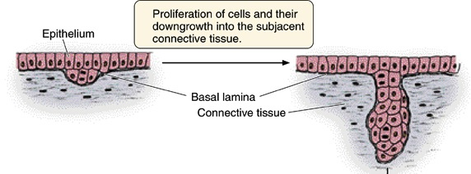
Formation of glands from surface epithelium

Slide 63
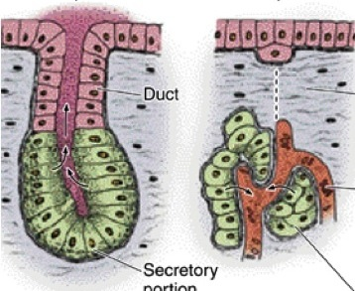
Exocrine gland
Endocrine gland
Disappearance of duct cells
Blood vessel
Secretory
portion
Secretory
portion

Slide 64
Methods of secretion in exocrine glands
Merocrine: secretory granules leave cell by exocytosis. Most common method.
Holocrine: Secretory product shed with entire cell. Example: sebaceous gland
Apocrine: secretory product shed with apical cytoplasm. Example: mammary gland

Slide 65
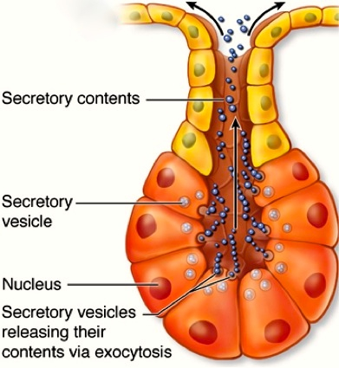
Merocrine gland
Secretes by merocrine mode of secretion: exocytosis of product at apical end of cell.
By far the most common type of exocrine gland based on mode of secretion.

Slide 66
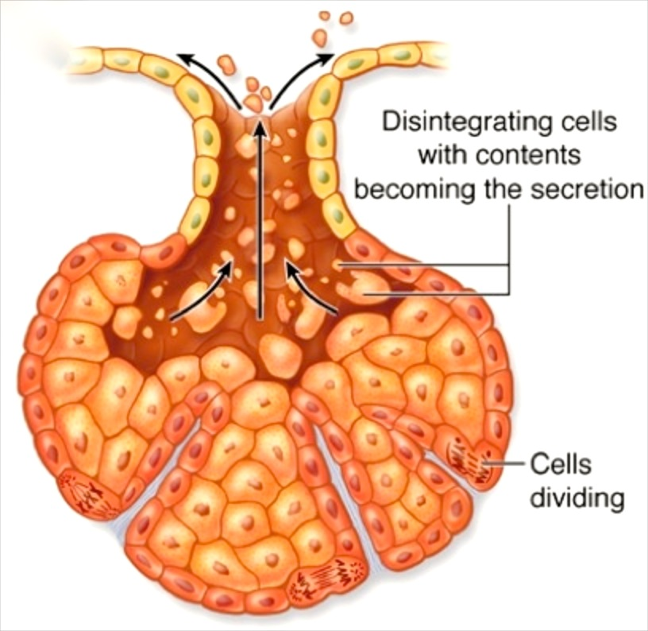
Holocrine gland
Secretion occurs by disintegration of secretory cells.
Example: sebaceous glands.

Slide 67
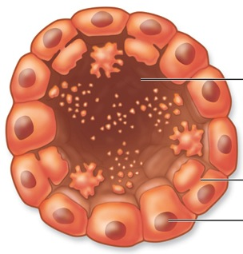
Apocrine gland
Secretion occurs by loss of large amount of apical cytoplasm.
Example: mammary glands.

Slide 68
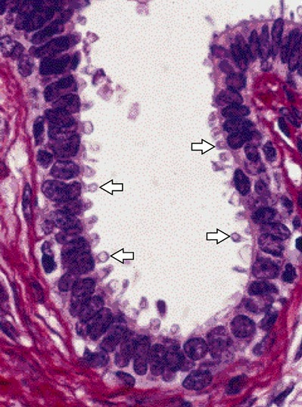
Mammary gland
Note loss of apical portions of cytoplasm.

Slide 69
Examples of glandular epithelial cells
Ion transporting cells
Serous secretory cells
Mucous secretory cells
Neuroendocrine cells
Myoepithelial cells

Slide 70
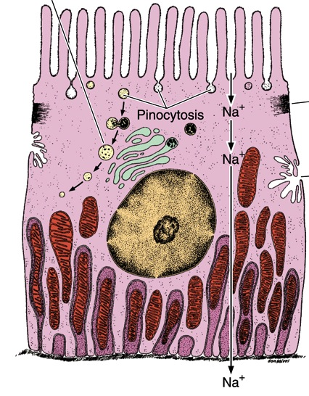
Ion-transporting cells
Deep invaginations of basal cell membranes
Zonula occludens
Mitochondria in basal cytoplasm provide energy for ion transport
Examples: proximal tubules in kidney

Slide 71

Serous secretory cells
Large rounded nucleus and abundant rough ER, Golgi and secretory granules
Examples: pancreatic acinar cells, serous cells in salivary glands

Slide 72

Serous secretory cells

Slide 73

Mucous secretory cells
Abundant rough ER, Golgi and secretory granules
Produce mucins (protective, lubricant glycoproteins)
Examples: mucous cells in stomach, goblet cells in small and large intestine, and mucous cells in salivary glands

Slide 74

Goblet cells in small intestine

Slide 75

Mucous secretory cells

Slide 76

Neuroendocrine cells
Dense secretory granules in cytoplasm contain polypeptides and/or amines (like epinephrine and norepinephrine)
Scattered throughout the body

Slide 77

Myoepithelial cells
Spindle-shaped cells found in glandular epithelial between basal lamina and basal cytoplasm
Embrace gland acini like an “octopus on a rock”
Contain actin: contract and squeeze out secretory product

Slide 78
Epithelium Lecture Outline
Function and types of epithelium
Structure of epithelium
Types of covering/lining epithelium
Types of glandular epithelium

