Slide 1
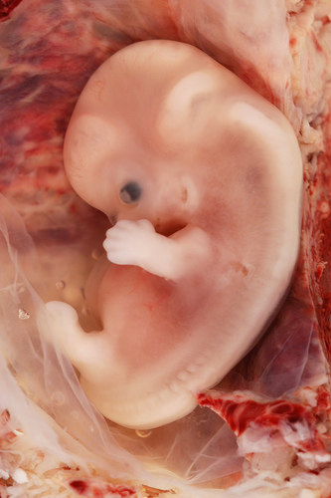
Early Embryology
Kristine Krafts, M.D.

Slide 2
Embryology Lecture Objectives
In general, what happens in the first and second phases of the embryonic period?
What happens during week 1 and 2?
Describe what happens during gastrulation.
How does the neural tube form, and what happens to it?
What structures are derived from the endoderm, mesoderm, ectoderm, and neural crest?

Slide 3
Embryology Lecture Outline
General overview of prenatal development
Embryonic period phase 1
  Formation of bilaminar disk
  Formation of trilaminar disk (gastrulation)
Embryonic period phase 2
  Formation of neural tube
  Differentiation of mesoderm
  Folding of embryo

Slide 4
Embryology Lecture Outline
General overview of prenatal development

Slide 5
Prenatal Development
Embryo
Fetus
Phase 1
Cellular
proliferation
and migration
Phase 2
Differentiation of internal & external structures
Phase 3
Growth and maturation
0
1
2
3
4
5
6
7
8
40
Fertilization
Delivery

Slide 6
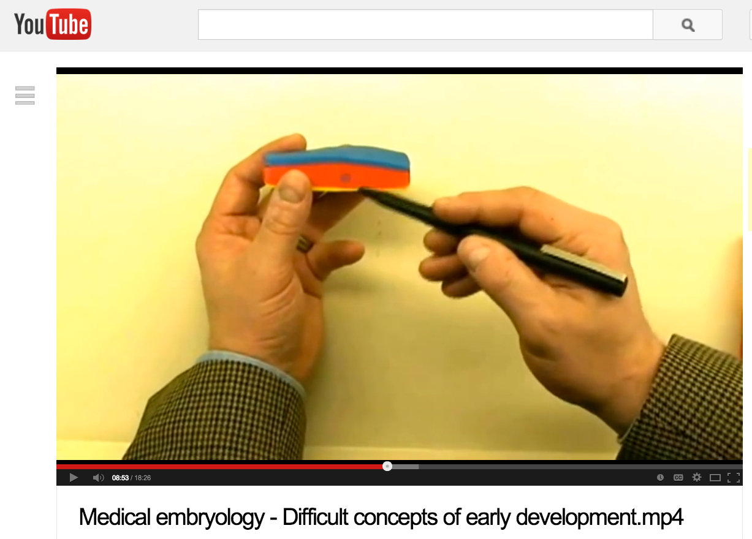
This YouTube video is awesome at explaining
early embryonic development:
http://www.youtube.com/watch?v=rN3lep6roRI

Slide 7
Embryology Lecture Outline
General overview of prenatal development
Embryonic period phase 1

Slide 8
Prenatal Development
Embryo
Fetus
Phase 1
Cellular
proliferation
and migration
Phase 2
Differentiation of internal & external structures
Phase 3
Growth and maturation
0
1
2
3
4
5
6
7
8
40
Fertilization
Delivery

Slide 9
Embryology Lecture Outline
General overview of prenatal development
Embryonic period phase 1
  Formation of bilaminar disk

Slide 10
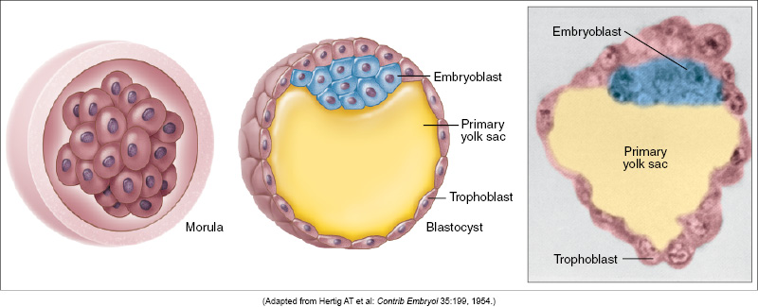
Week 1: Differentiation of Morula into Blastocyst
Morula
Blastocyst

Slide 11
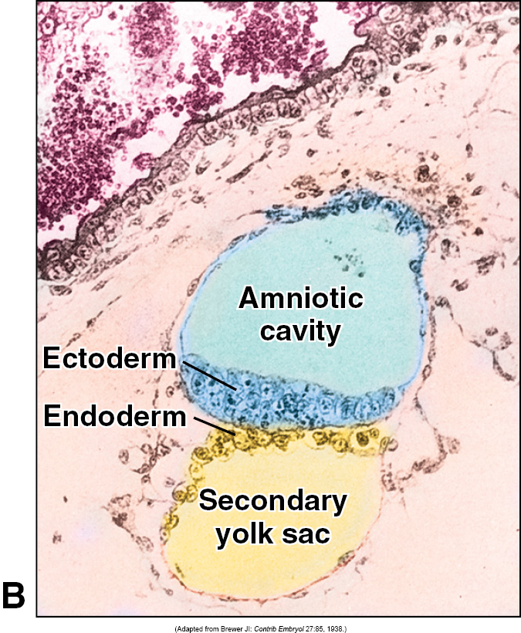
Week 2: Formation of Bilaminar Germ Disk
epiblast
hypoblast

Slide 12
Embryology Lecture Outline
General overview of prenatal development
Embryonic period phase 1
  Formation of bilaminar disk
  Formation of trilaminar disk (gastrulation)
"It is not birth, marriage, or death, but gastrulation
which is truly the most important time in your life.”
- Lewis Wolpert (1986)

Slide 13
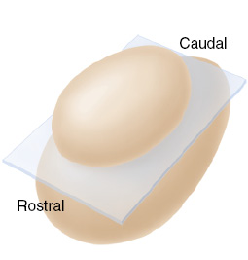
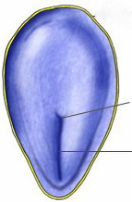
Gastrulation: formation of primitive streak
primitive streak
primitive node
epiblast

Slide 14
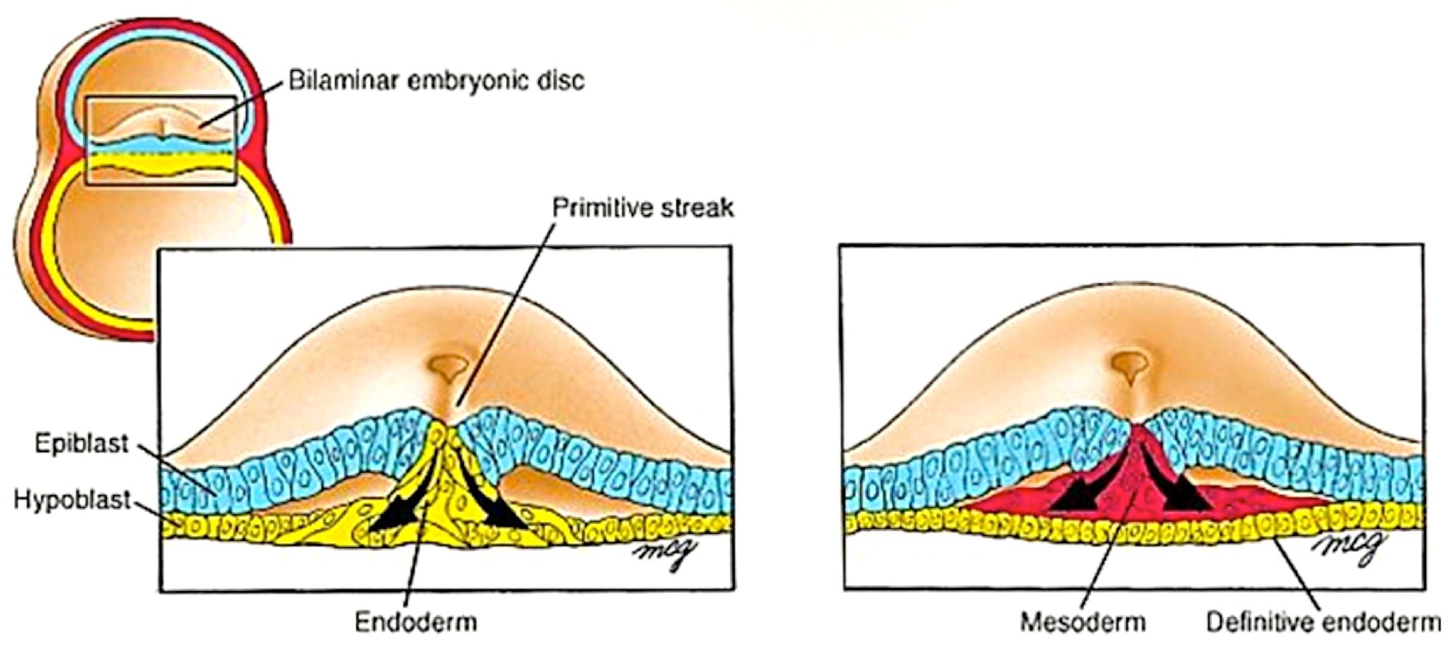
Gastrulation: movement and differentiation
of epiblast cells
Bilaminar germ disk
Primitive streak
Epiblast
Hypoblast
Endoderm
Ectoderm
Mesoderm
Endoderm
Epiblast cells give rise to all three germ cell layers!
(the hypoblast does NOT turn into endoderm)

Slide 15
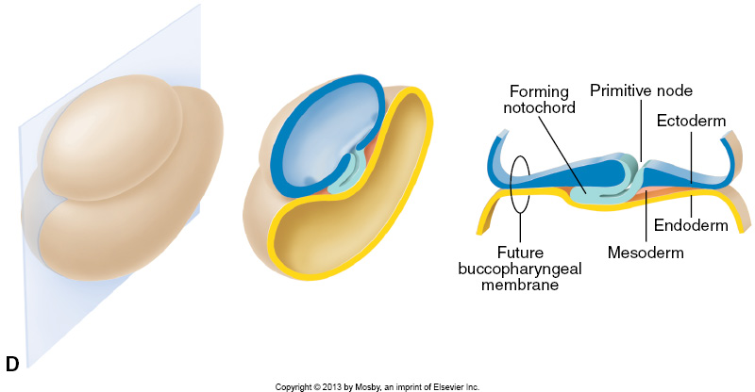
Gastrulation: formation of notochord
The notochord is super important because
it tells the three layers what to do next.

Slide 16
Embryology Lecture Outline
General overview of prenatal development
Embryonic period phase 1
  Formation of bilaminar disk
  Formation of trilaminar disk (gastrulation)
Embryonic period phase 2

Slide 17
Prenatal Development
Embryo
Fetus
Phase 1
Cellular
proliferation
and migration
Phase 2
Differentiation of internal & external structures
Phase 3
Growth and maturation
0
1
2
3
4
5
6
7
8
40
Fertilization
Delivery

Slide 18
Embryology Lecture Outline
General overview of prenatal development
Embryonic period phase 1
  Formation of bilaminar disk
  Formation of trilaminar disk (gastrulation)
Embryonic period phase 2
  Formation of neural tube

Slide 19
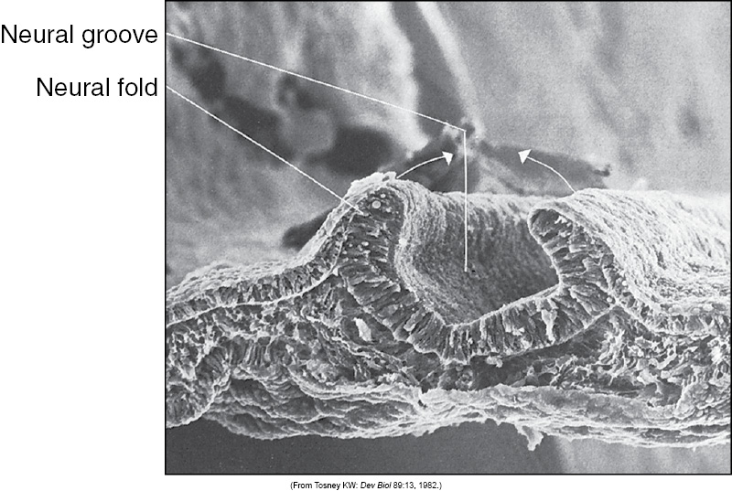
Formation of Neural Tube

Slide 20
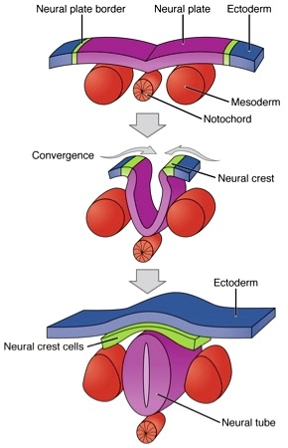
Formation of the Neural Tube

Slide 21
Embryology Lecture Outline
General overview of prenatal development
Embryonic period phase 1
  Formation of bilaminar disk
  Formation of trilaminar disk (gastrulation)
Embryonic period phase 2
  Formation of neural tube
  Differentiation of mesoderm

Slide 22
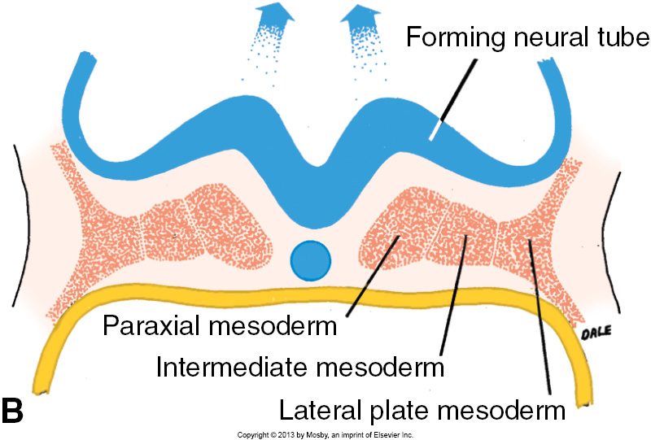
Differentiation of mesoderm

Slide 23
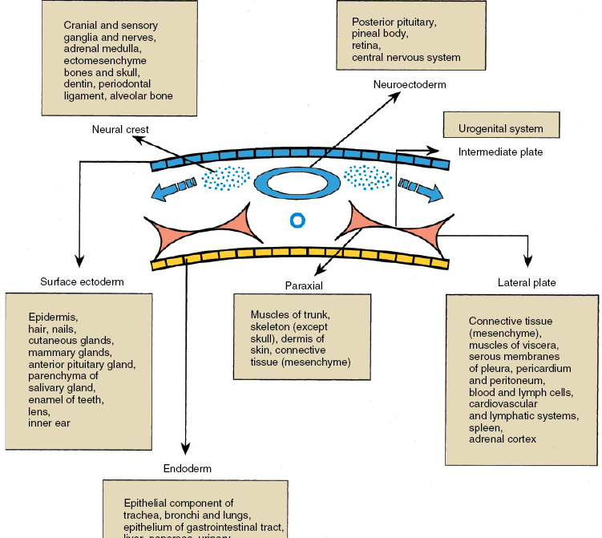
Central nervous system
Neuroectoderm
Bones of the head
Neural crest
Urogenital system
Intermediate plate mesoderm
Know this!
Surface ectoderm
Paraxial mesoderm
Lateral plate mesoderm
Epidermis
All the muscles of the body
Most of the bones of the body (except the bones of the head)
Heart
Hematopoietic system
Endoderm
Lining of GI tract

Slide 24
Embryology Lecture Outline
General overview of prenatal development
Embryonic period phase 1
  Formation of bilaminar disk
  Formation of trilaminar disk (gastrulation)
Embryonic period phase 2
  Formation of neural tube
  Differentiation of mesoderm
  Folding of embryo

Slide 25
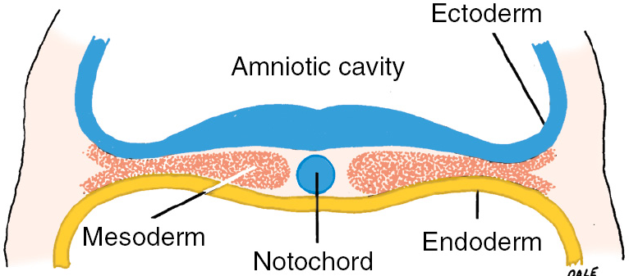
Folding of the Embryo
Lateral plate mesoderm splits in two.
One part remains near the ectoderm.
The other part follows the endoderm.

Slide 26
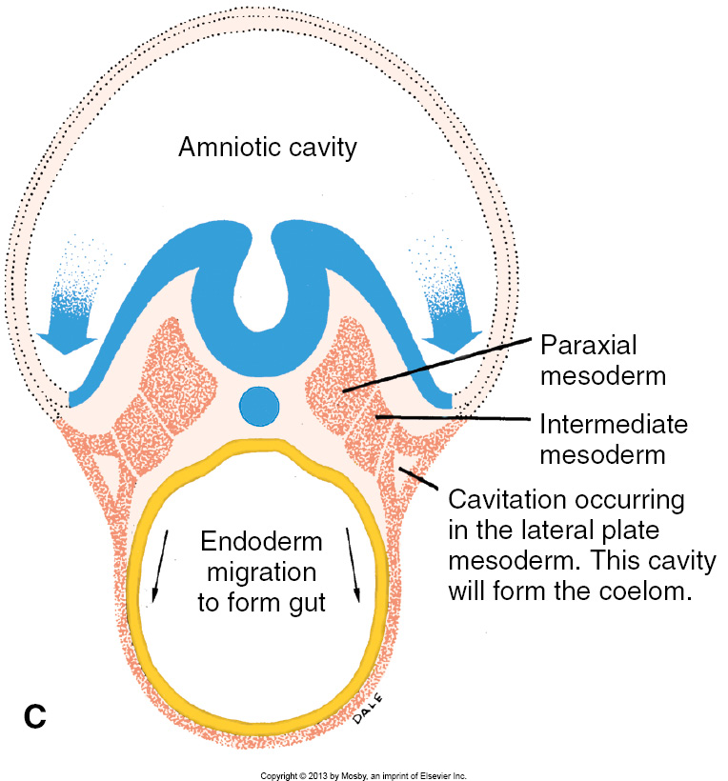
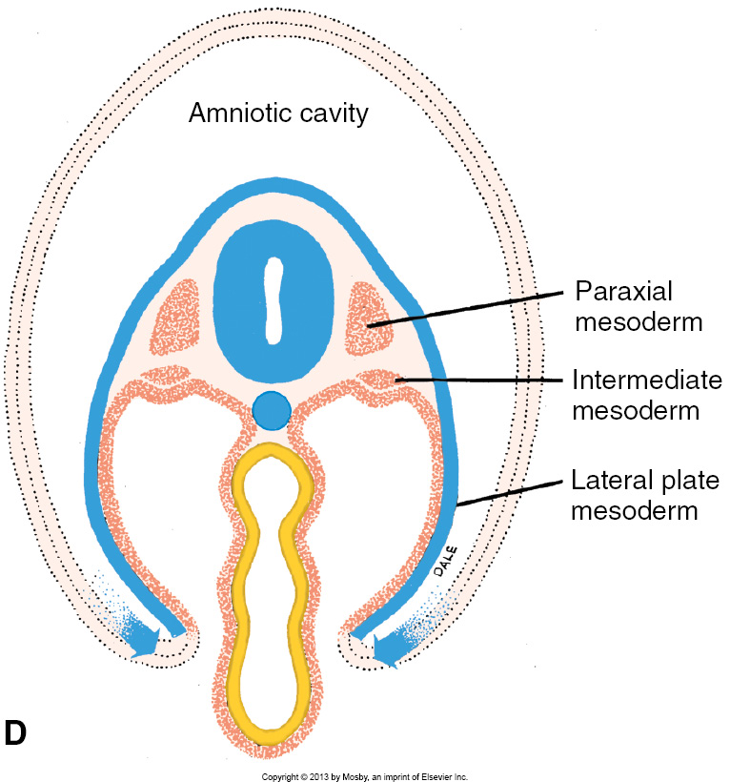
Folding of the Embryo
Endodermal layer (lined by mesoderm) bends, the edges reaching towards each other, meeting in front to form the gut.
Ectodermal layer (lined by mesoderm) grows forward, reaches around the gut, and zips up the front to form the anterior body wall.

Slide 27
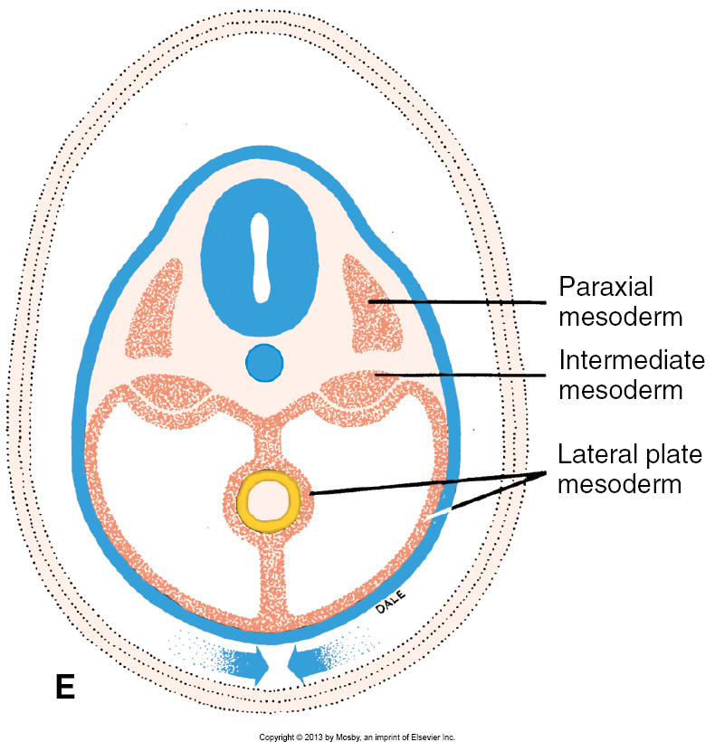
Folding of the Embryo
Back, with ectoderm overlying neural tube
Gut (lined by endoderm, surrounded by mesoderm)
Amnion (and amniotic cavity) comes along for the ride, eventually surrounding entire embryo.
Anterior thoracic wall (mesoderm covered with ectoderm)

Slide 28
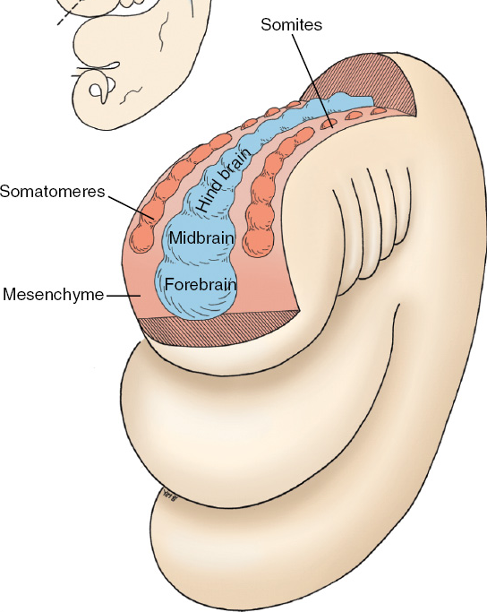
What happens to the neural tube?
It turns into the brain
(forebrain, midbrain and hindbrain)
and the spinal cord.
Hey, what’s that mesoderm doing there? It’s forming:
Somatomeres (which turn into muscles of the head and neck)
Somites (which turn into the bones and muscles of the back).

Slide 29
Prenatal Development
Embryo
Fetus
Phase 1
Cellular
proliferation
and migration
Phase 2
Differentiation of internal & external structures
Phase 3
Growth and maturation
0
1
2
3
4
5
6
7
8
40
Fertilization
Delivery
We covered this in this lecture.

Slide 30
Prenatal Development
Embryo
Fetus
Phase 1
Cellular
proliferation
and migration
Phase 2
Differentiation of internal & external structures
Phase 3
Growth and maturation
0
1
2
3
4
5
6
7
8
40
Fertilization
Delivery
We covered some of this in this lecture.

Slide 31
Prenatal Development
Embryo
Fetus
Phase 1
Cellular
proliferation
and migration
Phase 2
Differentiation of internal & external structures
Phase 3
Growth and maturation
0
1
2
3
4
5
6
7
8
40
Fertilization
Delivery
We’ll cover head and neck development in oral histology,
and we’ll cover development of organ systems later in this course.

