Slide 1
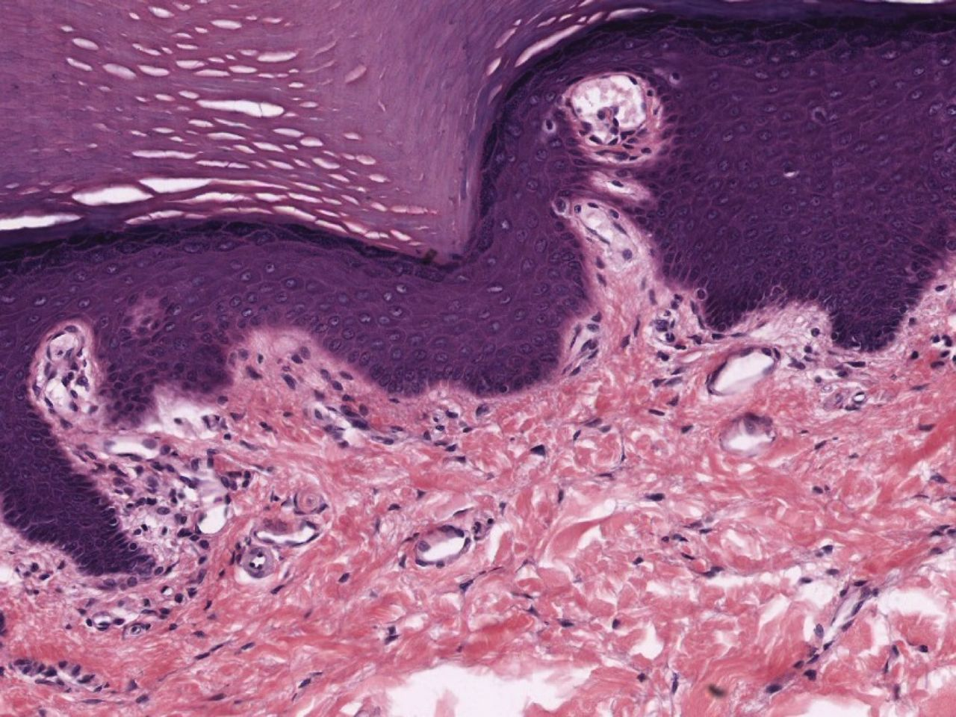
Introduction to Histology
Introduction to Histology | Kristine Krafts, M.D.

Slide 2
Why are we studying histology?
To develop a mental image of the microscopic appearance of cells, structures, tissues, and organs.
To correlate microscopic appearance with function in health and disease.
To provide a basis for later study of anatomy and pathology.
To pass boards.
Because it’s awesome.

Slide 3
What’s this course going to be like?
We’ll have lots of lectures, which will be recorded.
There’s no lab.
There are three exams, spaced pretty evenly throughout the course. The last exam is NOT cumulative.
I want you to succeed! So there are lots of resources (crosswords, Kahoots, summary videos) on our website, GeneralHistology.com.
There will be cookies and prizes.
It will actually be surprisingly fun.
It will ruin you for all other courses.

Slide 4
Introduction to Histology Lecture Objectives
Be able to fill out this table.
 | Hematoxylin | Eosin
Color of the dye
Charge (positive or negative) of the dye
Charge (positive or negative) of the structures the dye stains
Specific examples of some structures the dye stains

Slide 5
Introduction to Histology Lecture Objectives
Briefly explain what kinds of things stain with Wright-Giemsa, silver, PAS, and acid-fast stains.
Know that a red blood cell is about 7 µm in diameter. This may sound silly, but some day in the future, you’ll want to know how big a particular cell is, and then you’ll fondly recall your very first histology course, and you’ll remember that red blood cells are about 7 µm in diameter, and you’ll be able to use a nearby red blood cell as a cute little ruler.

Slide 6
Here is some background stuff you should know about histology before we get started.

Slide 7
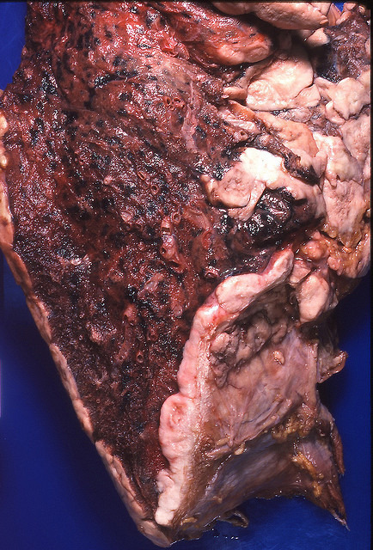
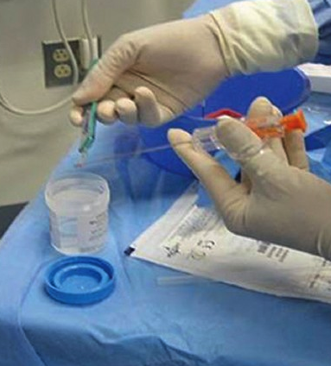
Specimens come to the lab fresh or in formalin.
Fresh lung specimen
Formalin container for specimen

Slide 8
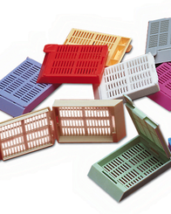
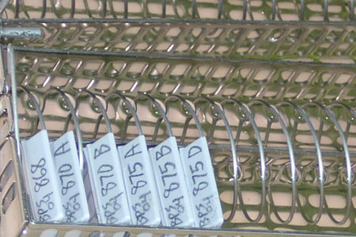
The specimen is placed in a “cassette” that goes into an automated processor for tissue fixation.

Slide 9
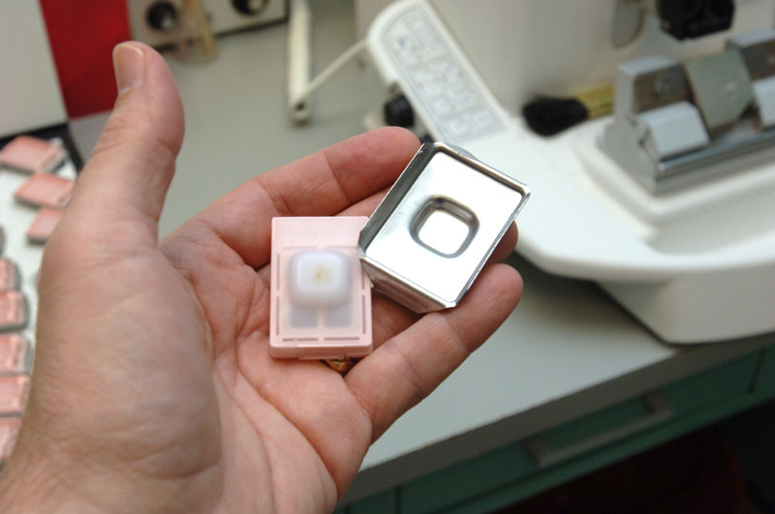
The specimen is embedded in paraffin…

Slide 10
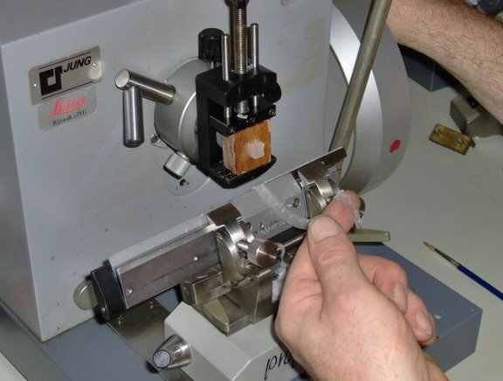
…and then cut into super thin slices.

Slide 11
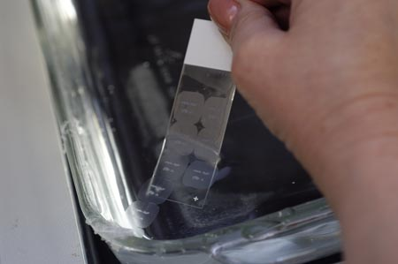
The tissue is transferred onto a slide...

Slide 12
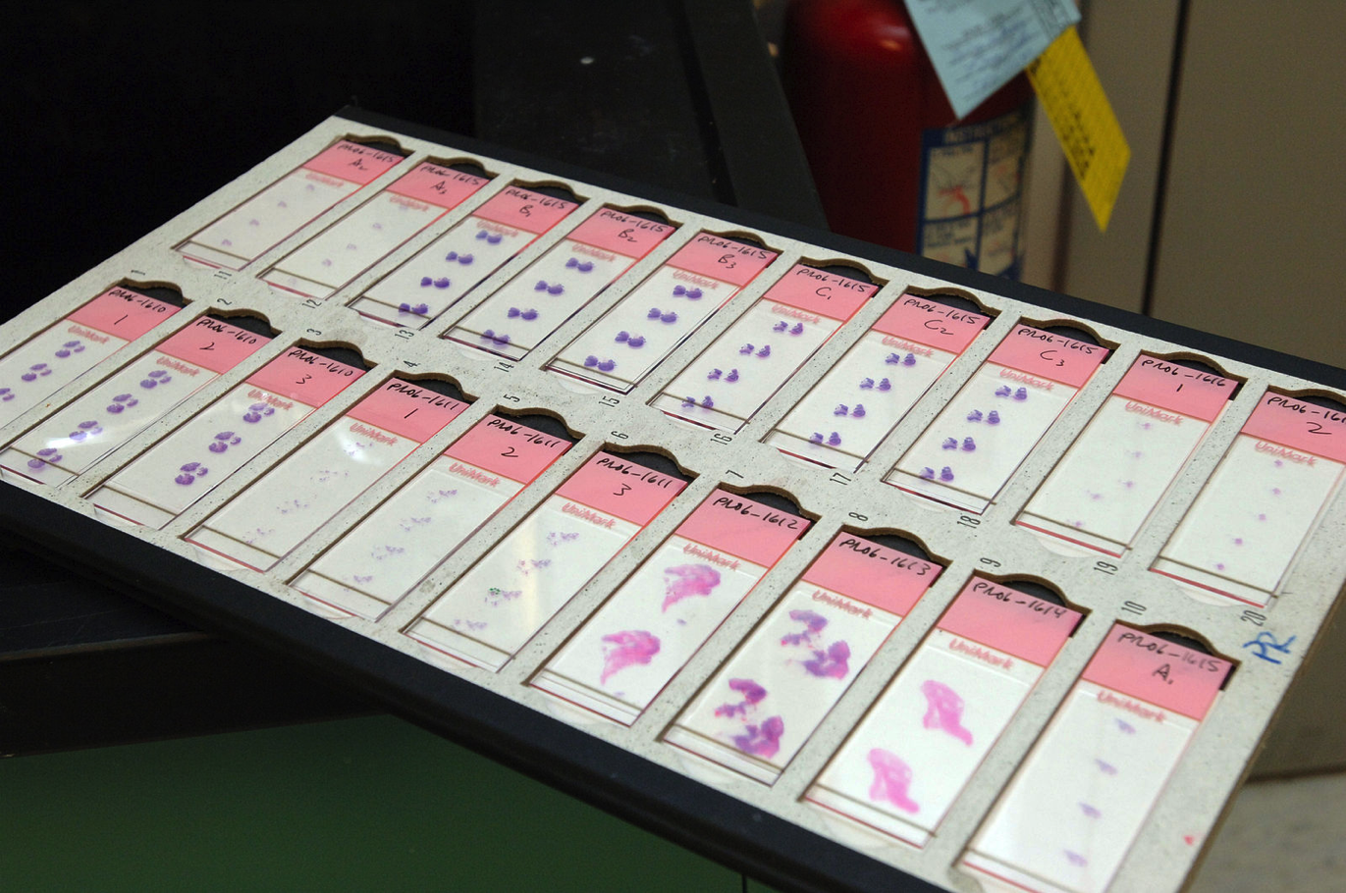
...and then stained and coverslipped.

Slide 13
So many stains!
Most tissue specimens are stained with hematoxylin and eosin.
Most blood smears are stained with the Wright-Giemsa stain.
Other stains (like silver, PAS, and acid-fast stains) can be used to highlight special cells or features.

Slide 14
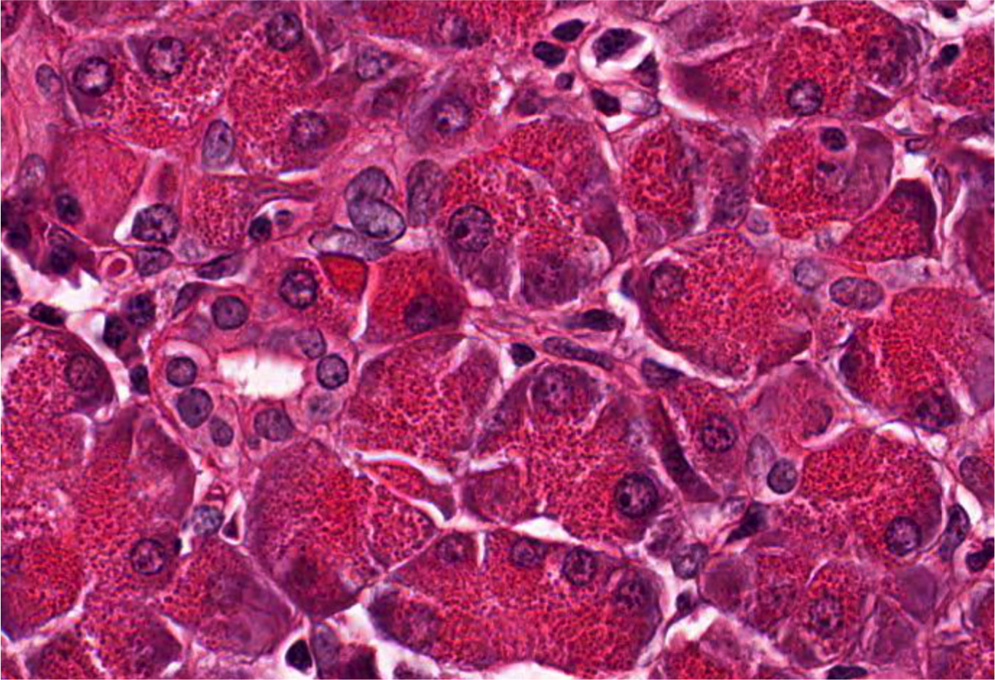
Section of pancreas stained with hematoxylin and eosin

Slide 15
Hematoxylin stains negatively-charged things (like DNA) blue.
Eosin stains positively-charged things
(like most cytoplasmic proteins) red.
Hematoxylin (blue) is positively charged.
Eosin (red) is negatively charged.

Slide 16
Section of pancreas stained with hematoxylin only

Slide 17
Section of pancreas stained with eosin only

Slide 18
Same section stained with both H & E…WAY BETTER.

Slide 19
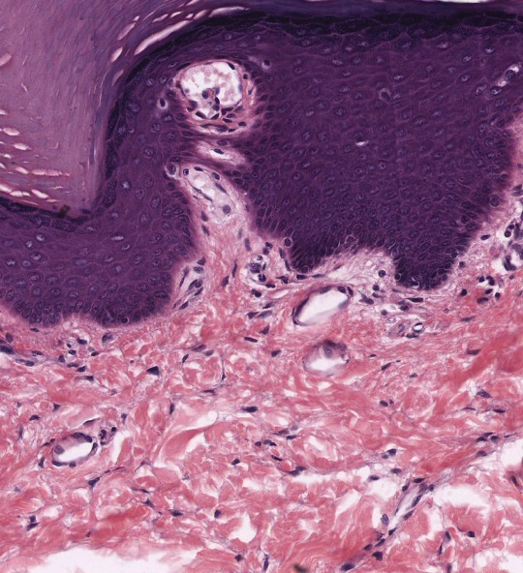
Cell nuclei stain purple with hematoxylin.
Collagen
stains pink-red with eosin.
Section of skin stained with hematoxylin and eosin

Slide 20
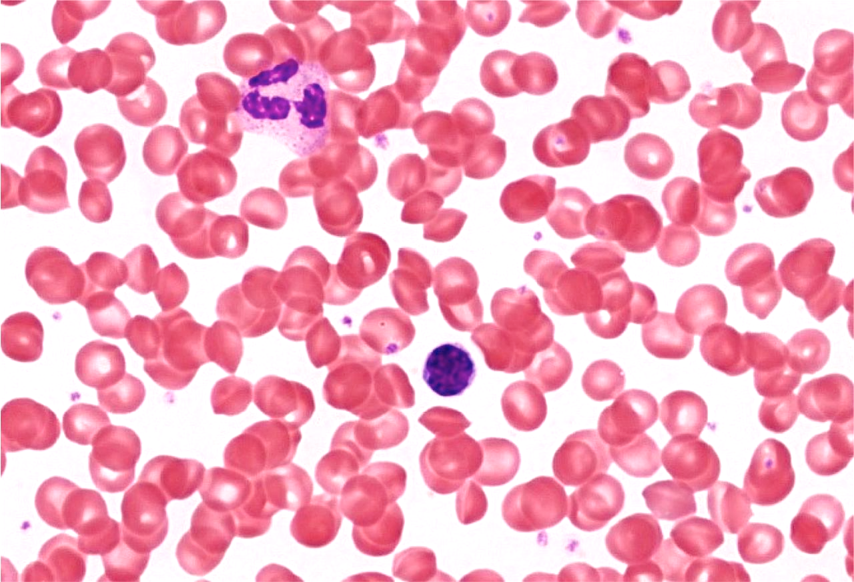
Blood smear stained with Wright-Giemsa stain

Slide 21
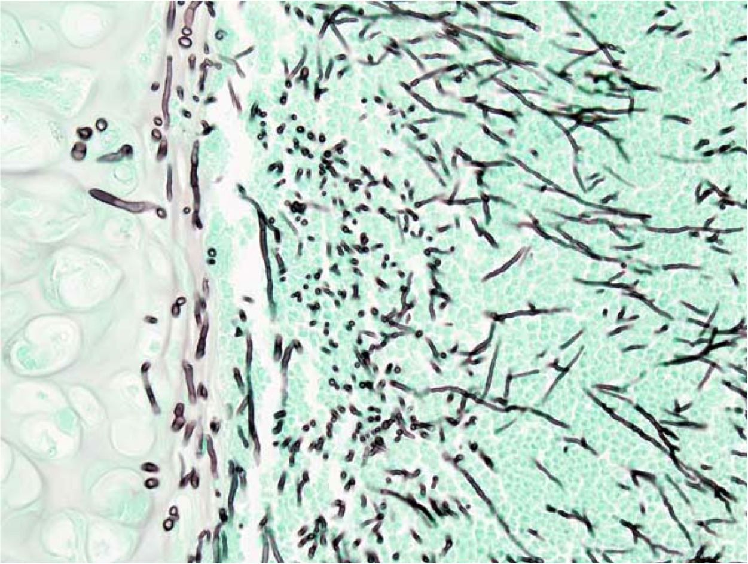
Silver stains are great for fungi (this one is Aspergillus)

Slide 22
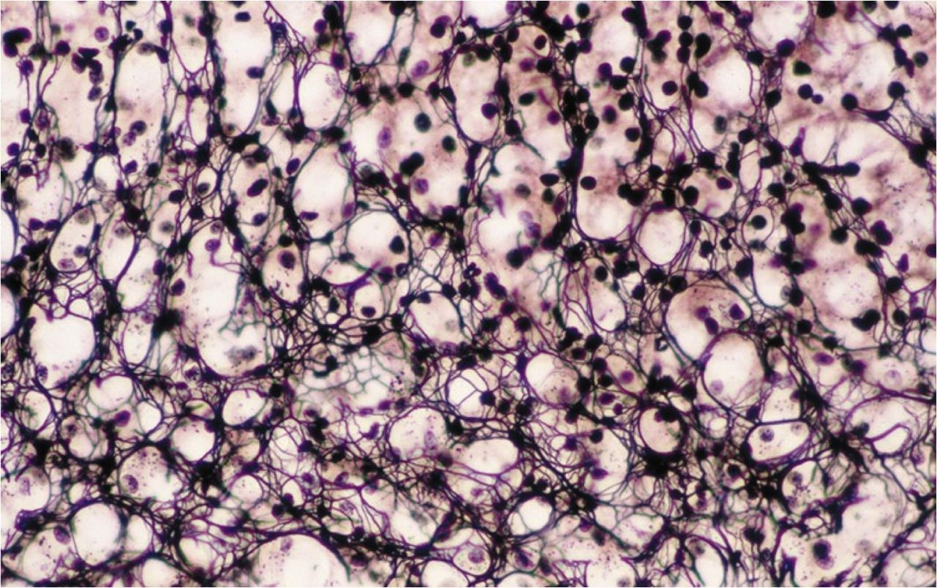
The silver stain also stains reticulin fibers
(this is a lymph node).

Slide 23
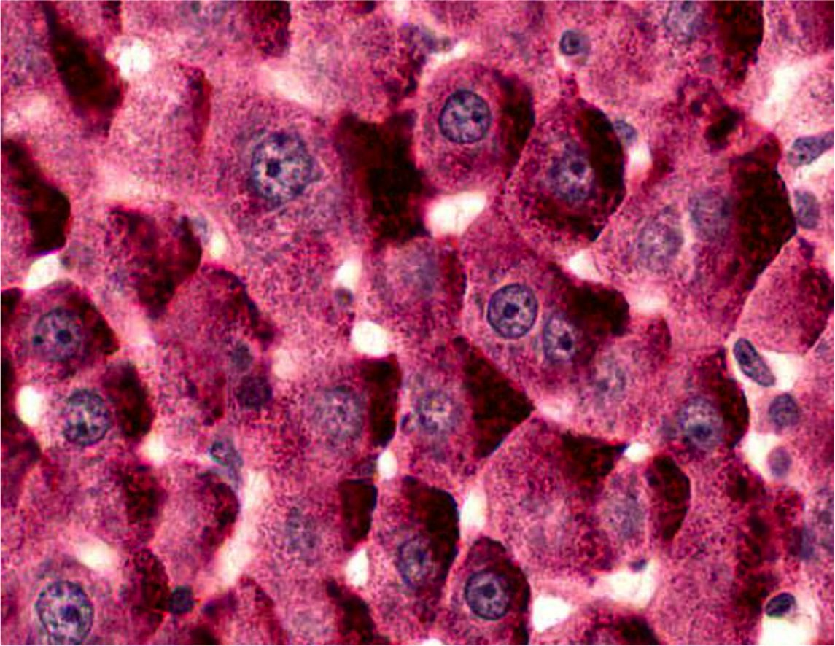
The periodic acid-Schiff (PAS) stain highlights sugars
(this is a liver section with a lot of glycogen).

Slide 24
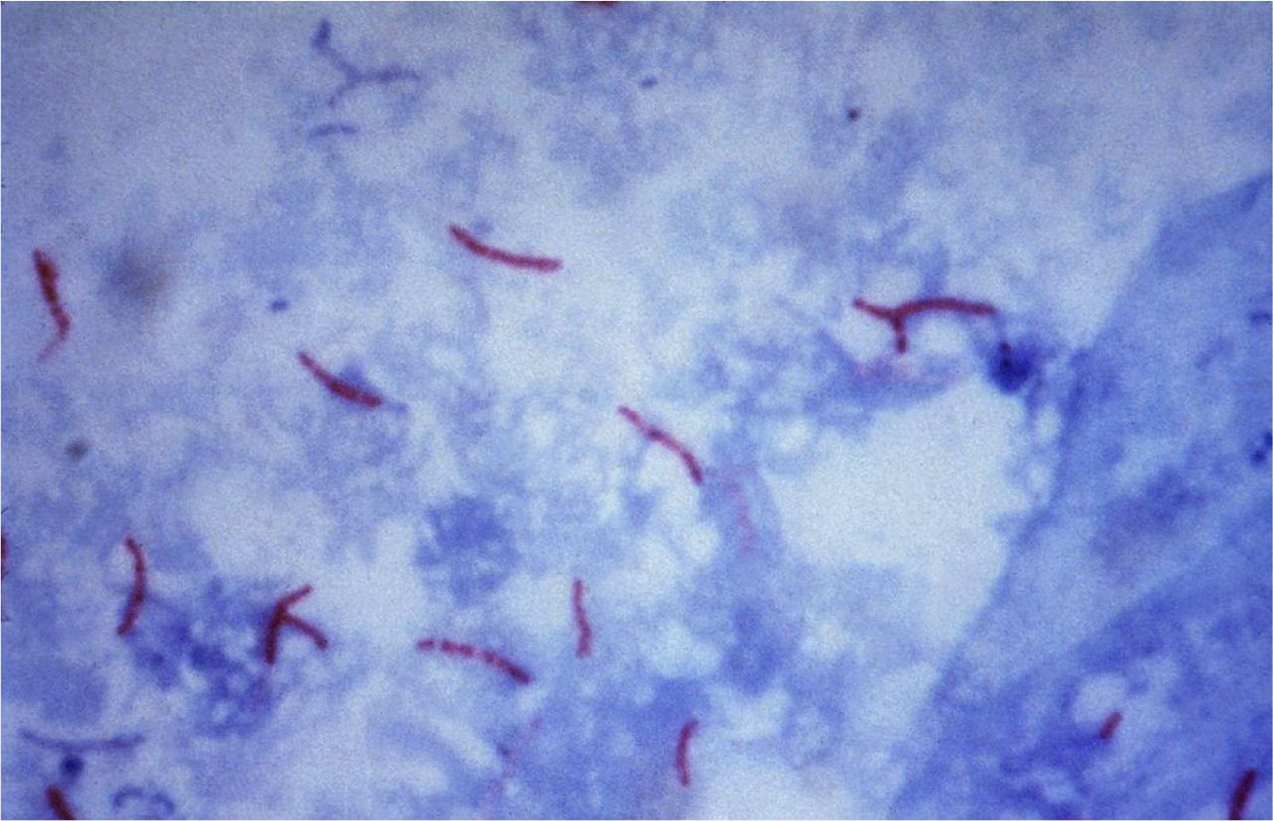
The acid-fast stain highlights M. tuberculosis organisms.

Slide 25
So many cell sizes and shapes!
The biggest cells are motor neurons, which can be
up to 80 µm in diameter.
Most cells are somewhere between 10 and 30 µm.
Some cells are quite small (red cells are about 7 µm).
Cell shapes vary from round to hexagonal to flat.
Nuclear shapes and locations vary too.

Slide 26
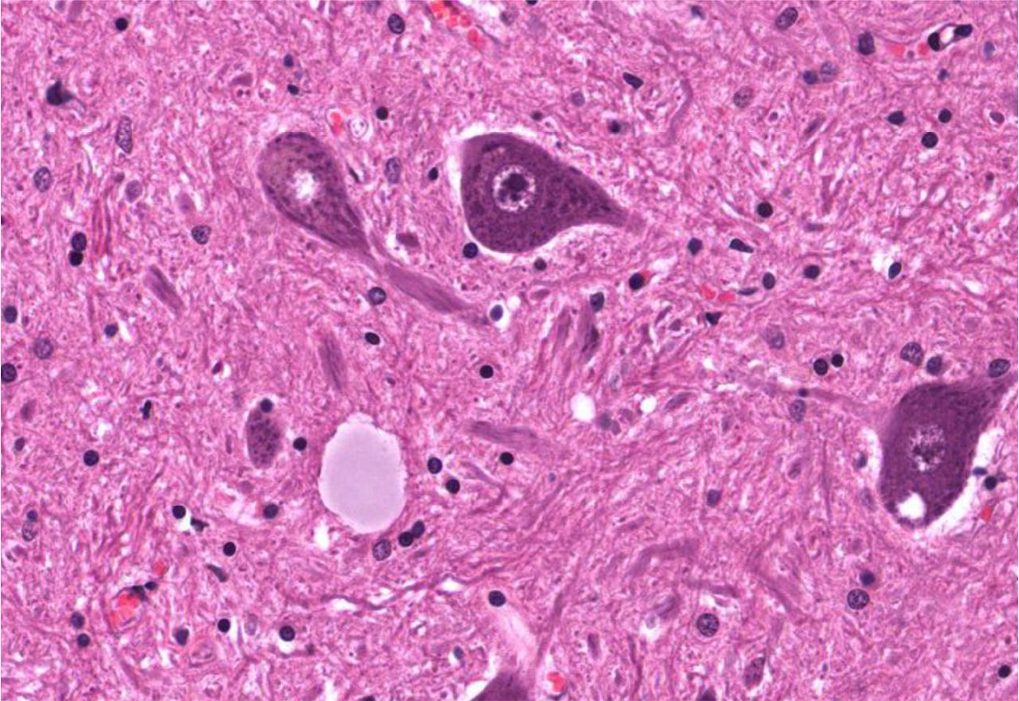
Motor neurons (about 50-80 µm)

Slide 27
Red blood cells (about 7 µm)

Slide 28
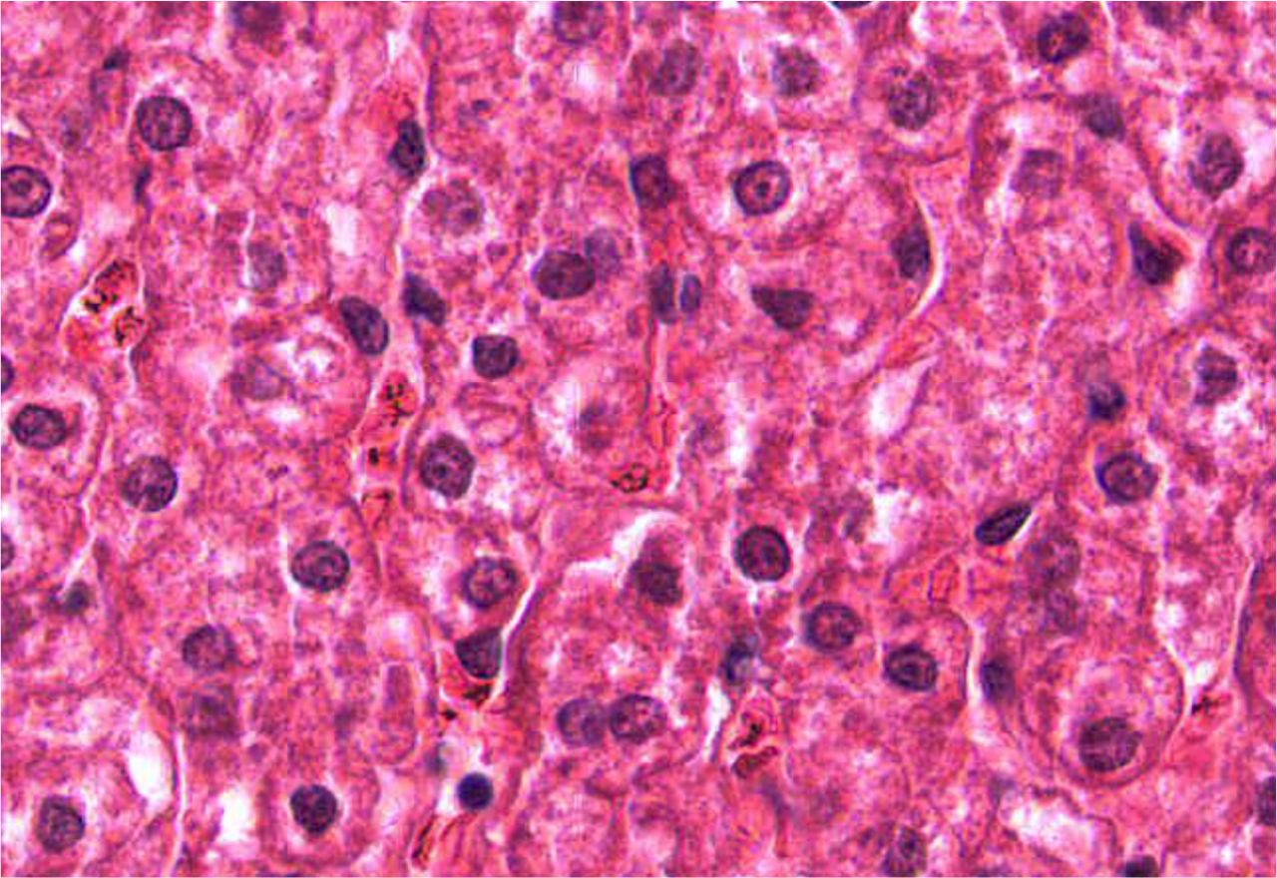
Hepatocytes (about 25 µm)

Slide 29
Red blood cells

Slide 30
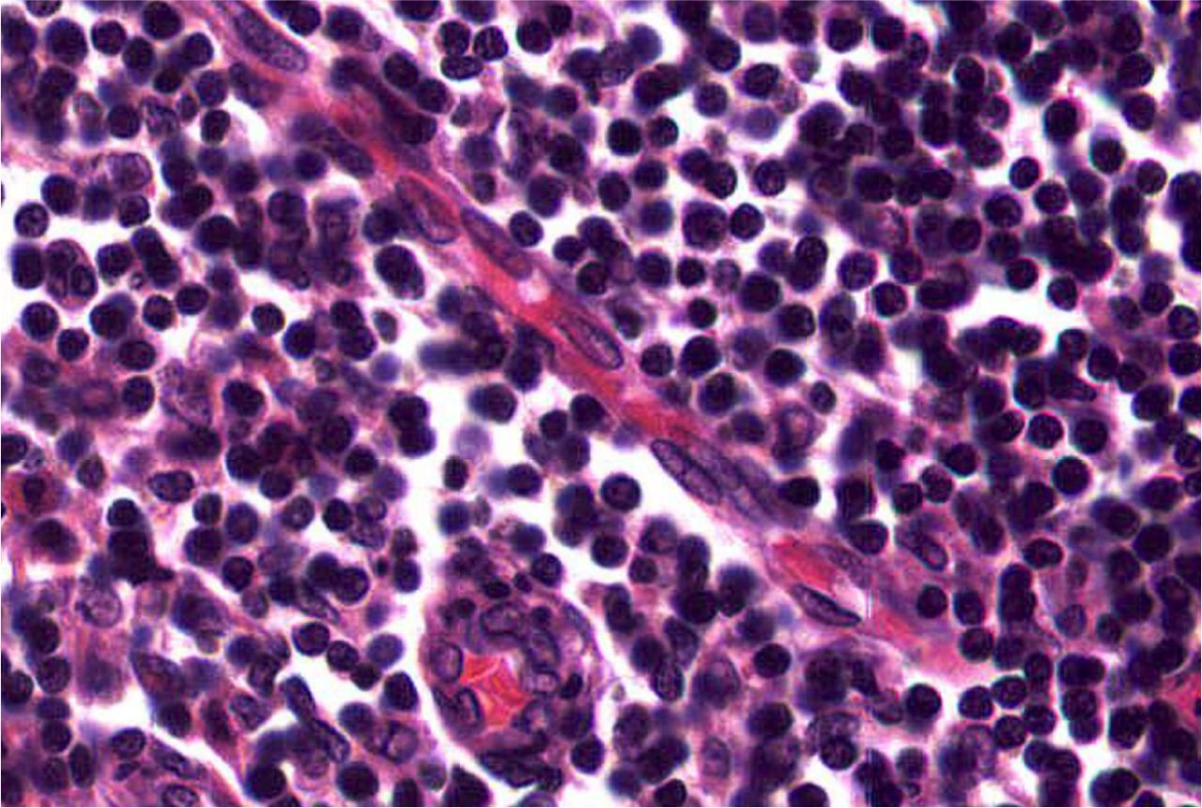
Lymphocytes (about 9 µm)

Slide 31
Red cells

Slide 32
Motor neurons and their nuclei

Slide 33
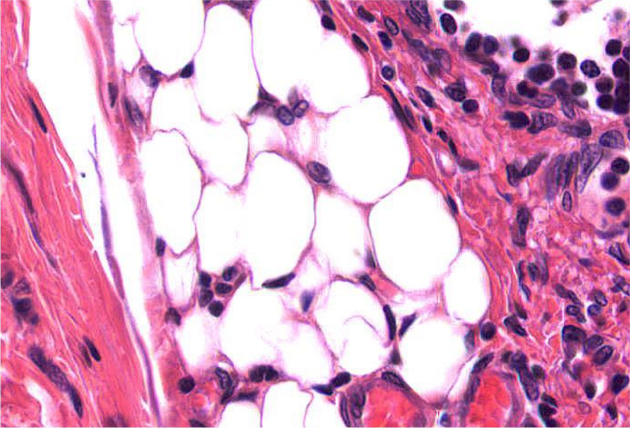
Adipocytes and their nuclei

Slide 34
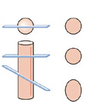
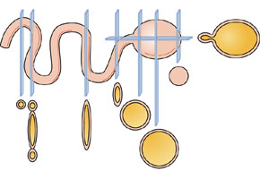
Something else to remember: slides show 2D images of 3D structures
Hollow ball and tube
Solid ball and cylinder

Slide 35
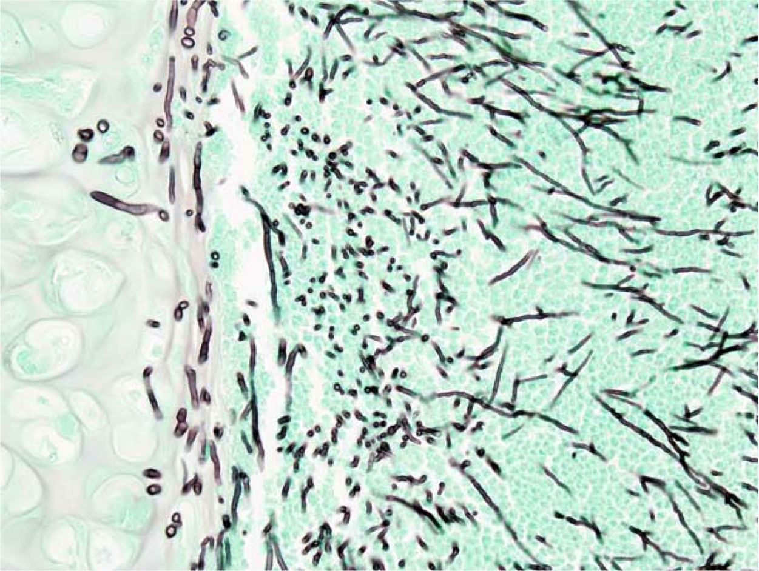
Cross-sections
Lengthwise cuts
Aspergillus is a long, branching organism

Slide 36
Histologic Hierarchy
Cells
Tissues
Organs
Organ systems

Slide 37
A few more terms
Tissues are composed of:
  Cells
  Extracellular matrix
Organs are composed of:
  Parenchyma (the cells that perform the main function of organ)
  Stroma (supporting tissue)

